Slide 1

Backpack Speaker
David Rogers, Alex Mathis, Jack Glennon, Andrew Vernetti, Connor Brothers
Notes:
https://drive.google.com/open?id=1iJJGCx9hrjwfHpclpaF7qVAHtUCVQuce
https://drive.google.com/file/d/1-N35CN0BemI9bpgI7PYKLyFtxzRElJxp/view?usp=sharing - summary
Intro - Andy
Original Goal - Andy
Explanation of parts - Alex
ADC, AMP, MBED, Launchpad
Communication Methods
System layout - David
Project B.C.- Connor
Covid Limitations - Regrouping stuffs - Alex
New System Layout - David
Project A.C. - Jack
Actual System - Jack
What we could do better?

Slide 2
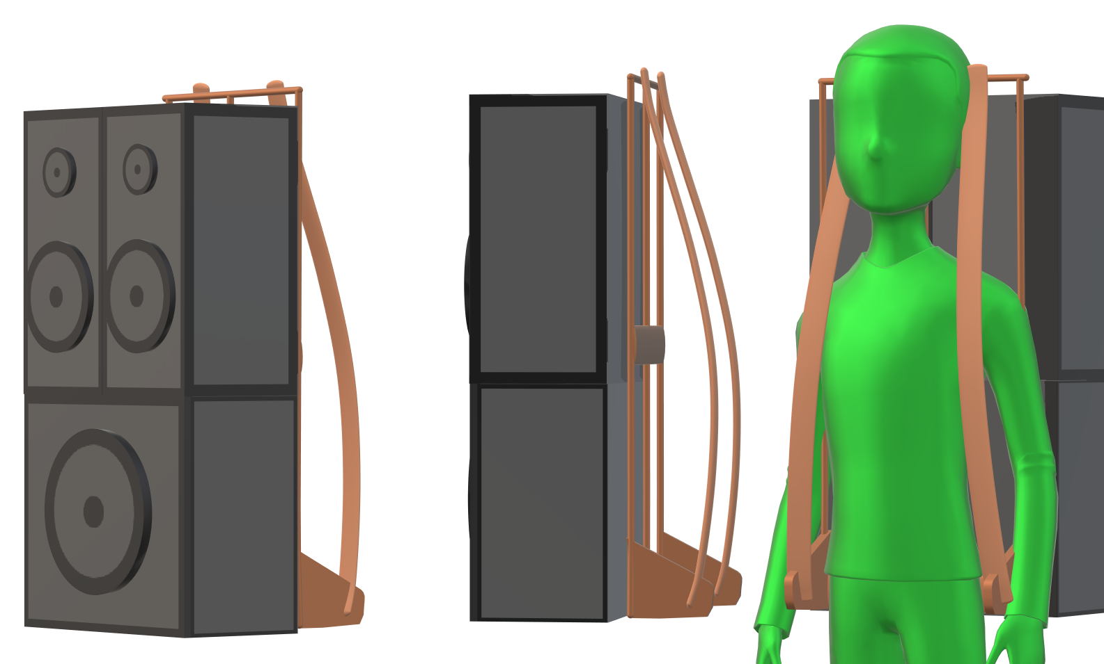
Introduction
A portable, high-fidelity, powerful, low-power, wireless and wired speaker system.
Agenda:
Original goals
Parts
System Overview
Impact of COVID-19
Final system
What we would’ve done differently.
Notes:
Our team, Big Type D Energy, had identified what seemed to be a hole in the market of speaker systems. There are very many high quality, powerful systems. There are also many small, portable, wireless speaker systems.
There is a distinct lack of crossover systems that attempts to be a jack-of-all-trades. That is what we set our sights on.
We wanted to create a speaker system that had high-quality sound at a powerful level, that was also very power efficient and light, able to be stowed and carried easily. The system would also be very user-friendly, with an internal amplifier and the ease
Of being able to connect an input either wired to the system or wirelessly over Bluetooth.
In this presentation, I will start by defining our original goals. Alex will go over the parts used in the system. David will give an overview of the system and how it integrates together. Connor will talk about the status of the project before COVID-19, and Jack will pick back up with what was able to be done after the quarantine. Lastly, we will reflect upon the changes we would’ve made if we had a chance to do it all again.

Slide 3
Original Goals
System-Level:
Lightweight (<40lbs)
Fit on backpack frame (2’x1.5’x3’)
Low-cost (<$500)
Durable, weather resistant materials
Mobile App:
Source input over Bluetooth
Choose equalization settings
Adjust volume levels
Speakers:
High-quality sound
Low-frequency response (<0.5dB)
High output power (200W)
Frequency range 20-20,000 Hz
Internal amplification system
Ability to switch to battery power
24V
1 hr of life @ 200W
Notes:
There were many design goals that were accepted in our written proposal, but I have broken them down into a few of the major categories that we focused on.
System-level:
Total weight <40 lbs
Max dimensions 2’ wide x 1.5’ deep x 3.5’ tall
Cheap to make
Resistant materials that balances weight and structure (mdf w aluminum)
Mobile App:
Read from slide
Speakers:
Max frequency response ripple 0.5dB
200W power output - very high, blow you out of a room high
Frequency range of 20-20,000 Hz
Power supply voltage of 24V, battery life @ 200W of 1 hour

Slide 4
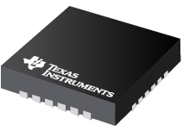
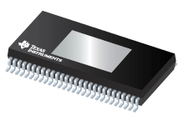
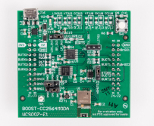
Parts
ADC - TLV320ADC6140IRTWT
I2C & I2S
Sampling rate up to 768kHz
Amplifier - TAS3251DKQR
I2C & I2S
175W to 285W
Programmable crossover and filters
LaunchPad MC w/ CC2454MODA
I2C & I2S
Notes:
Hey this is Yeetastic McGee
Main communication: I2C for programming while using I2S for the serial data communication between the ADC and BT to the Amplifier. Chose I2S since it allows for high quality audio data transmission. With this in mind we had to find an ADC, AMP, and BT module that allowed for mainly I2S communication since I2C is pretty standard.
At first we picked the ADC and AMP since we could get samples for free from TI and the AMP pinout would be relatively easy to solde, while the ADC pinout we could solder using solder paste. Additionally, we were able to find the BT Boost Board with a Launchpad that supported both I2C and I2S communication. We were able to get the Boost board for $20 and the Launchpad was borrowed from the HIVE.
ADC: EXTREMELY HIGH SAMPLING RATE… LIKE WTF
44.1khz to 48khz limited by the Amp and BT module/target sampling rate

Slide 5
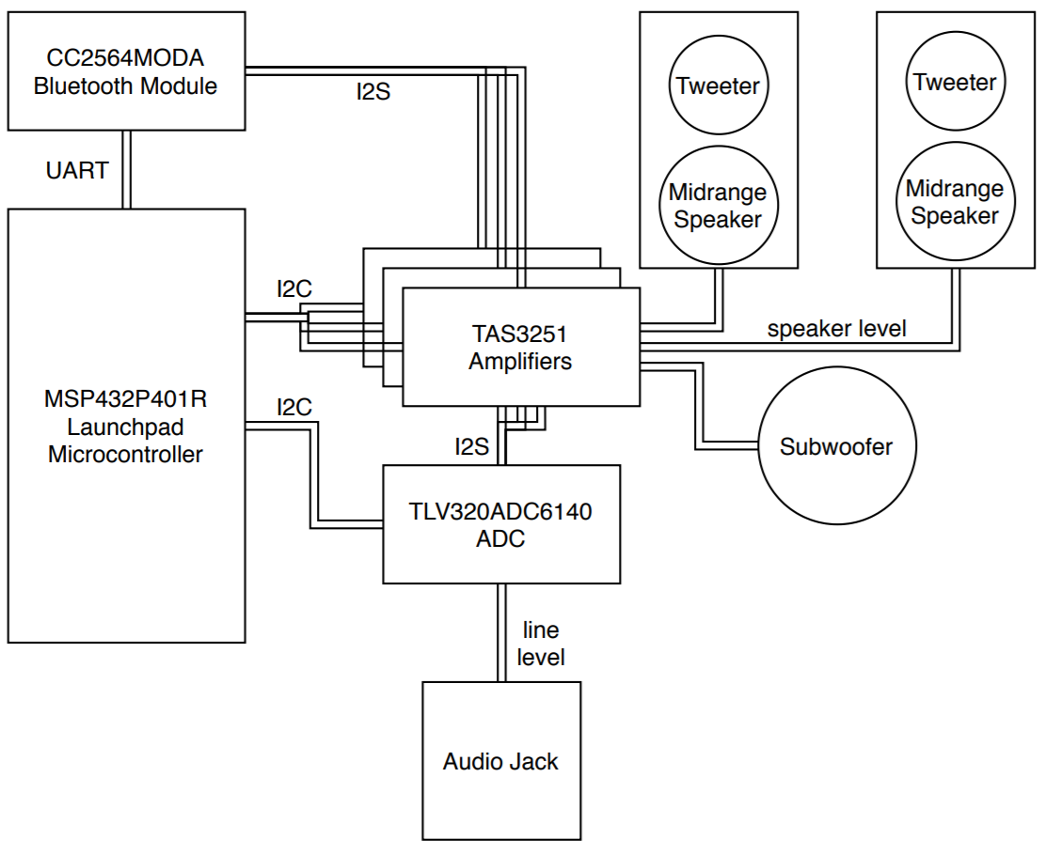
System Layout
Communication over I2C and UART
Audio signal over I2S and analog line level
Notes:
This is David and I will be discussing the system layout
The majority of the electronics shown were intended to be housed within the subwoofer cabinet.
The MSP432 Launchpad contains all of the start up commands for the bluetooth module, amplifiers and ADC.
If a signal is being supplied through the audio jack the ADC converts that line level signal into I2S and feeds it to the amplifiers.
If the signal is being supplied through bluetooth, the I2S signal is able to go directly to the amplifiers.
One amplifier will drive the left side, one will drive the right side and the last will drive the subwoofer.
Each amplifier has 2 outputs.
For 2 of the amplifiers one output will be for the tweeter and one will be for the midrange speaker while the amplifier driving the subwoofer will have the 2 outputs bridged.
The TAS3251 has digital biquad filtering which will ensure that each speaker gets only the frequencies it should.

Slide 6
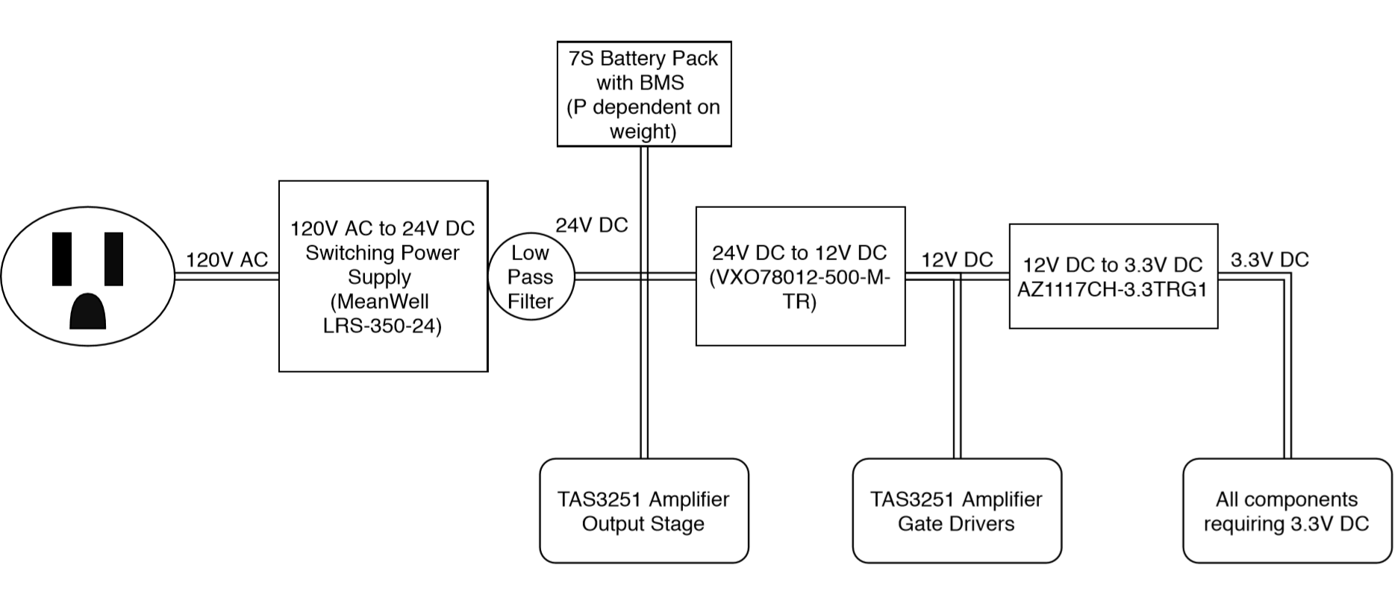
Power System Layout
Notes:
For the power system, power coming from a standard wall socket would go through a switching power supply to convert it to 24 volts DC which will be low pass filtered depending on ripple.
The 24 volt output will then be used to charge the 7S battery pack and power the amplifier output stage.
The 24 volt signal will be converted to a 12V signal to power the amplifiers gate drivers
the 12 volt signal will be converted to a 3.3V signal to power the many components that require 3.3 volts

Slide 7
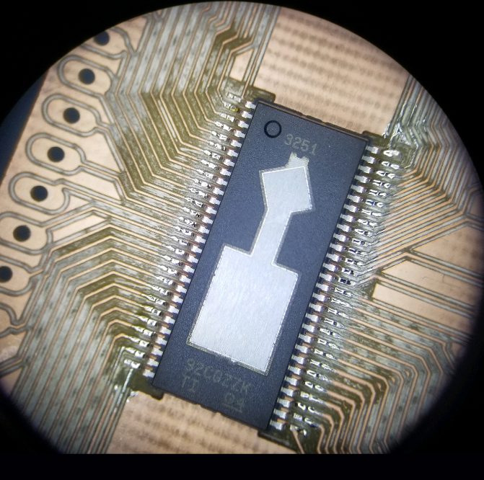
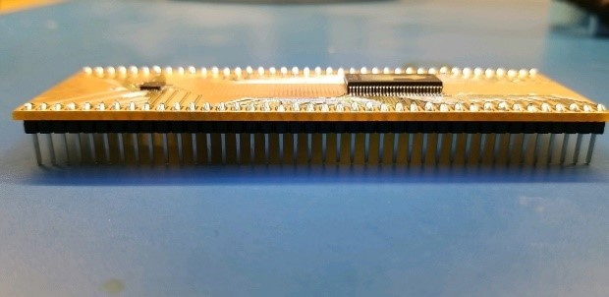
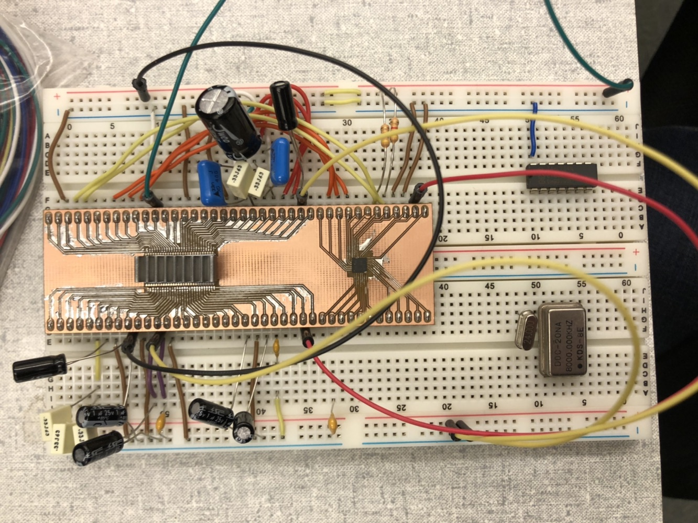
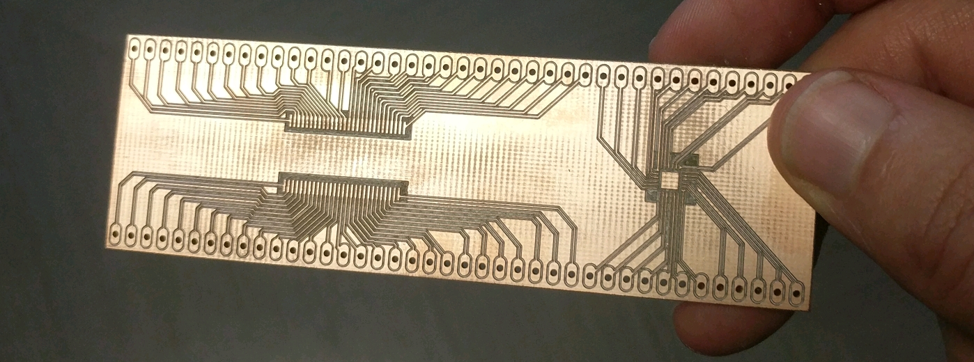
Before COVID-19
Soldering amp and ADC to breakout board
Wired the many required resistors and capacitors to the amp and ADC as listed by the datasheet
Notes:
The list of tasks accomplished before the COVID-19 outbreak are as follows. The amp and ADC we ordered were surface mount components, so we had to solder them to a breakout board for testing. Luckily someone in the *invention studio(?)* was able to get us one within a day. After taking awhile to solder due to solder paste with a solder gun being necessary since the component leads were extremely small, we were able to connect this to a breadboard for testing with the Mbed. All the necessary circuit components were gathered, which was quite a large amount of resistors and capacitors, and all the necessary connections were checked.

Slide 8
Before COVID-19
Setting register values
Huge number of registers to look through in datasheet(~100+)
Using Logic Analyzer, Oscilloscope, and function generator for testing
Continued to not produce sound despite many tweaks to code(e.g. changing different register bits, changing CLK frequencies, double checking wiring)
Notes:
After looking through the datasheet, we realized properly programming the Amp may be more complicated than we originally thought. We had to read info for every register and using I2C through the Mbed, change the bits of each register to what we needed. After lots of testing we were however still unable to produce sound through a test speaker. The Amplifier seemed to read as muted even though we thought we had clearly changed all the necessary bits to unmute. This was likely due to a power delivery issue. We also experimented with many different clock frequencies and register bits that we hadn’t previously considered. Sadly, after finally getting some reasonable data output, garbage data began transmitting, likely due to the ADC being fried. Lastly, some traces on the breakout board got bent during the soldering process not allowing for further testing

Slide 9
COVID-19 Limitations
Limitations on ordering:
New Parts: Including PCB, Speakers, Power Supply
Replacement parts: ADC and amplifier
Limitations on meeting and equipment:
Only one member had access to the parts and equipment
Went from an 8 channel oscilloscope to a 2 channel oscilloscope
Granted access to:
2 channel oscilloscope
Stationary power supply
Arbitrary wave function generator
Notes:
Pretty straightforward, only focusing on the limitations of COVID.
NOT MENTIONING: Adc shorting or AMP shorting
Urge to replace amp
Might Mention: 8 Channel Osc was useful for debugging I2S and I2C communication as well as measuring all the clocks at the same time

Slide 10
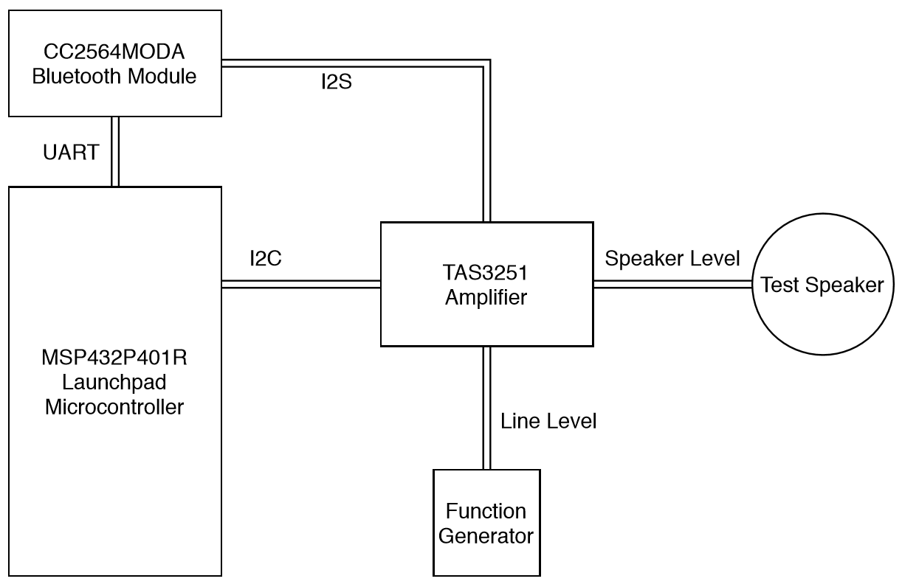
New System Layout
Notes:
This is David again and I will be going over the amended system layout due to the limitations of COVID-19
The MSP432 Launchpad supplies the start up commands to both the amplifier and the bluetooth module.
Signals from the bluetooth are provided to the amplifier
Generated signals can be provided directly to the amplifier by bypassing the built in DAC on the TAS3251.
The ADC is not shown as it was fried and unable to be replaced.
Those amplified signals are then provided to a speaker

Slide 11
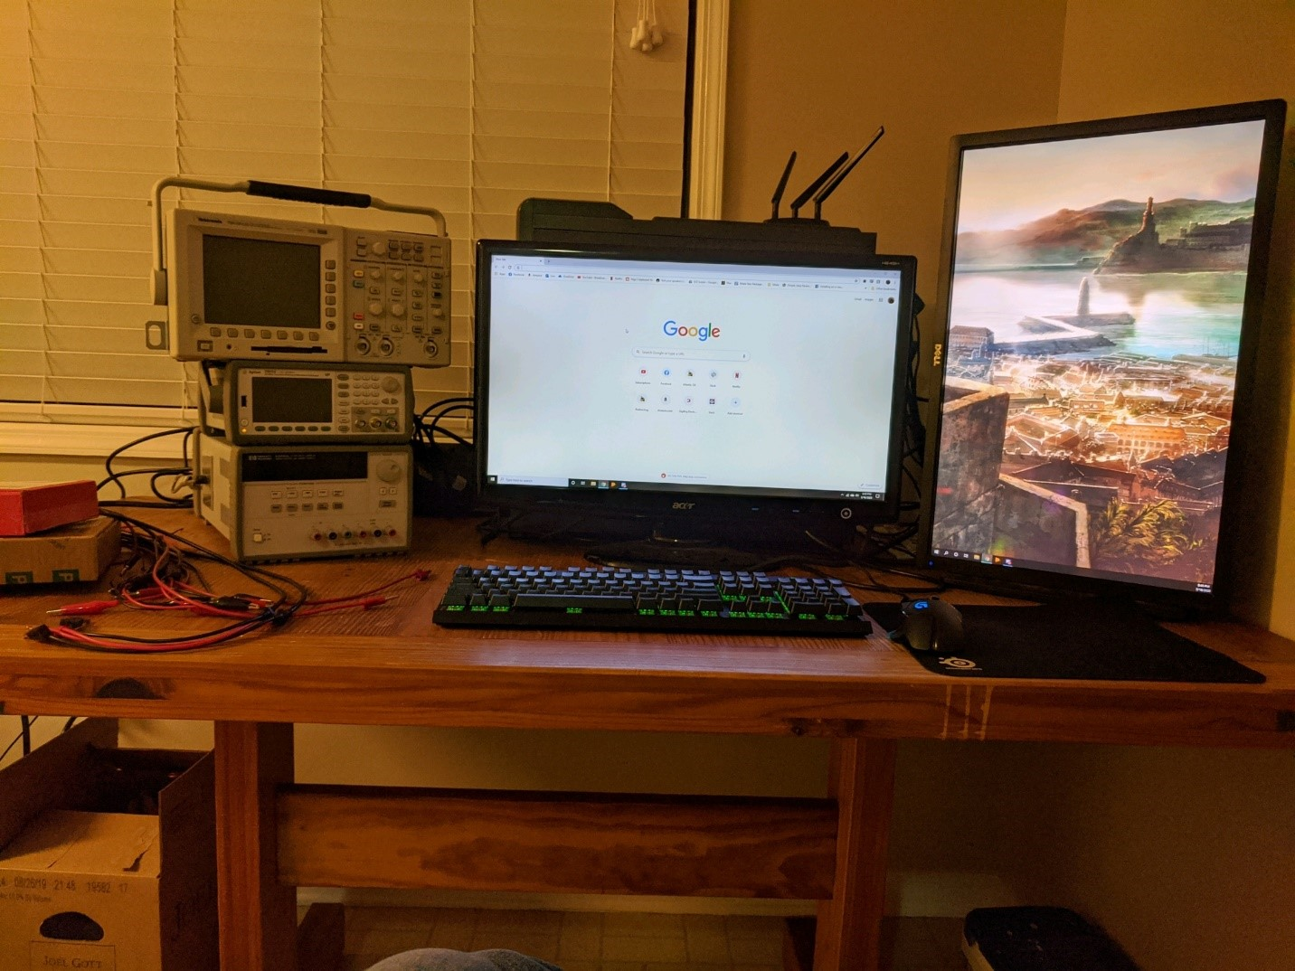
After COVID-19
Moved equipment to a member’s house
Continued debugging only amp and bluetooth module
No new parts or PCBs
Amp’s heatsink got bumped into and shorted several traces (April 23rd)
Notes:
No new parts of pcbs
So had to stick with previous prototypes even though they had known flaws such as clocking and noise
No soldering equipment
Equipment was brought to a member’s house for continuing the debugging process on the amp and later also the bluetooth module. This also meant that no new prototypes would be made since the equipment necessary to solder and inspect weren’t available.

Slide 12
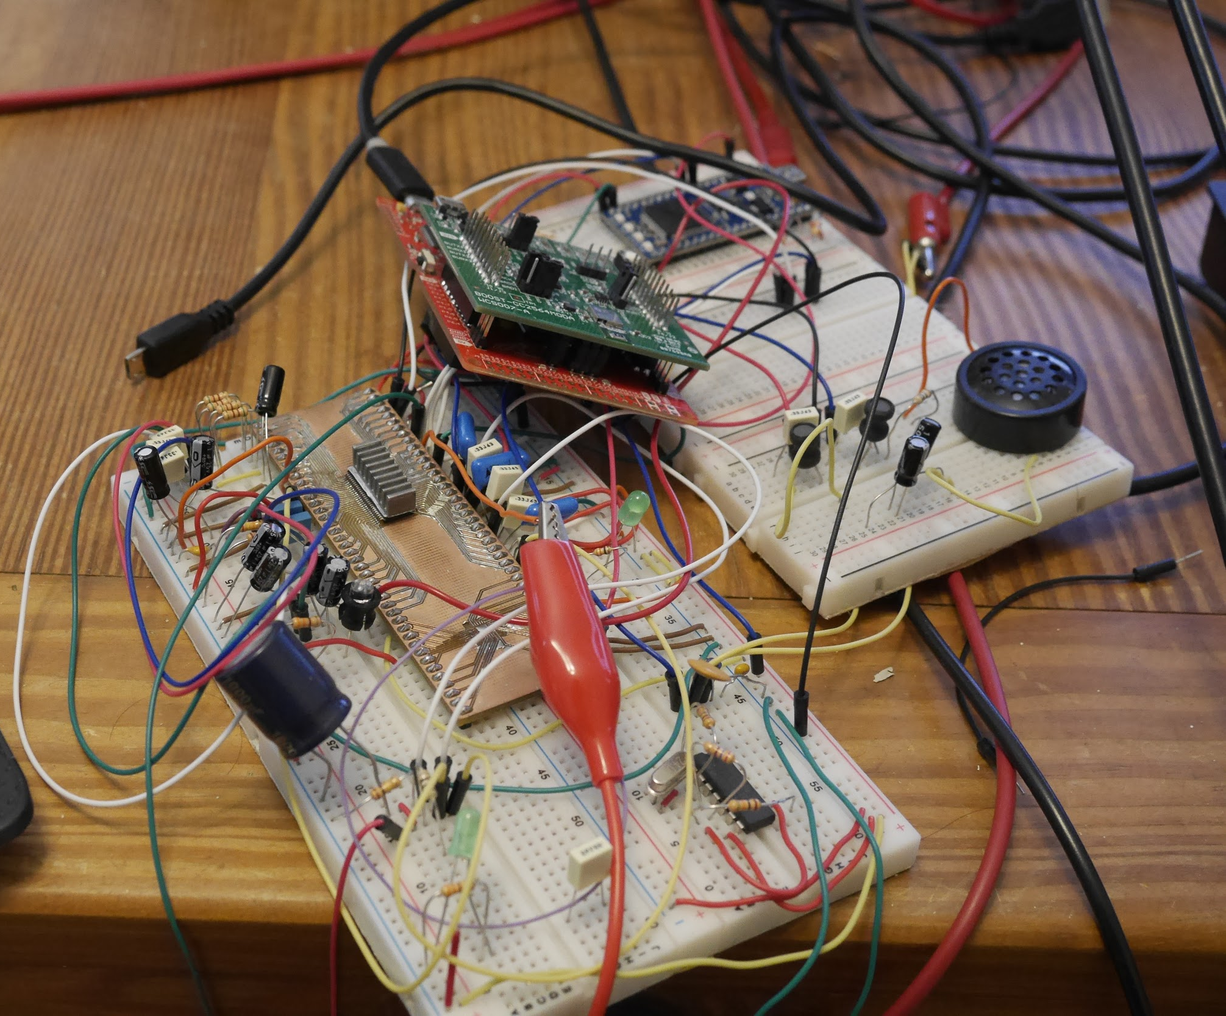
Resulting System
Amp SNR = ? without digital conversions.
Amp SNR = 8dB
White noise interference likely from MBED ADC
Bluetooth works
Pair after restart
Single connection
Quick startup (<<1s)
Notes:
So what was the result of this project? The amplifier ended up being very good when provided a direct signal from the function generator to its analog inputs, but when that same signal was put into the MBED’s ADC and subsequently converted back in the amplifier’s DAC, the signal quality was terrible. This was thought to be because of the MBED’s ADC, so debugging efforts were put into another signal source, the bluetooth module. The bluetooth module ended up working as intended meeting all the design specifications for it: pairing in less than 5 seconds, starting up in less than one, and outputting audio data. While debugging the clock jitter from the bluetooth module, this is when the amp’s heatsink was bumped and the system fried causing an end to the project.

Slide 13
What We Could Have Done Better
DAC / DSP and amp that were not integrated
More modules means more parallelism
Make many PCB prototypes instead of single no-silkscreen protoboard
Less reliability of discrete components that can become loose or fall out in transport
Notes:
So in the end, what could have been done better? The chip that was used had an integrated DAC, DSP, and amp with very limited exposed signals that made it very hard to to diagnose, so individual chips for each of these functions would’ve accelerated the debugging process.
Having more modules would have also made parallelizing the development of these module much easier since every member would be able to work at the same time on their own section all at once with independent debugging.
More itterations of the pcb would’ve helped since many persistant issues ended up being caused by misalignment of wire, cross-talk, and parts moving and coming loose during transport. Most of these issues could’ve been resolved by making a pcb much earlier in the project since parts were selected early on.

