Slide 1
Backpack Speaker
David Rogers, Alex Mathis, Andy Vernetti, Jack Glennon, Connor Brothers

Slide 2
Responsibility Breakdown
Connor: Background and goals
Andy: Structure of the case
Power
David: Amplifier selection
Jack: Tweeter and woofer selections
Alex: Microcontroller requirements and options

Slide 3
Introduction
Backpack speaker system
Portable
Goal is <40 lbs
High quality with subwoofer
Durable
Withstand outdoor conditions and frequent transportation
Ideally not too expensive
Budget is ~$500
Ability to run on battery(ideally)
RGB Lighting
User Interface
On the system as well as through Bluetooth app
Control equalization through both

Slide 4
Background
Motivation
No speaker systems on the market that are both portable and good quality
Can be carried around(with some effort) and has good frequency response
Battery powered speakers on the market are typically unimpressive
Amplification
Typically the Tweeter, Woofer, and Subwoofer all connect to external amplifier
Internal Class D Amplifier
Housed in Subwoofer box
3.5mm, RCA, or Bluetooth
Allows for more portability and less cables
Standalone system

Slide 5
Physical Case
Dependent on speaker selection:
2 Mid Speaker dimensions: 12” tall x 7” wide x 10” deep (maximum)
Subwoofer dimensions: 14” tall x 14” wide x 10” deep (maximum)
Materials:
¼” MDF (for dimensions above, weighs 14.67lbs) - $42.25 for 48”x 96”
Aluminum bracing possibly for support
reduce standing waves with polyfill

Slide 6
Power System
Don’t have funds or weight for full battery power - demonstration instead
Will be plugged in for most of the time
Can unplug and go on battery power to show viability
7S Li-Po battery, to get voltage required (24V)
C rating in order to supply current necessary
Don’t need huge capacity

Slide 7
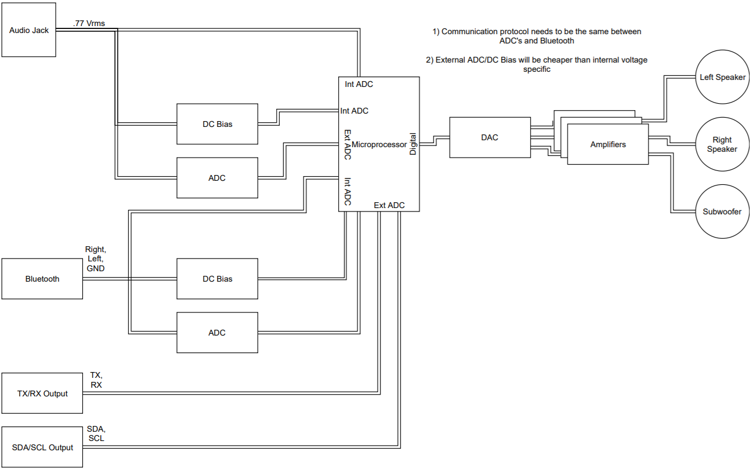
Parts
Microcontroller with I2C and I2S
Class D Audio Amplifiers
2 Layer PCB
Switching power supply

Slide 8
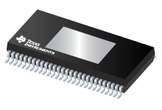
Amplifier
Subwoofer and Midrange Speakers TAS3251DKQR 175W-Stereo, 350W-Mono, Ultra-HD Digital-Input Class-D Burr-Brown™ audio amplifier
Audio inputs: I2S, TDM, left or right justified
Fixed function processing SmartEQ (up to 15x BiQuads per channel) Crossover EQ (2x5 BiQuads)
12-V to 36 V supply voltage operation Error reporting, integrated protection

Slide 9
Speaker Selection Guidelines
Minimal ripple within operating range
High dispersion with little signal degradation within 45 degree cone in front of speaker
^{Sensitivity of 90 dB 1W/m}
^{Minimal weight if possible}

Slide 10

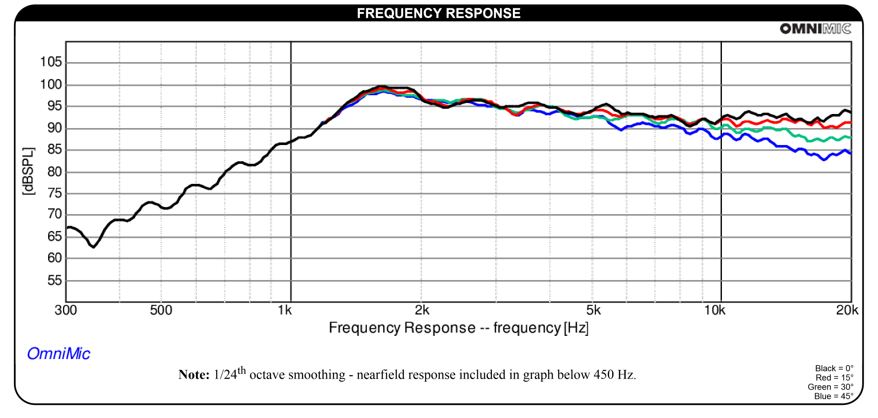
Tweeter
Re = 3.23 Ohms
SPL = 94dB 2.83V/1m (2W)
40 Wrms power handling
.25 lbs
$20.48

Slide 11
Midrange
Ideally 4-6” diameter
4 Ohm
Flat response between 100 Hz and ~1.5kHz
Problem: most speakers so far have a significant bump around 1kHz to 2kHz or have other significant ripples in the passband
Possible solution: smaller speaker that’s less efficient / has lower Wrms

Slide 12

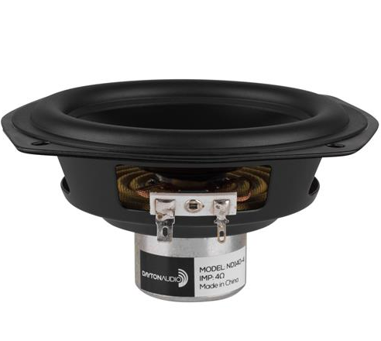
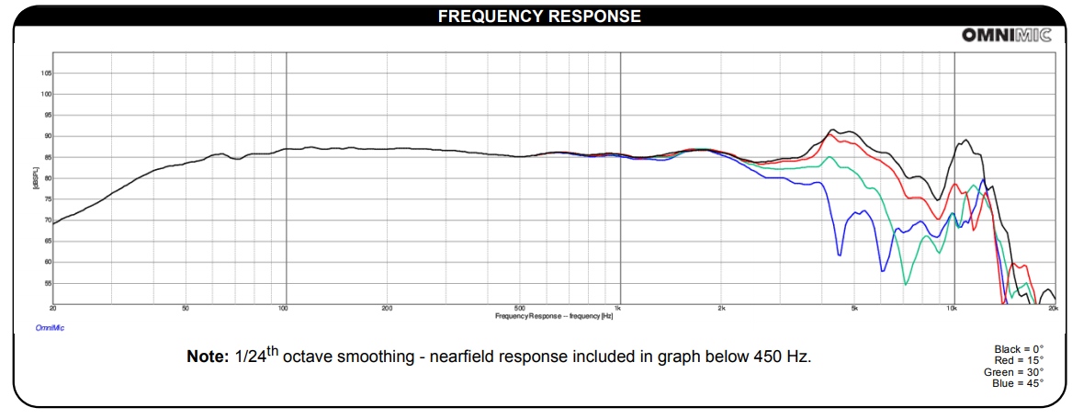
One Possibility for Midrange
Vb = .1403 ft^3 Fl = 93.9 Hz (assuming Qmc = 3.5 for sealed box)
88.4 dB 2.83 V/1m (2 W) 1 lbs $29.98

Slide 13

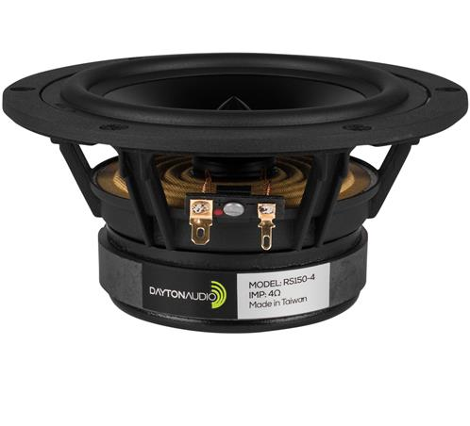
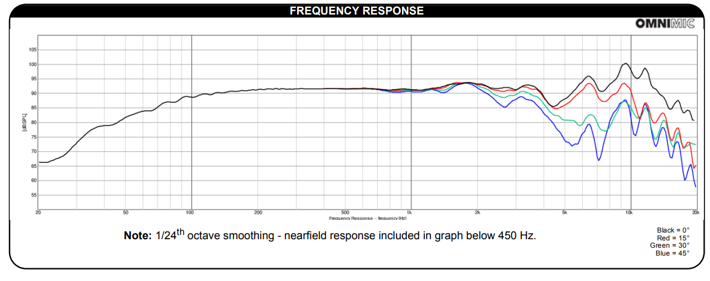
Second Possibility for Midrange
Fl = 109.62 Hz Vb = .0983 ft^3
91.8 dB 2.83 V/1m (2W) 2.8 lbs $35.98

Slide 14

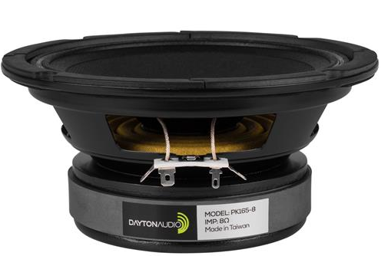
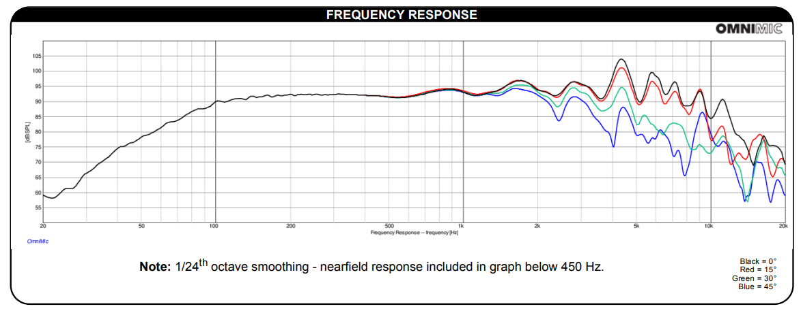
Third Possibility for Midrange
Vb = .1709 ft^3 Fl = 139.5 Hz 91.4 dB 2.83V/1m (1 W!!!) ->
Twice as efficient as previous! $32.98 4.2 lbs

Slide 15
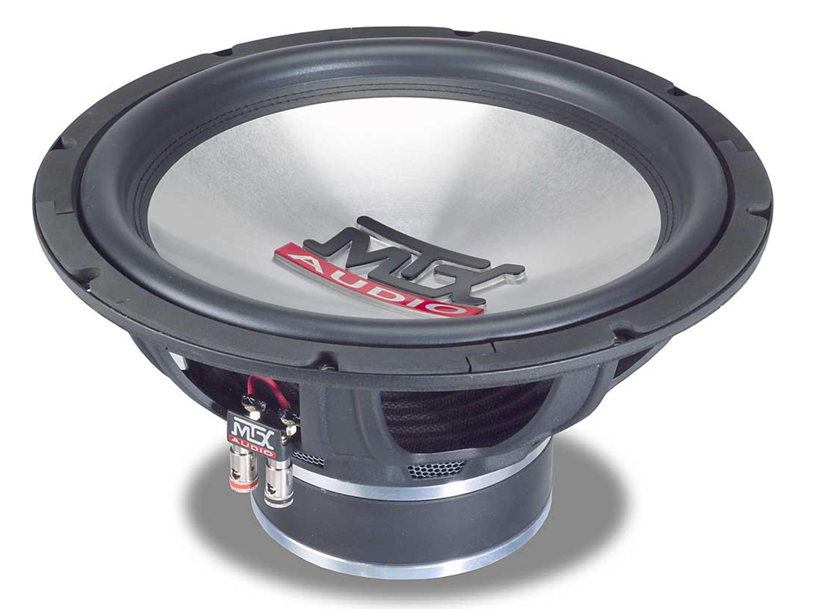
Infrawoofer
MTX audio T5512-44
It was $4
Dual 4 Ohm voice coils
Fl = 49.20 Hz
Vb = 1.06 ft^3
92.89 dB 2.83 V/1m (@2 Ohms -> 4W) = 89.89 dB @ 2W

Slide 16
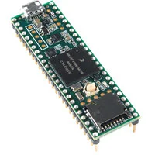
Microcontroller
Analog input pins
ADC: 16-bit resolution
I2S and I2C for Amps
Communicate with 3 Amps
DSP not needed on Microcontroller
Amplifiers have the ability to do DSP
Teensy
Four I2C ports
I2S audio port, 4-channel digital audio input and output
25 analog inputs to two ADCs with 12 bit resolution
Two analog outputs (DACs) with 12-bit resolution
$36.88

Slide 17
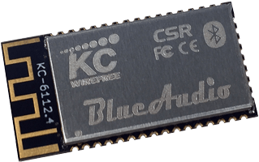
Bluetooth Module
KC-6112 BlueAudio Module
Specific Protocols for Audio
Internal Class 2 Antenna
I2C and I2S Ports
25 meter range
Vdd: 2.9 - 4.4V
Cost: $25

Slide 18
Current Status
Ordered: Test Amplifiers (2 different types)
Research:
Bluetooth Modules
Microcontrollers
ADC - if Microcontroller doesn’t have right bit rate
Switching Power Supply
Matching Speakers’ frequency response
Next Steps
Microcontroller
Bluetooth Module
Switching Power Supply
Block Diagram
PCB Design

