Slide 1
2.4 GHz Phased Array System for Lunar Extravehicular Activity (EVA) Communications
Lucas Wray, Sarah Deitke, Baris Volkan Gurses
Notes:
Sarah

Slide 2
Motivation
2.4 GHz Wi-Fi links are used for EVA communications on the lunar surface.
Compared to VHF links, 2.4 GHz links introduce 18 dB more path loss.
This severely limits the range of communication devices on the lunar surface.
Current NASA goal for EVA range is 0.5 km.
A phased array can be used to increase the gain in the azimuthal plane and surpass this goal.
Notes:
Sarah

Slide 3
Technical Specifications
2.4 - 2.5 GHz (Wi-Fi band)
10 dB bandwidth ≥ 20 MHz (802.11b channel BW)
Power delivered to 0.5 km ≥ -91 dBm
360° azimuthal coverage (resolution ≤ 30°)
Notes:
Lucas

Slide 4
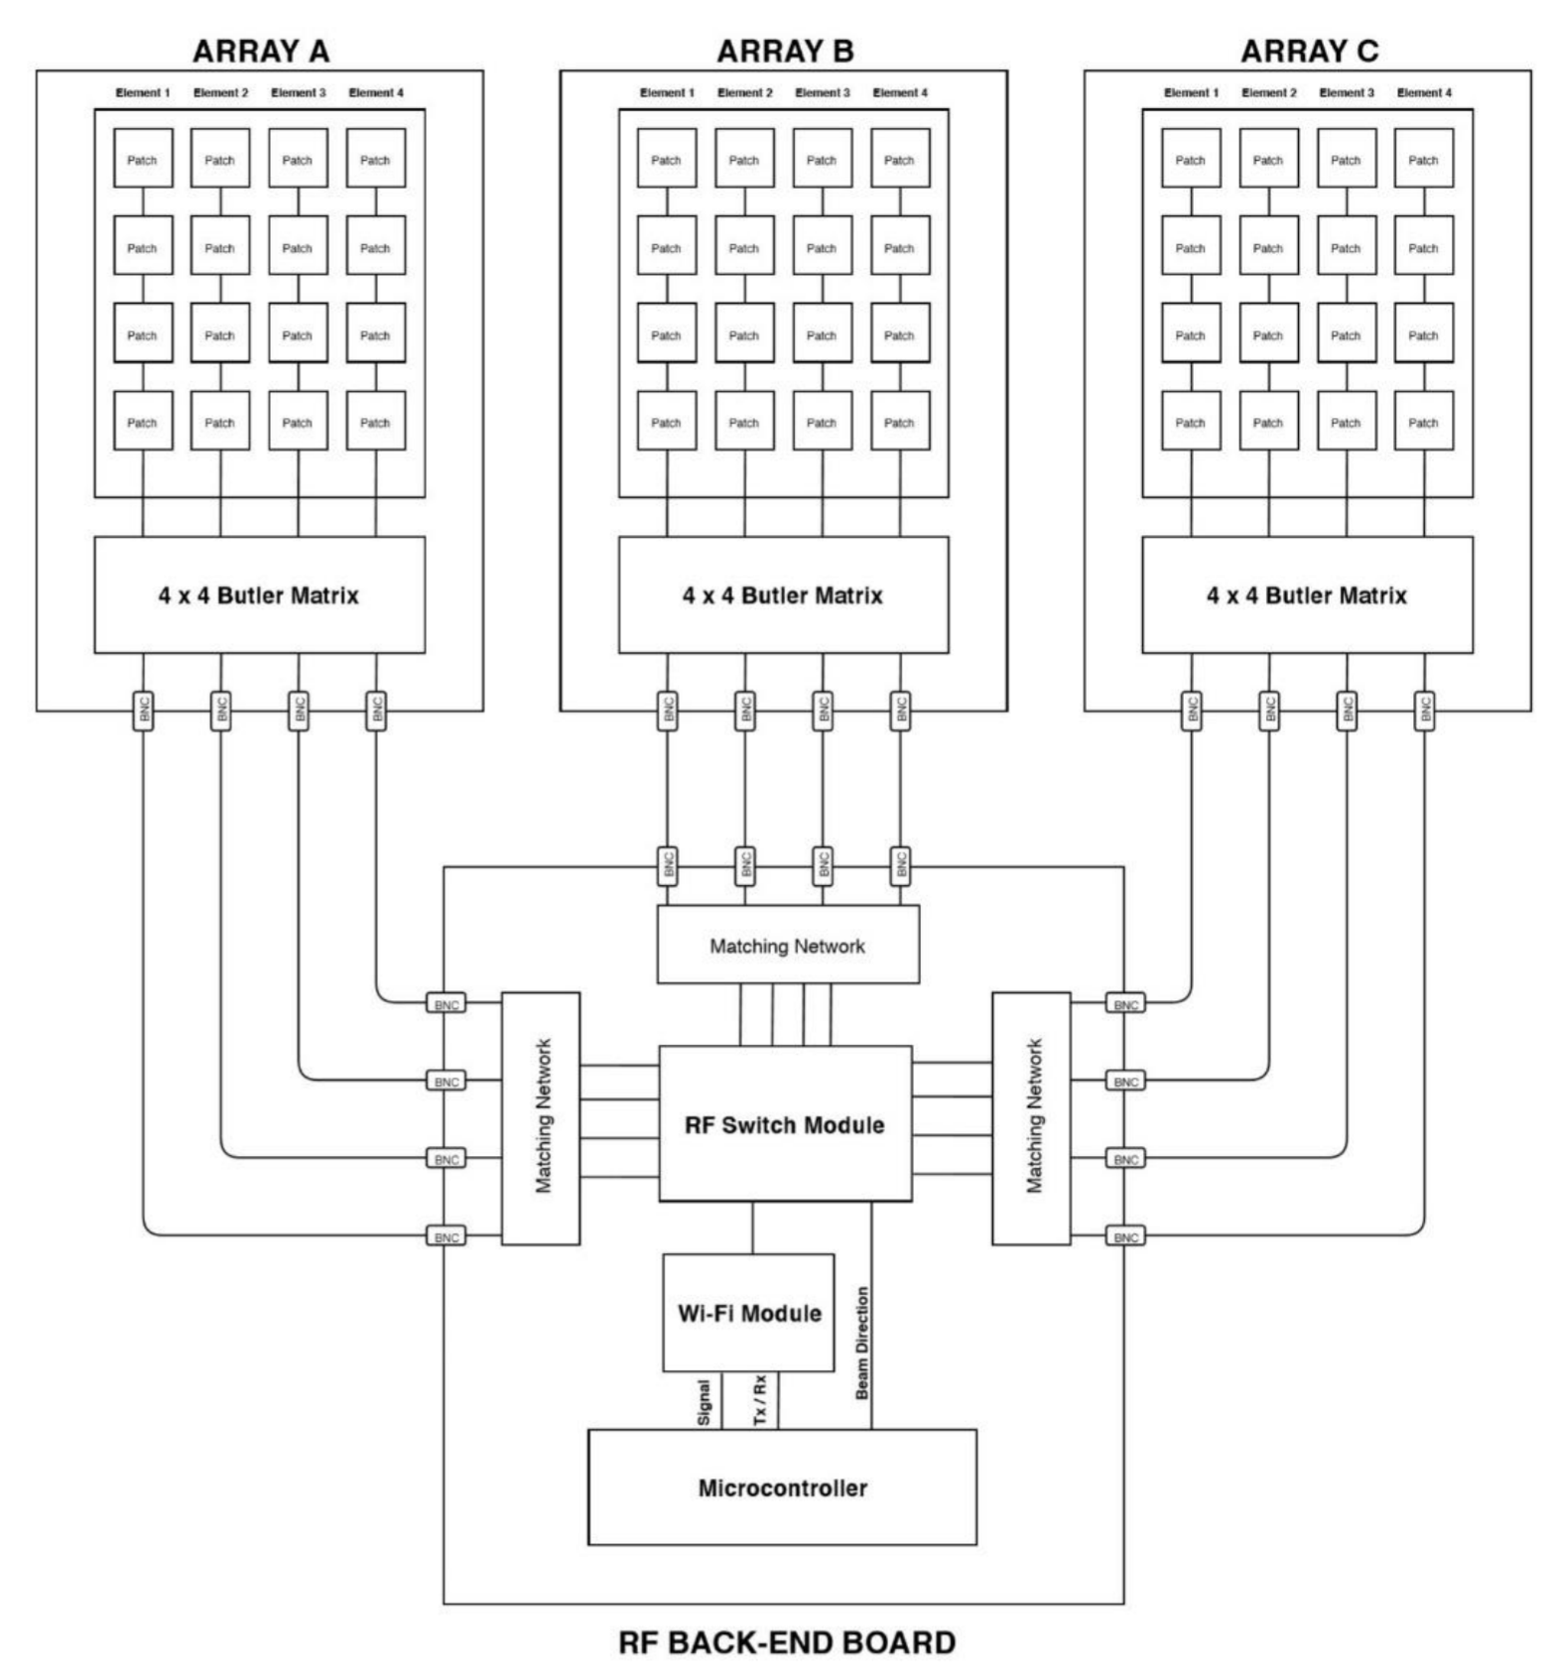
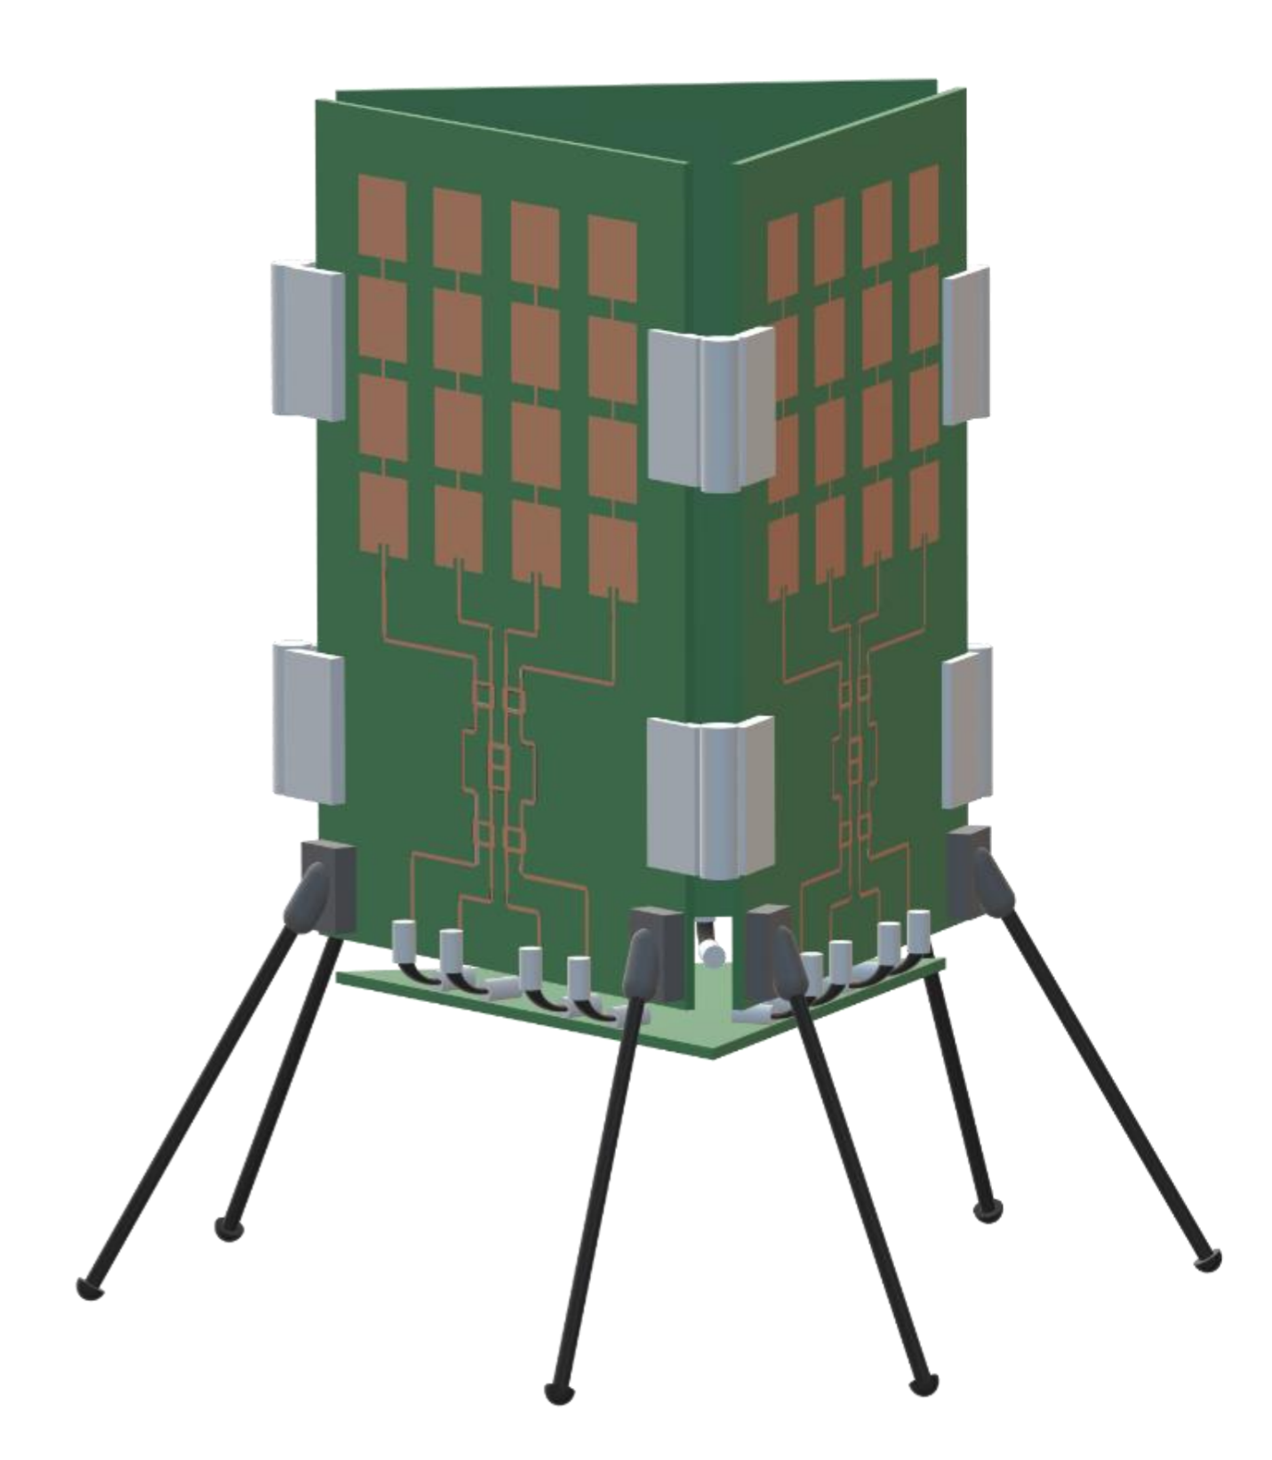
System Design
Front end:
Series-fed linear patch antennas
Butler matrices
Back end:
RF switch module
Wi-Fi module
MCU
Mechanical Fixture:
BNC connectors
Hinges
Mechanical supports
Notes:
Volkan

Slide 5
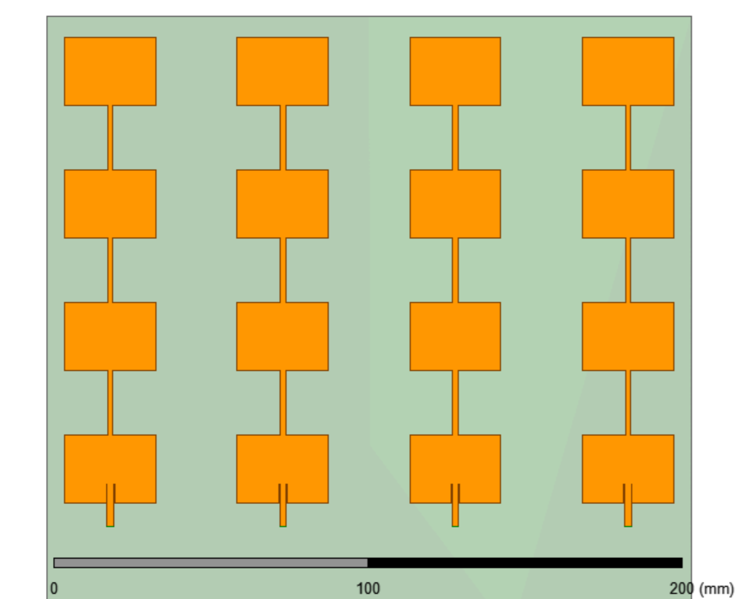
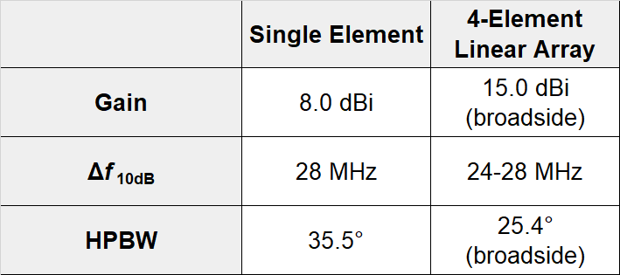
Antenna Array Design
Series-fed patch elements
Designed to 2.45 GHz
Inset feed for 50 Ω match
4-element linear array
λ/2 element spacing
0.060” Rogers 3006 (ε_{r} = 6.15)
Notes:
Lucas

Slide 6
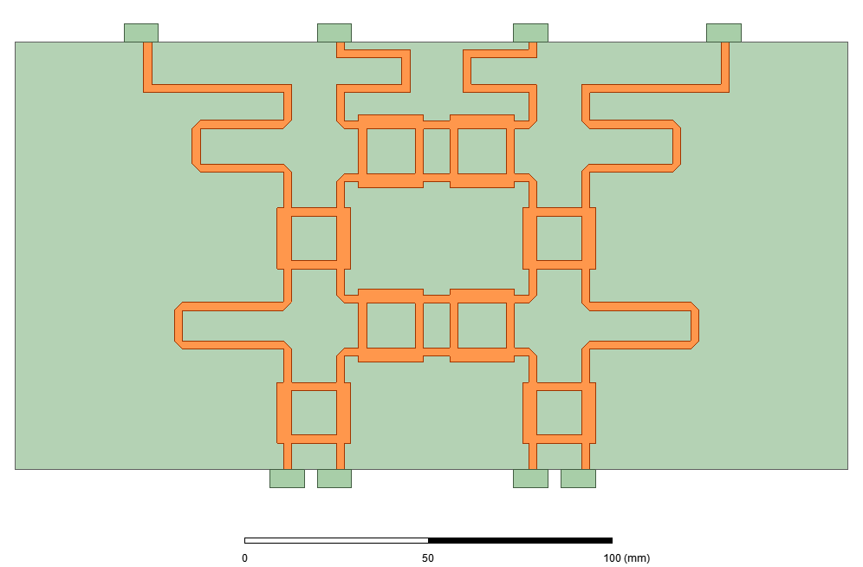
Butler Matrix Design
Port 5
Port 6
Port 7
Port 8
4×4 topology:
4 90° hybrid couplers
4 phase shifters
2 crossover structures
Distributions Unit: dB, degree | Port 1 | Port 2 | Port 3 | Port 4
Port 5 | -6.12∠-38.5° | -7.58∠-113° | -7.42∠-70.8° | -7.47∠-162°
Port 6 | -6.58∠-62.0° | -7.65∠12.9° | -6.48∠137.9° | -8.80∠-95.3°
Port 7 | -7.37∠-92.5° | -6.60∠139.0° | -7.74∠14.1° | -6.55∠-61.1°
Port 8 | -7.64∠-162° | -7.36∠-71.0° | -7.64∠-112° | -5.50∠-36.8°
Steer Angle (from broadside) | 15° | -45° | 45° | -15°
Port 1
Port 2
Port 3
Port 4
Notes:
Volkan

Slide 7
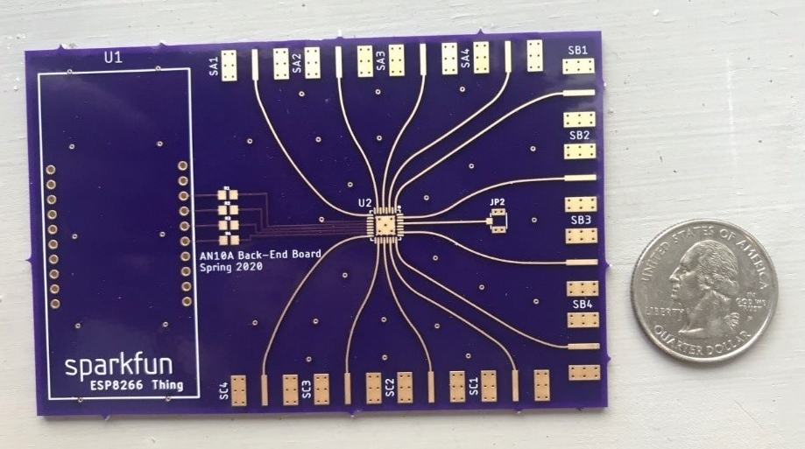
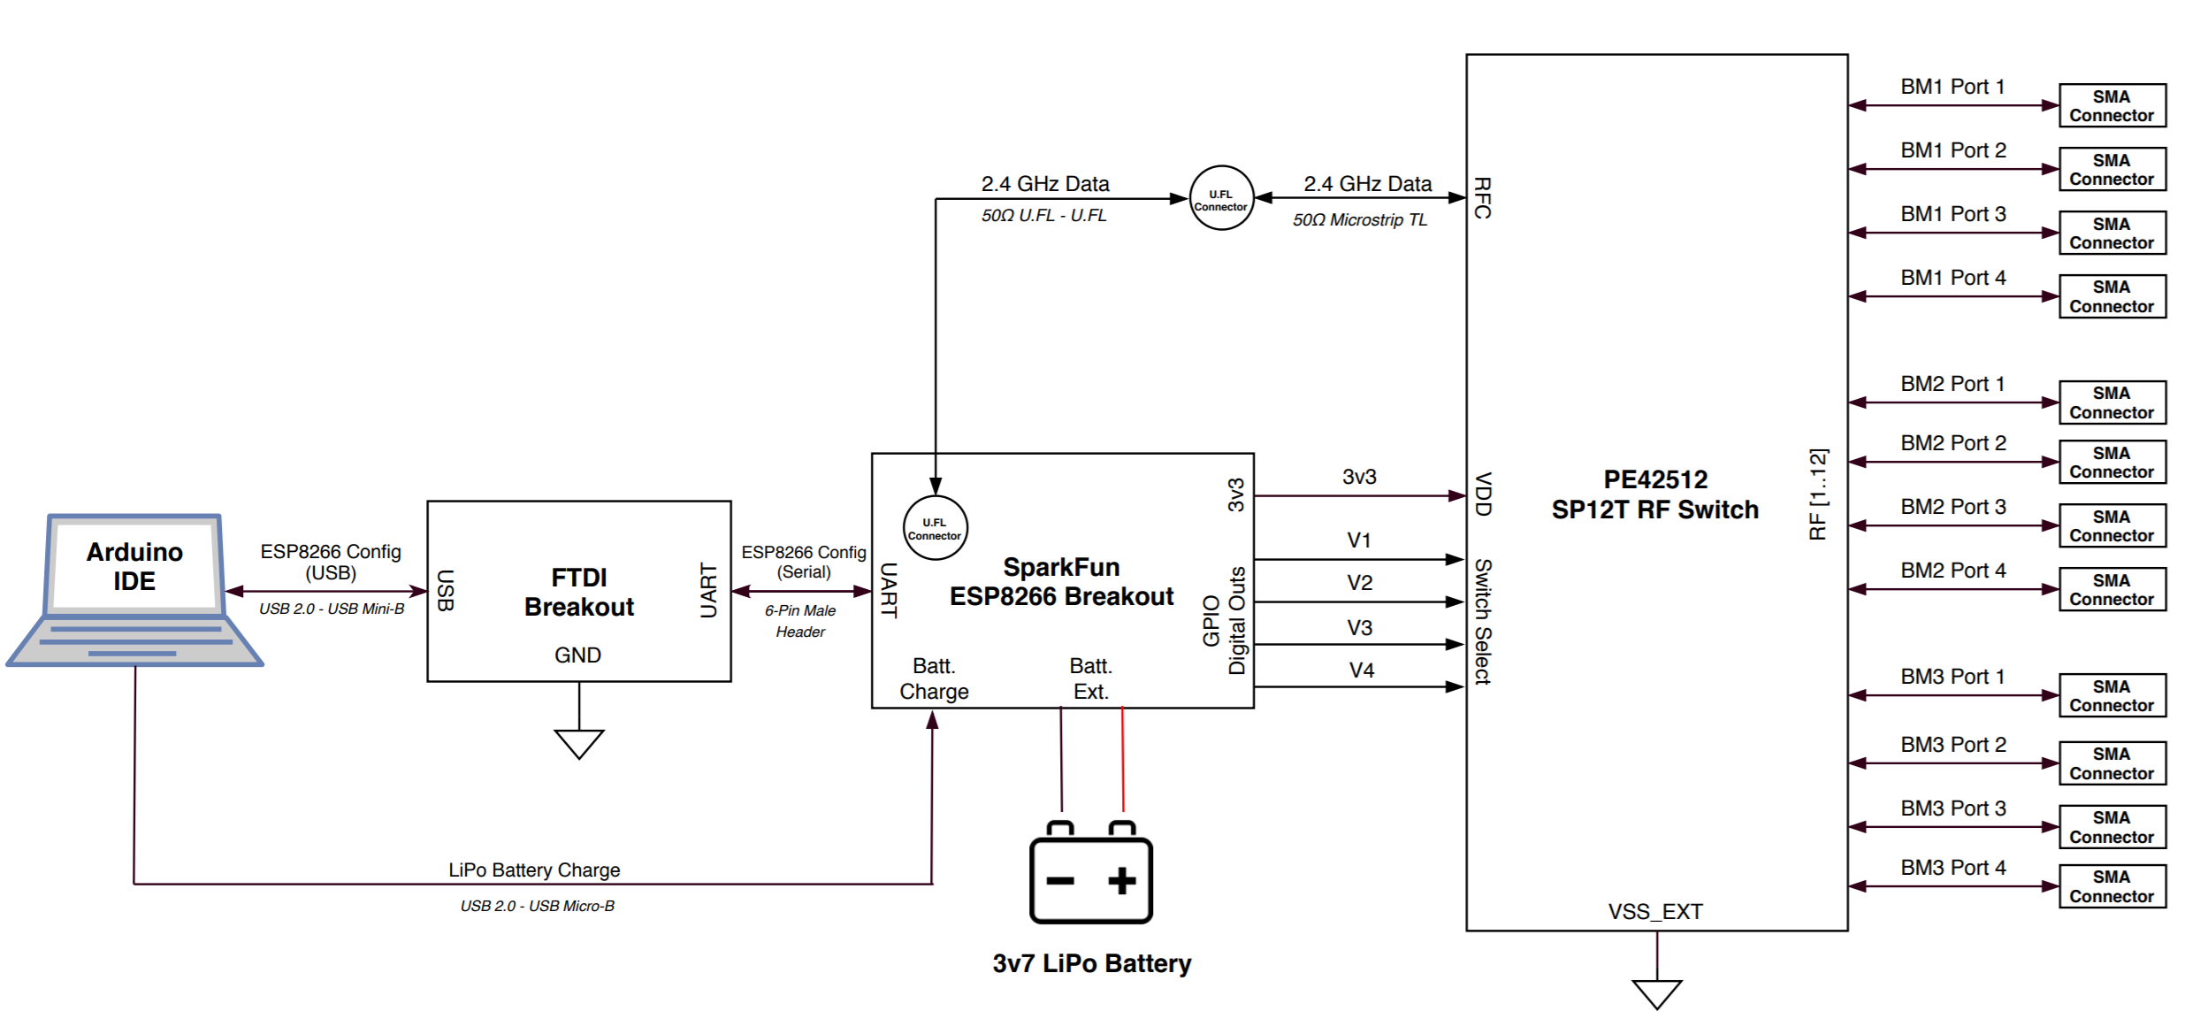
Back-End Design
Wi-Fi module/MCU (ESP8266 Thing)
Runs high-level C code
Built-in Wi-Fi APIs
2.4 GHz signal output
Single pole, 12-throw switch (PE42512)
Bidirectional
Connects Wi-Fi module to one of 12 ports
Switch (and thus beam direction) controlled by 4 input bits
PCB layout (Osh Park)
4-layer board
Signal layer: 0.17mm FR408 (ε_{r} = 3.67)
50 Ω microstrip lines
SMA I/O ports to front-end
Notes:
Lucas

Slide 8
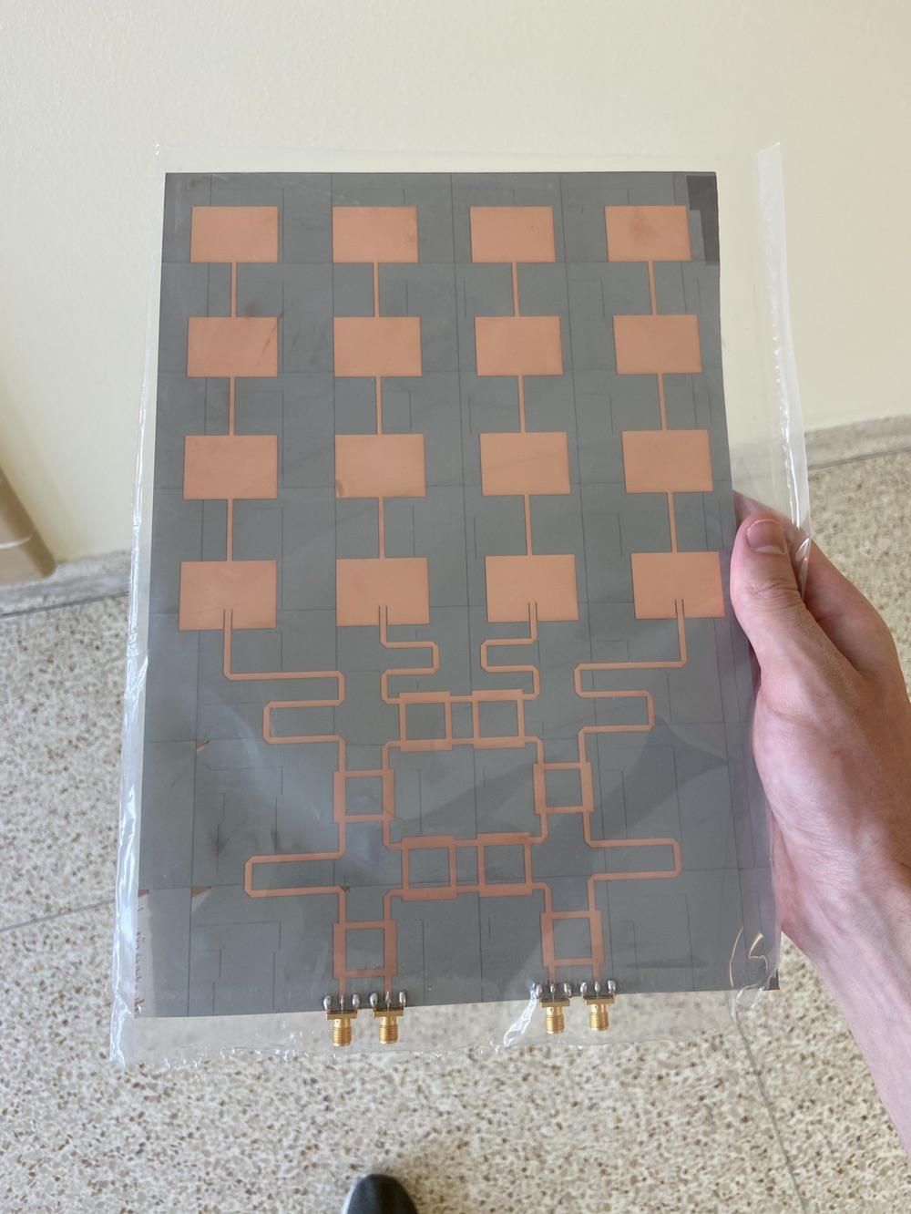
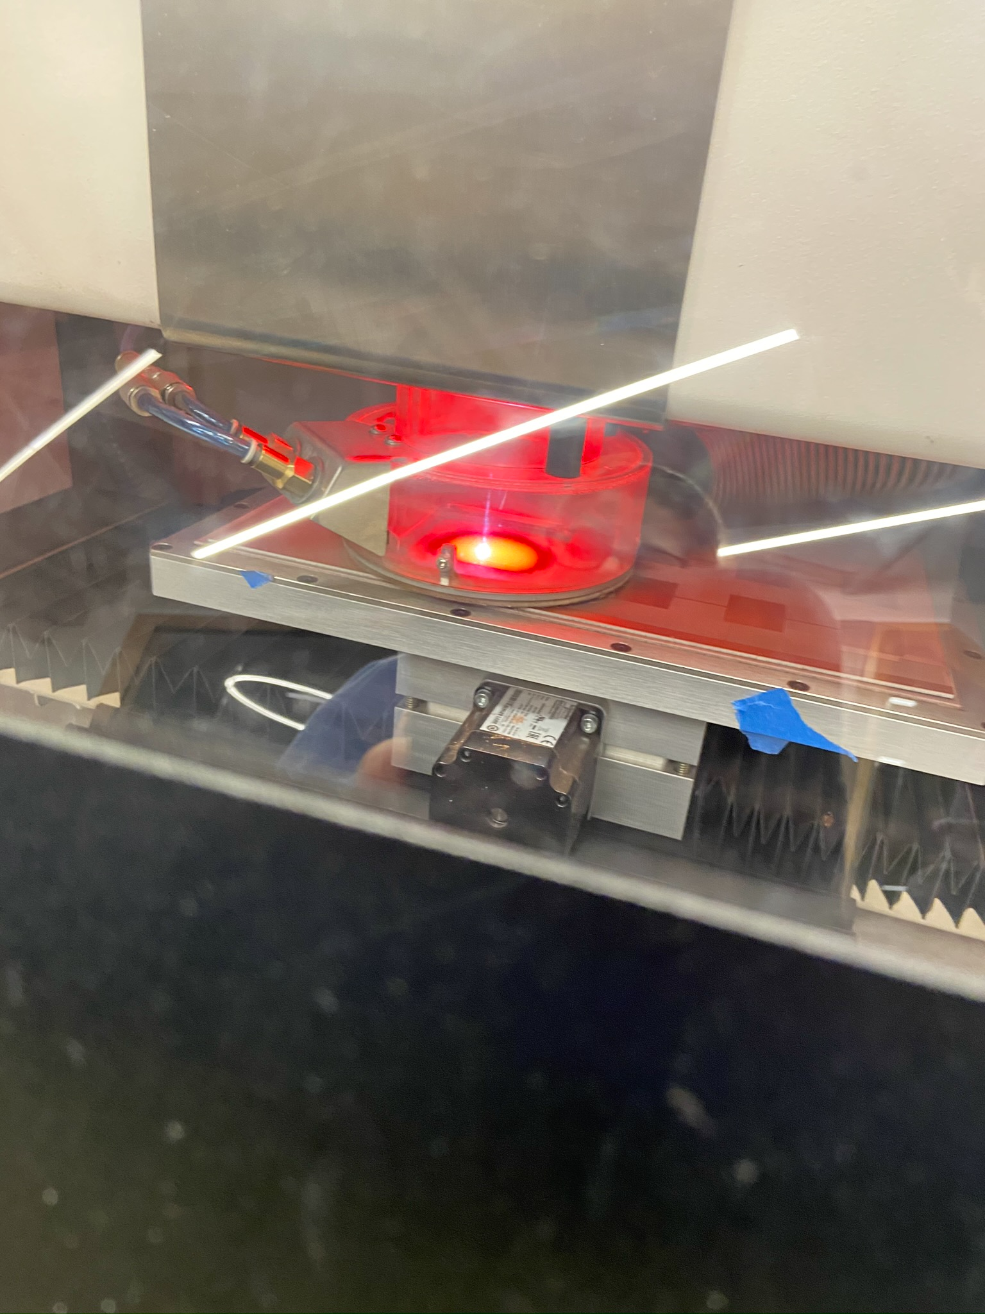
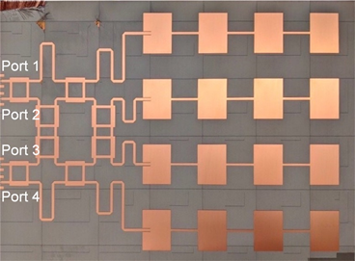
Front-End Fabrication
Utilized Georgia Tech’s Interdisciplinary Design Commons to print the front end boards on Rogers 3006 substrate and solder connectors.
Printing
Fabricated Board
With hand to show scale
Notes:
Sarah

Slide 9
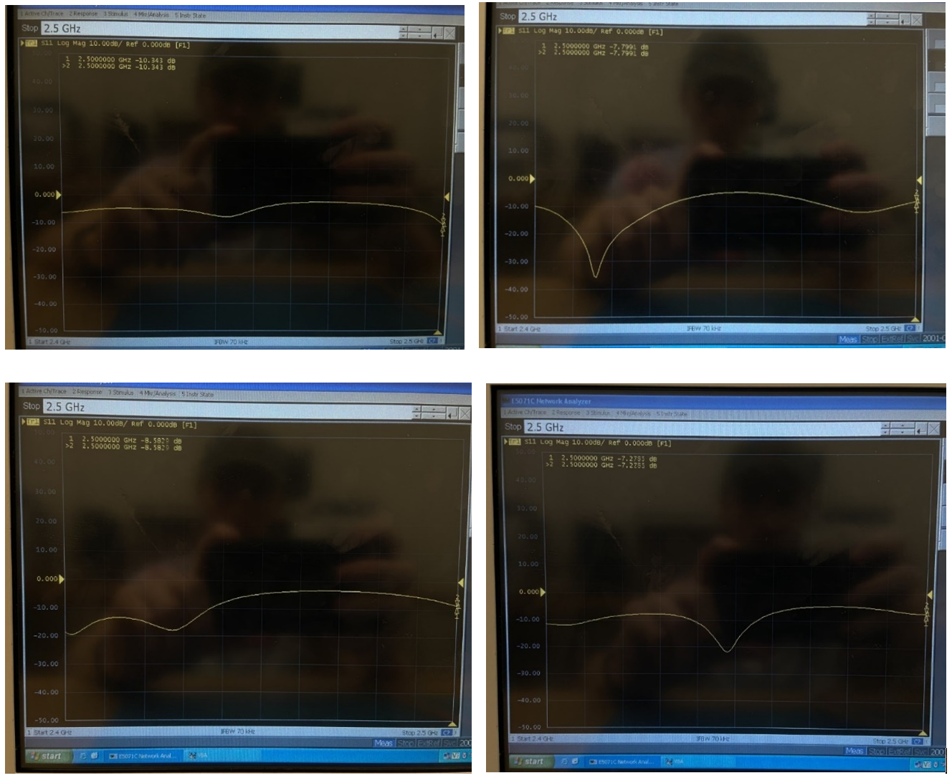
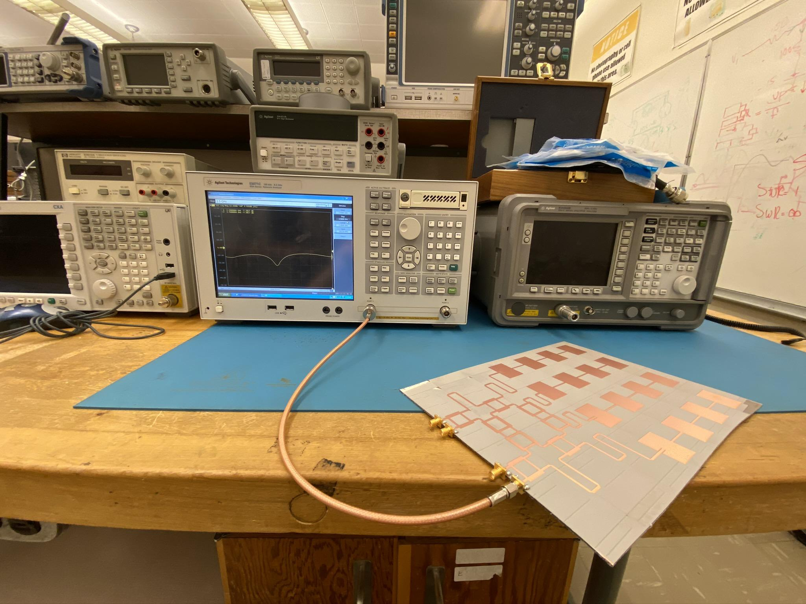
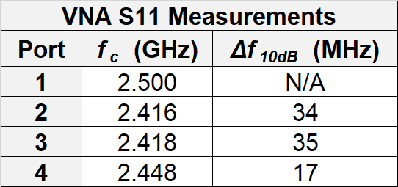
Front-End Measurements
Return loss as measured in VL365
1
2
3
4
Notes:
Lucas

Slide 10
Project Demonstration
Notes:
Sarah

Slide 11
Range Demonstration
Source of Values
G_{T} = Front End Design
G_{R} = Assumed
P_{T} = 100 mW - assumed 2dB internal loss at back end and 3 dB internal loss at Butler matrix
P_{R} = ESP8266 minimum sensitivity using 802.11 b
h_{T} = 5 meters
h_{R} = 2 meters
M = 20 dB, upper limit on lunar surface
https://ntrs.nasa.gov/archive/nasa/casi.ntrs.nasa.gov/20070025224.pdf
Notes:
Sarah

Slide 12
Coverage Demonstration
Notes:
Volkan

Slide 13
Acknowledgments
We would like to acknowledge Dr. Greg Durgin and Cheng Qi for their help, mentorship, and guidance throughout this project.
Notes:
Volkan

Slide 14
Thank you for listening!
Notes:
Volkan

