Slide 1
ECE 4012 AN10A Proposal Presentation
By: Sarah Deitke, Baris Volkan Gurses, Lucas Wray

Slide 2
Agenda
Introduction
Motivation
Goals
Technical Specifications
System Design
Schedule and Milestones
Project Demonstration
Cost Analysis
Current Status

Slide 3
Introduction
This project is inspired by NASA’s upcoming Artemis mission.
NASA seeks to send back astronauts to the lunar surface.
To be used as a gateway for interplanetary exploration.
With the advent of this program, lunar surface communication systems have attracted attention.

Slide 4
Motivation
2.4 GHz Wi-Fi links are used for EVA communications on the lunar surface.
Compared to VHF links, 2.4 GHz links introduce 18 dB more path loss.
This severely limits the range of communication devices on the lunar surface.
Current NASA goal for EVA range is 0.5 km.
A phased array can be used to increase the gain in the azimuthal plane and surpass this goal.

Slide 5
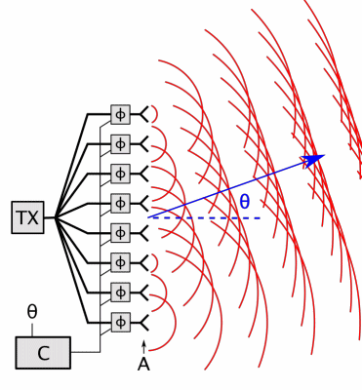
Goals
Develop a phased array system to be deployed on the lunar surface in the space environment.
Spatially-reconfigurable and reliable communication links
Easily deployable
Lightweight
Cheap
Compatible with NASA and IEEE standards

Slide 6

Technical Specifications
2.4 GHz frequency
0.5 km or greater range
2 lbs.
-70 dBm minimum received signal strength
30-degree electrical beam steering resolution
70 mW gross power consumption

Slide 7
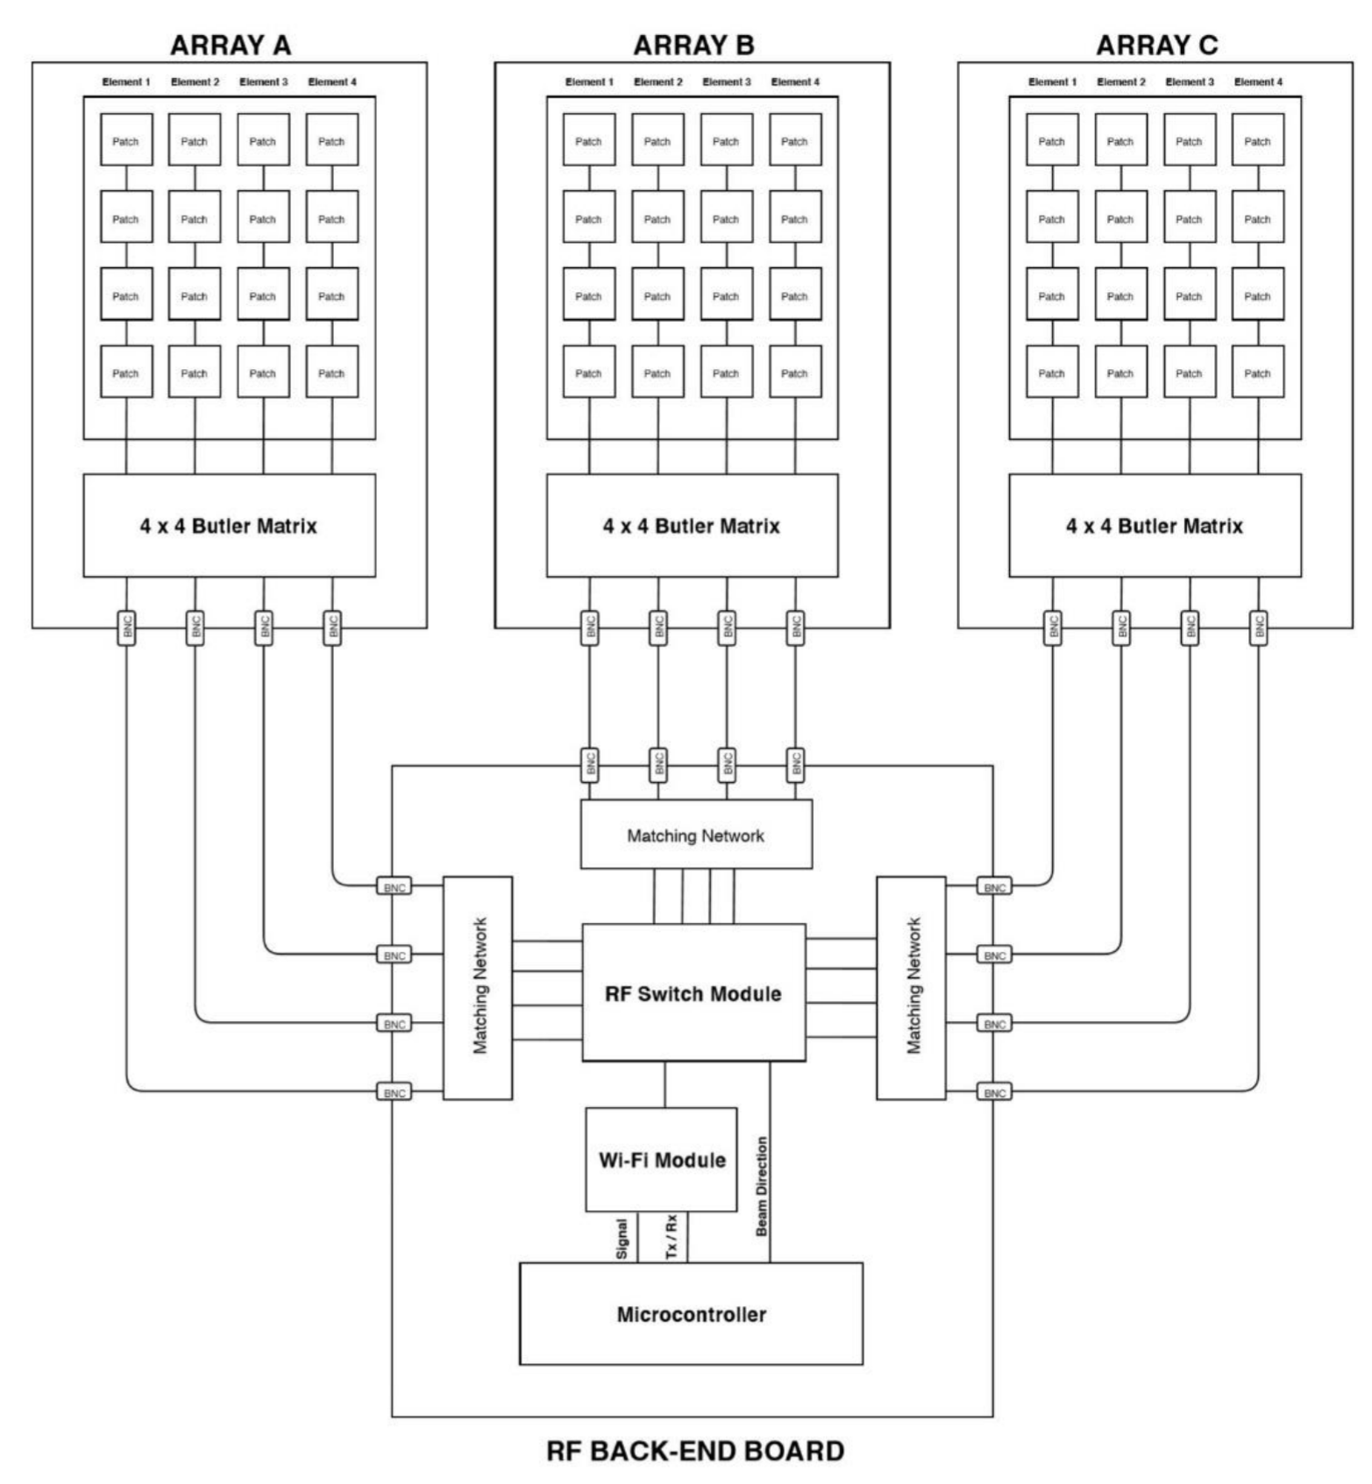
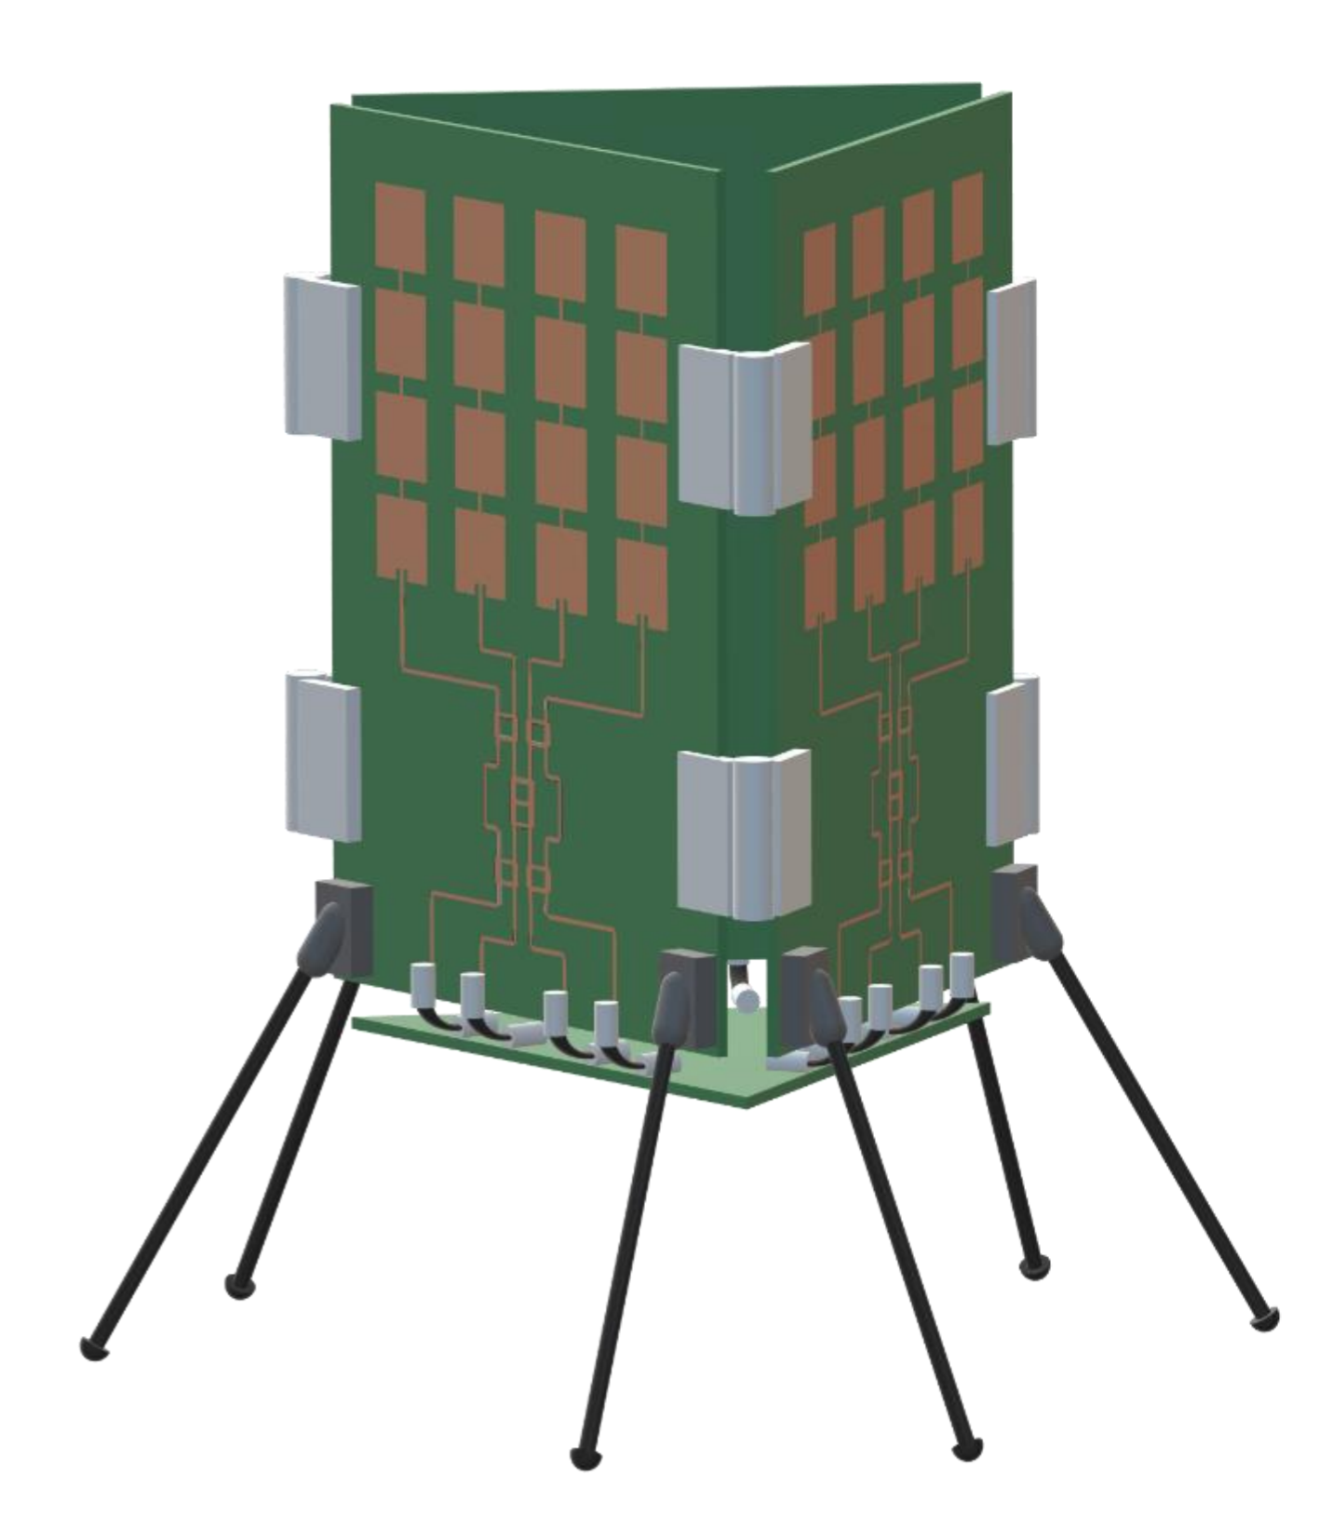
System Design
Front end:
Series-fed linear patch antennas
Butler matrices
Back end:
RF switch module
Wi-Fi module
MCU
Mechanical Fixture:
BNC connectors
Hinges
Mechanical supports

Slide 8
Schedule and Milestones
Task Building Blocks | Start Date | End Date | Task Lead
Design circuit topology for Butler matrix | November 9th | January 6th | Baris Volkan Gurses
Design/finalize patch antenna design | November 9th | January 6th | Lucas Wray
Simulate/optimize Butler matrix | December 15th | January 6th | Baris Volkan Gurses
Simulate/optimize patch antenna | December 15th | January 6th | Sarah Deitke
Write project proposal/summary | November 9th | November 15th | All
Create the PCB layout | January 6th | January 20th | Lucas Wray
Design the mechanical fixture | January 6th | January 13th | All
Fabricate/populate the PCBs | January 20th | February 17th | Sarah Deitke
Build the mechanical fixture | February 3rd | February 17th | All
Characterize the system | February 17th | March 3rd | All
System field tests | March 3rd | March 30th | All
Write final report | March 30th | April 6th | All
Create/rehearse oral presentation | March 30th | April 6th | All
Create the design expo demo/poster | April 6th | April 20th | All
Project demonstration | April 13th | April 13th | All
Participate in design expo | April 20th | April 20th | All

Slide 9
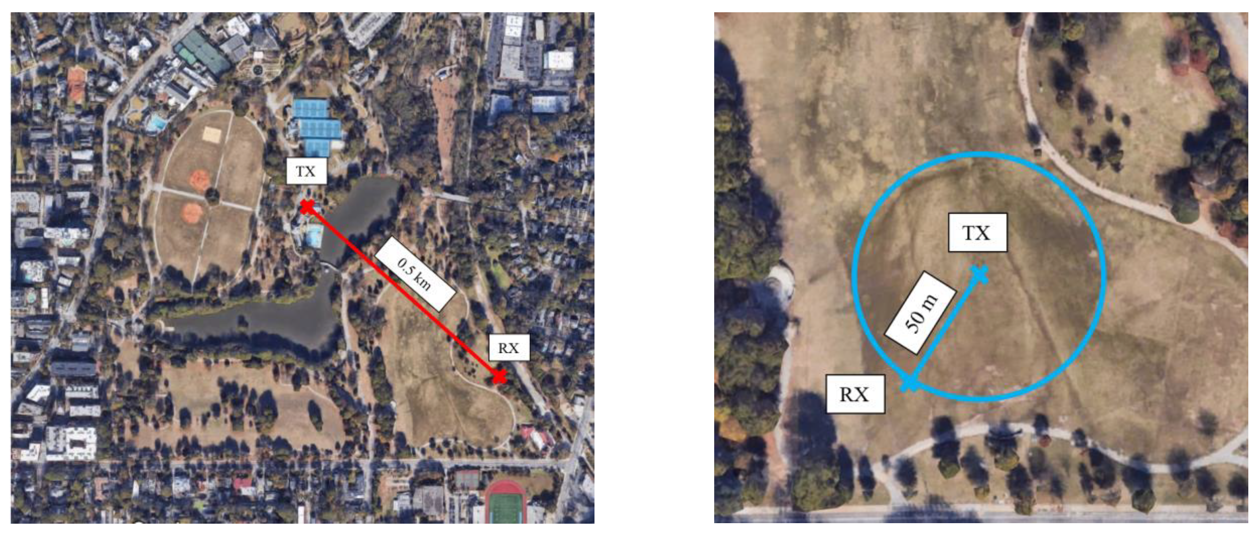
Project Demonstration
Range Demonstration:
Phased array and an off-the-shelf receiver with an isotropic gain of 17 dbm will be place 0.5 km apart.
Successful communication link will be tested.
Same test will be repeated by increasing the distance in 100-m increments.
Coverage Demonstration:
Off-the-shelf receiver will be placed 50 m away from the phased array.
Receiver will be moved around the phased array.
Successful communication link will be tested at each location.

Slide 10

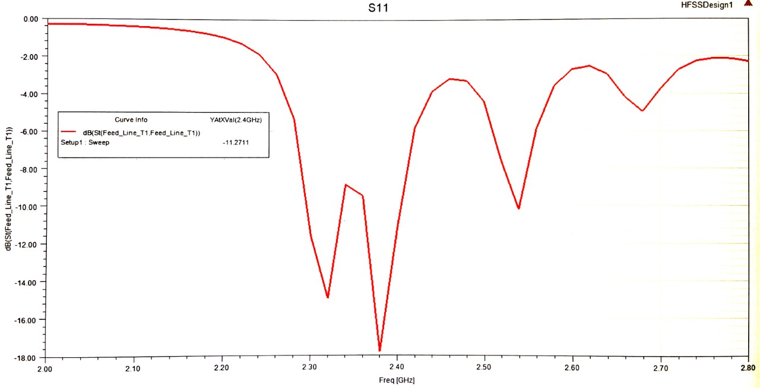
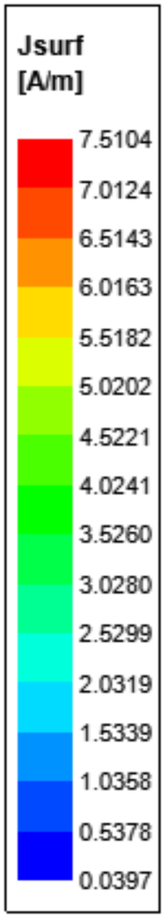
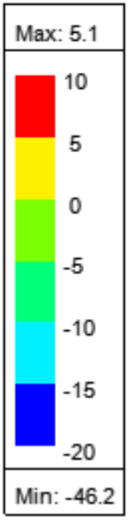
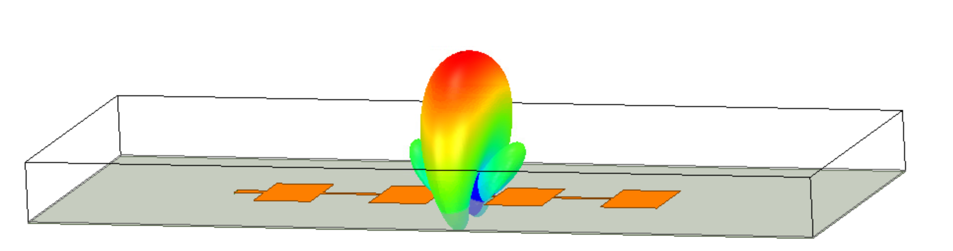
Current Status Patch Antenna Design
Optimize dimensions (gain, S11)
Chebyshev width tapering (SLL)
If BW < 100 MHz, explore other feed options

Slide 11
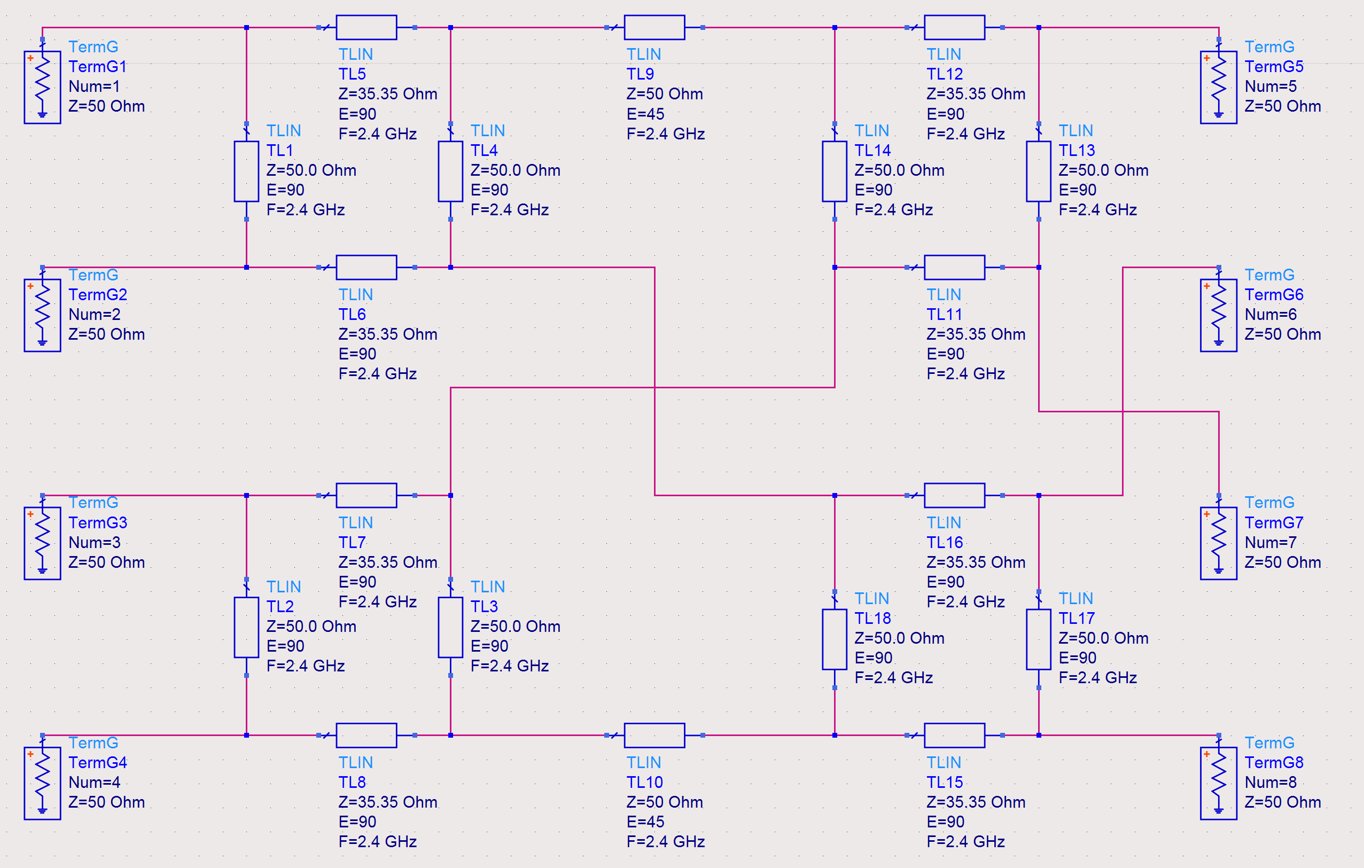
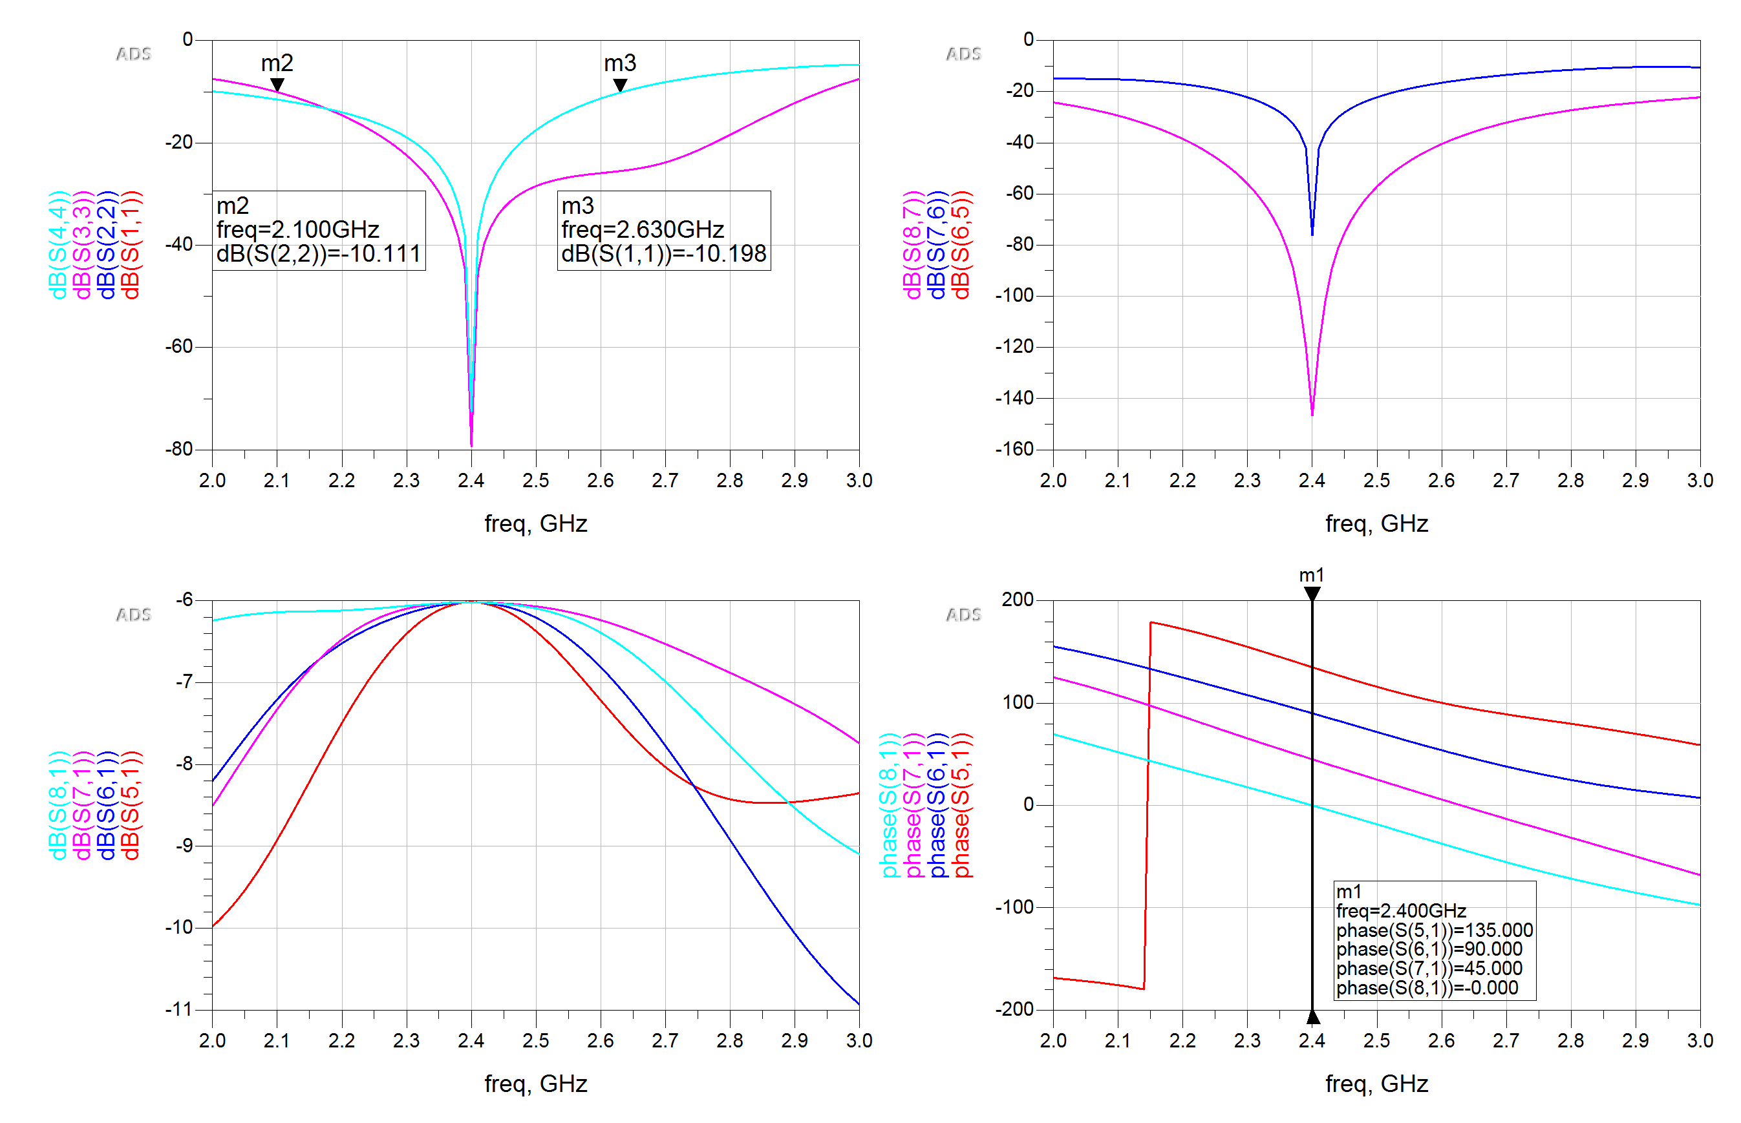
Current Status Butler Matrix Design

Slide 12
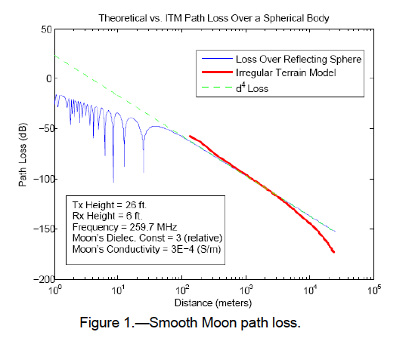

Current Status Lunar Propagation Model
d⁴ path loss exponent
Longley Rice Irregular Terrain Model modified to lunar surface
Recommended margin 15-20 dB of additional power

Slide 13
References
https://www.nasa.gov
https://ntrs.nasa.gov/archive/nasa/casi.ntrs.nasa.gov/20070025224.pdf

