Slide 1
AutoQuads Final Presentation
Spring 2020 Senior Design
Max Rudolph
Eddie Stevens
Dave Patel
Rishov Sarkar
Michael Bermudez
Nyaire Najieb
Suhani Jain
Notes:
Max

Slide 2
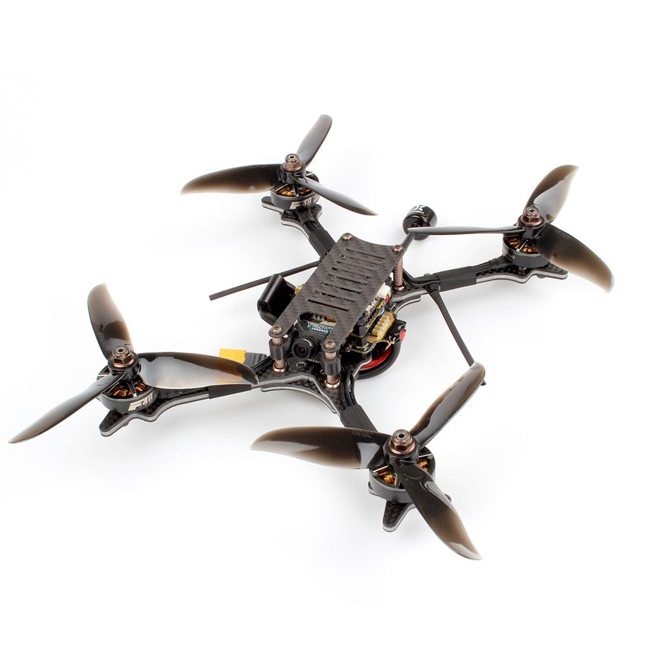
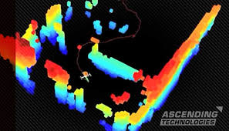
Our Original Goal
Build a drone that can autonomously fly through a racing course (with course knowledge apriori)
Notes:
Max

Slide 3
Our Revised Goal (Post COVID-19)
Have a drone “fly” autonomously using real-time computer vision and tracking
Simulate all the necessary components to deliver a final product
Prepare necessary software and hardware for next senior design team to start the the project right off the bat (without being delayed, like we were)
Notes:
Max

Slide 4
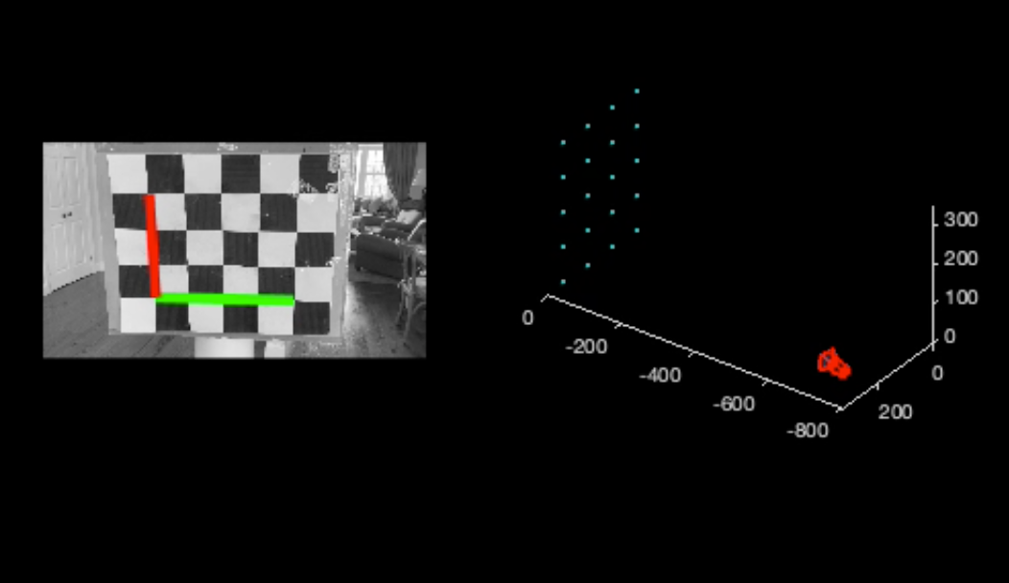
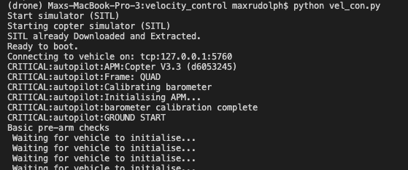
What we accomplished
Developed real-time computer vision localization scripts using MATLAB and OpenCV
Used localization to create velocity commands to direct drone to target
Implemented drone simulator that mimics the setup procedure of actual ArduPilot on drone
Built actual drone that takes off autonomously and loiters for commands
Notes:
Max

Slide 5
How have we measured success (post-COVID)?
Comparing CV computed path with dronekit simulator path
Our simulator can do take in position commands (absolute and relative), loiter commands, and velocity commands.
We relegated ourselves to just sending velocity commands to mimic real life drone control
Succeeded
Achieving possible real-time CV for drone implementation
Autonomous drone control is only possible in real-time
Reduce computation time for traditional CV methods which will allow for real time control of drone once the next team integrates the software
Succeeded
Notes:
Max

Slide 6
Drone Architecture and Software Stack
Notes:
Eddie

Slide 7
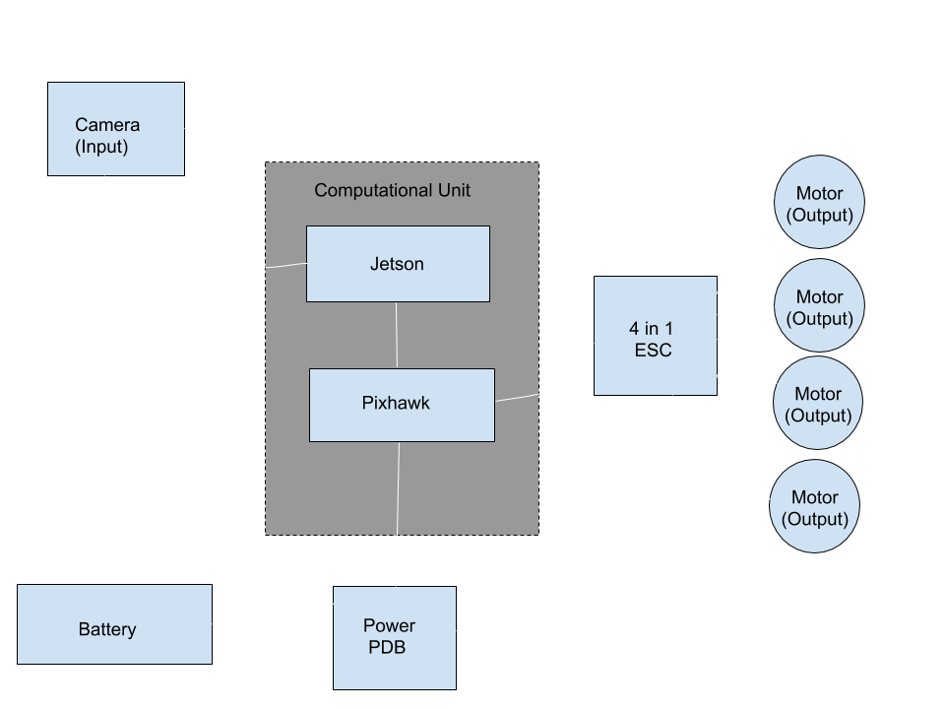
Proposed Flight System
Nvidia Jetson Nano: computer used to perform computer vision and path planning.
Pixhawk: flight controller to keep drone in air.
ESC: Electronic Speed Controller used to send signals directly to motor.
Notes:
Eddie

Slide 8
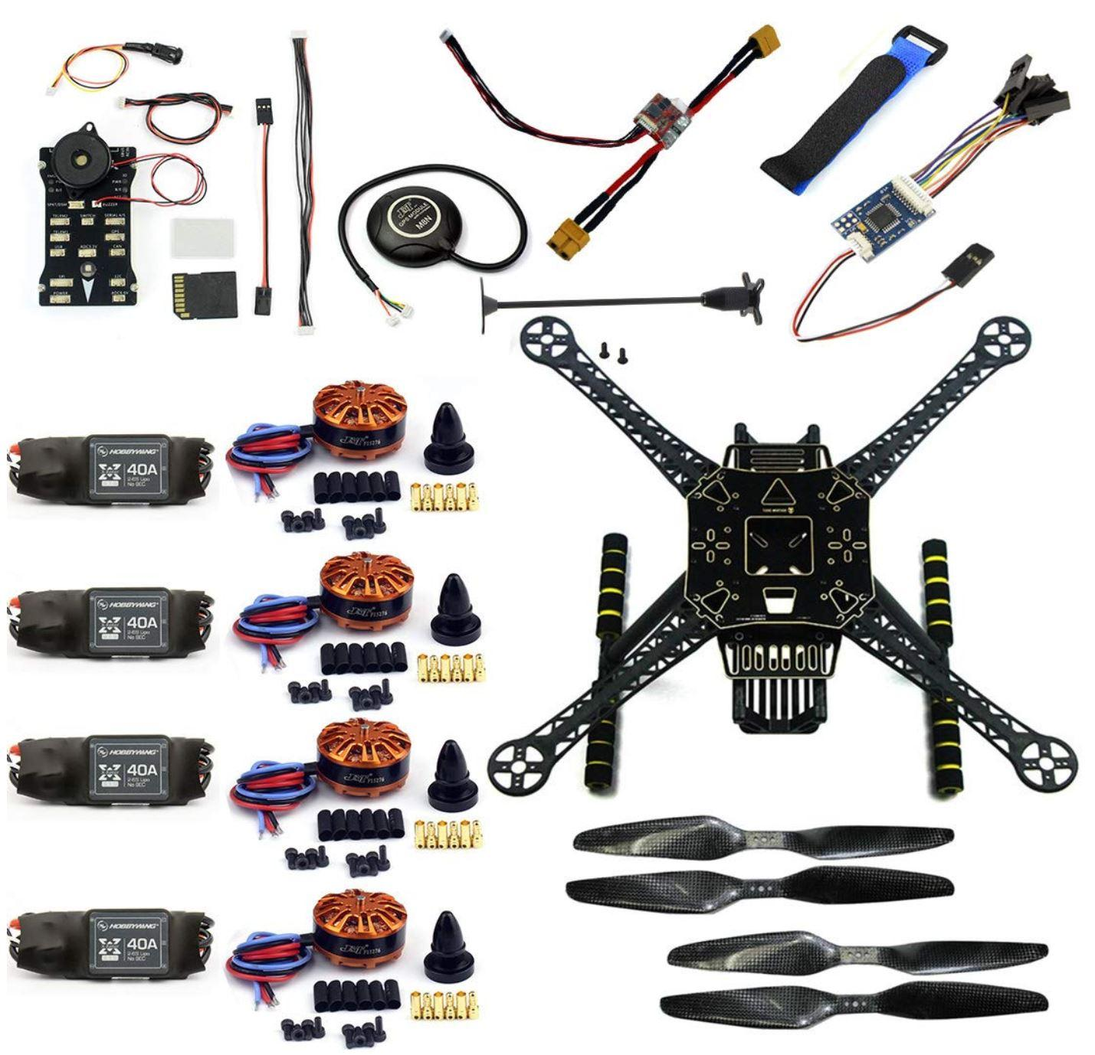
Hardware: Drone Kit
Most work on drone system will be in software, not hardware; perception, control, data networking, path planning
Drone kits are cheap, readily available, and reliable.
Individual parts can be swapped out if they break cheaply and with minimal effort
Notes:
Eddie

Slide 9
Computing Unit
Notes:
Eddie

Slide 10
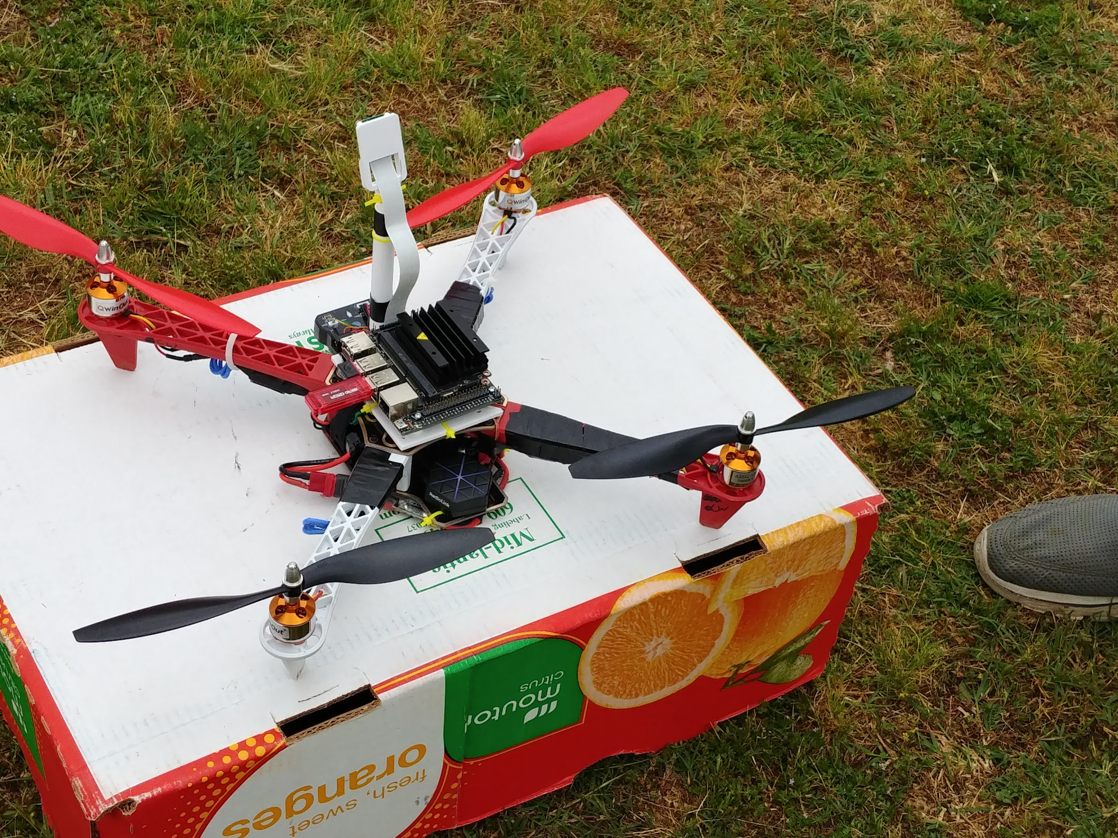
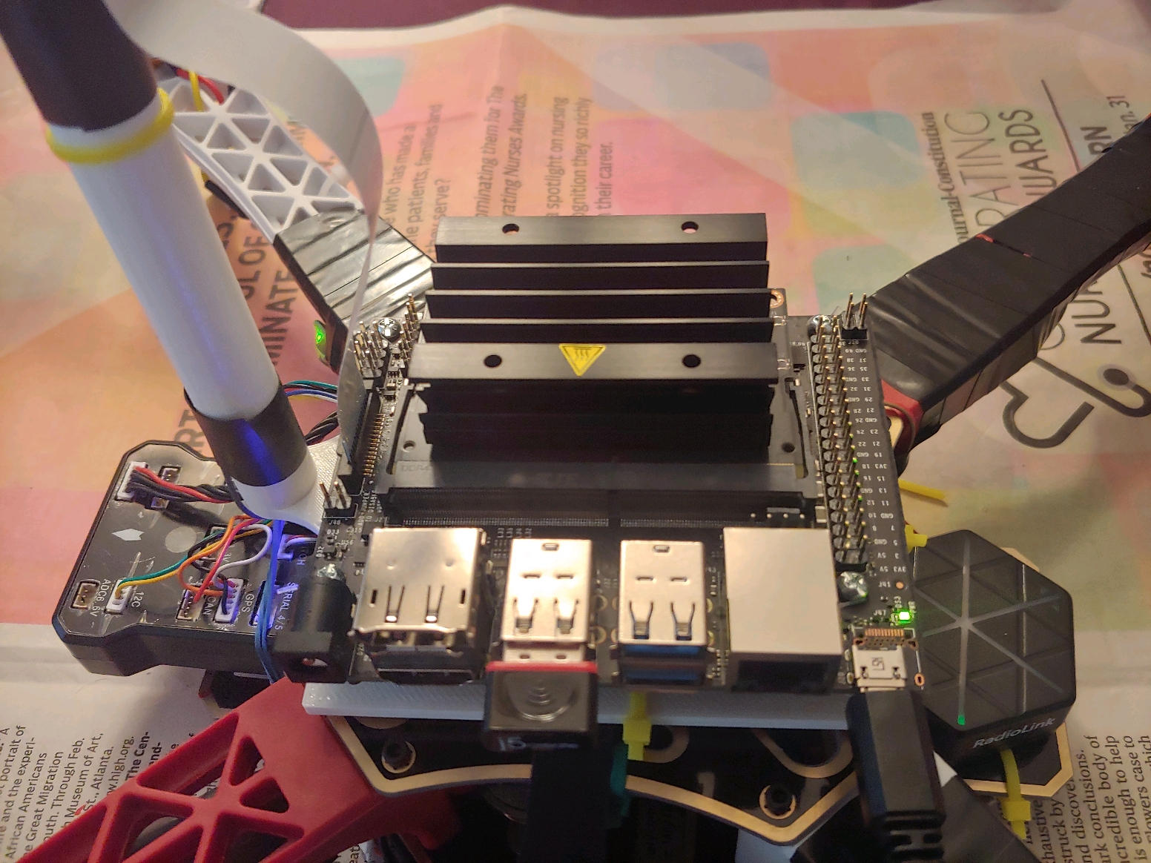
Final Build
Notes:
Eddie

Slide 11
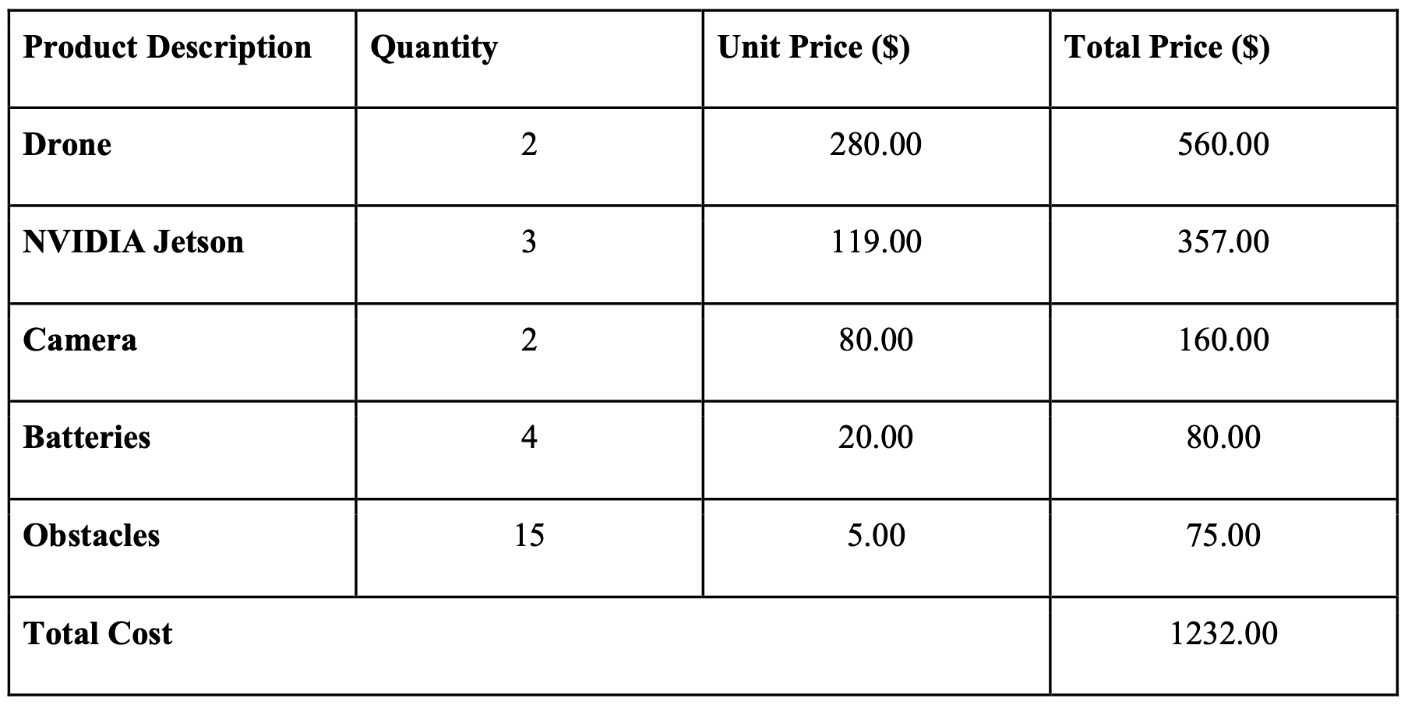
Estimated Cost
Notes:
Suhani

Slide 12
Capability Methodology and Demonstration
Notes:
Max

Slide 13
Methodology
Capture simulated video
Detect checkerboard of variable size in each video frame
In simulation this step is done at 60Hz but only needs to operate at max. frequency of 10Hz when implemented on the drone because flight controller cannot respond faster than 10Hz
Use MATLAB/Python to extract location/orientation data
Plot the calculated location for accuracy measures of drone simulator
From any given location, calculate and record velocity necessary to bring drone to target
Send real-time calculated velocities to drone simulator
Compare dronekit path to MATLAB path to ensure accuracy
Notes:
Max

Slide 14
Capture Real-Time Localization with Checkerboard
The localization present in the video was calculated in real-time at around 10 Hz.
Notes:
Max

Slide 15
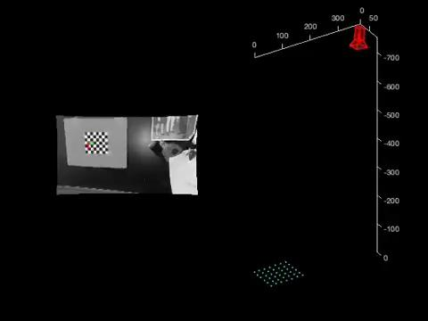
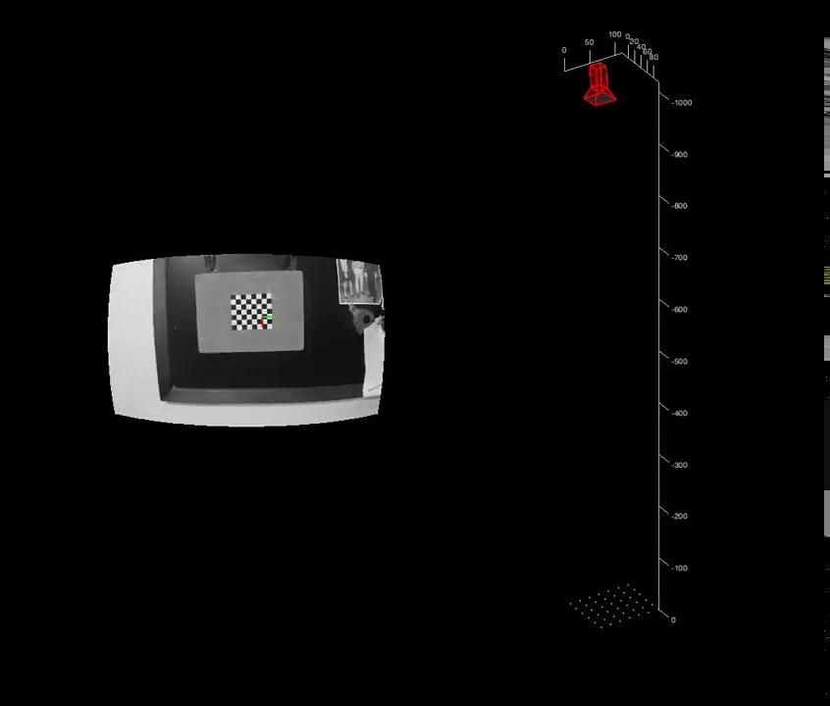
Versatility of Checkerboard Detection
Notes:
Max

Slide 16
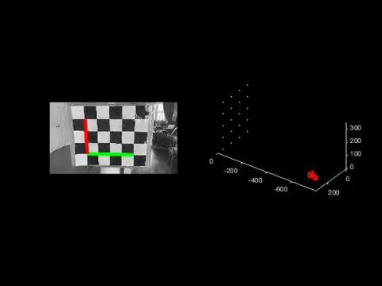
Simulated Drone Movement
Notes:
Max

Slide 17
Computed Drone Movement
Pink dots represent points at which drone velocities are calculated and sent to drone simulator (approx. 1 Hz)
Notes:
Max

Slide 18
Simulation Examples
Notes:
Max

Slide 19
Path of Simulated Drone Using Velocities from CV
Visualization of drone movement when velocities are put into simulator. Notice the matching between this plot and the previous plot
Notes:
Max

Slide 20
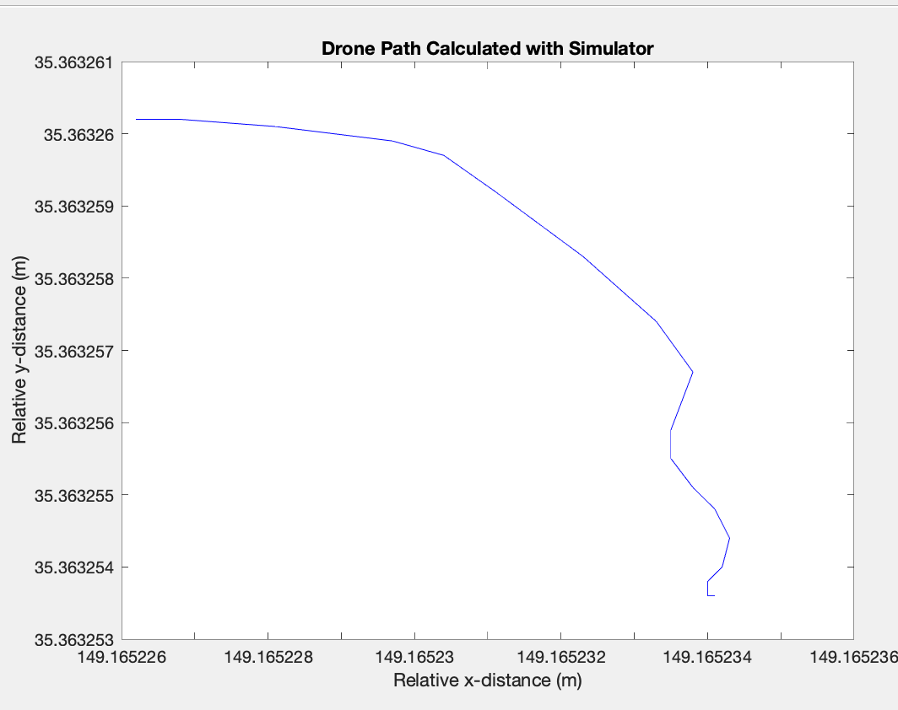
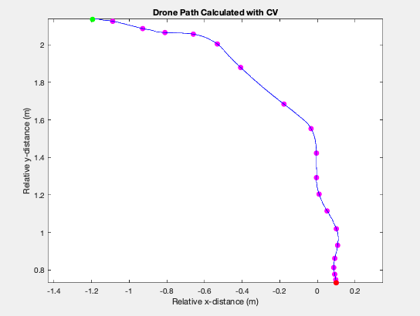
Side by Side Comparison of Drone Paths
Notes:
Max

Slide 21
Autonomy on Drone
Notes:
Rishov
Aside from computer vision, the other key component to our project is autonomy of the drone itself. If not for our constraints, we could synthesize both of these components to create a fully functioning project.

Slide 22
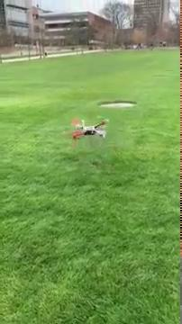
First Steps: Unstable Drone
Notes:
Rishov
At first, we had a lot of trouble trying to get the drone to fly in a stable manner. We spent quite a bit of time reading documentation and calibrating sensors in order to try to fix our stability issues.

Slide 23
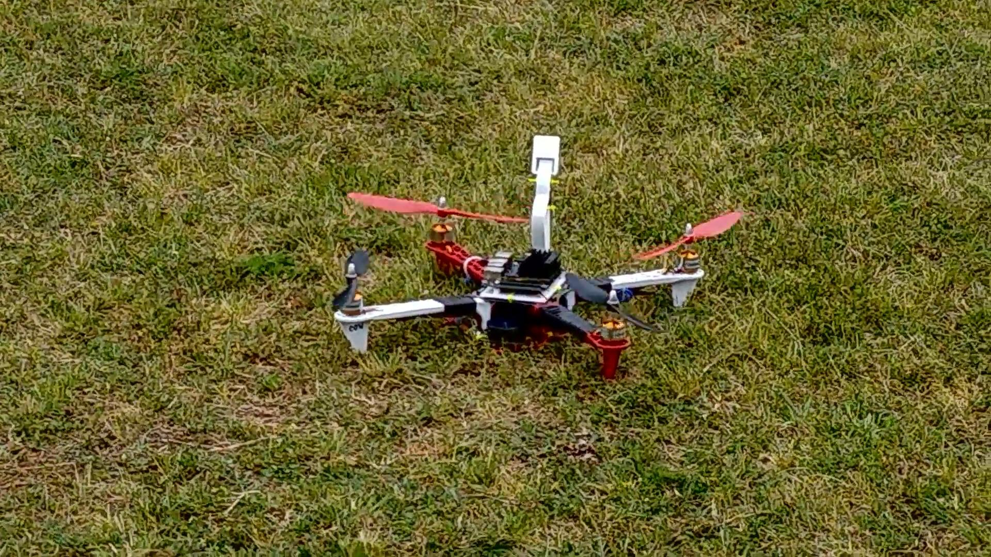
Self-Stabilization: Loiter Mode
Notes:
Rishov
Eventually, after fixing our propeller orientation, soft-mounting the Pixhawk, and moving wires to avoid compass interference, we were able to get the drone to stabilize itself. Here, we can see loiter mode in action, where the drone attempts to hold its altitude and position using barometer and GPS.

Slide 24
Autonomous Flight in Guided Mode
Notes:
Rishov
Finally, we were able to get the drone to fly fully autonomously. Here, we see the drone executing a set of preplanned steps in guided mode. Just like in the simulations, we could have programmed the Jetson to send MAVLink commands to the Pixhawk in order to compute a flight path in real time.

Slide 25
Footage from Drone
Notes:
Rishov
Here, we can see the footage captured from the camera on the drone. The drone is able to capture footage at 720p resolution and 120 frames per second. We would have piped footage like this into our real-time computer vision algorithms in order to track visual fiduciaries, compute the drone’s pose, and autonomously control the drone’s flight.

Slide 26
Potential Final Product
Given our separate demonstrations for object detection and issuing flight commands, we have laid the groundwork for an autonomous drone.
Future teams could utilize our real-time localization scripts to generate appropriate velocity commands, then use the MAVLink protocol to send the commands to the flight controller. We proved the concepts; they just need to be fully integrated on the drone!
Notes:
Dave

Slide 27
Reflection and Mistakes
Project scope too large
Honing in on a single aspect such as CV and path prediction would have been better
Having a single Jetson cause delays
A second jetson would have allowed for prototype/testing CV algorithms without having drone on hand
Too much time on drone hardware, not enough time on CV
A well established detection and path planning algorithm would have been of greater use to future groups. Our understanding of the drone hardware-software only helped us at the beginning.
Lack of clarity on amount of software and hardware integration needed
Notes:
Dave

Slide 28
Future Team Expectations
Integrate drone localization into actual drone
Add more autonomous functionality: path planning and execution
Add computer vision software to enable the camera do detect and recognize objects
Ability to prevent collisions and re-adjust course with object detection
After accurate detection is achieved, strive for higher flight velocities
Attempt a drone race course once the software is fully integrated and optimized
Multiple or better cameras could be added, for better field of view. This would allow for better forward navigation and obstacle avoidance.
Notes:
Suhani

Slide 29
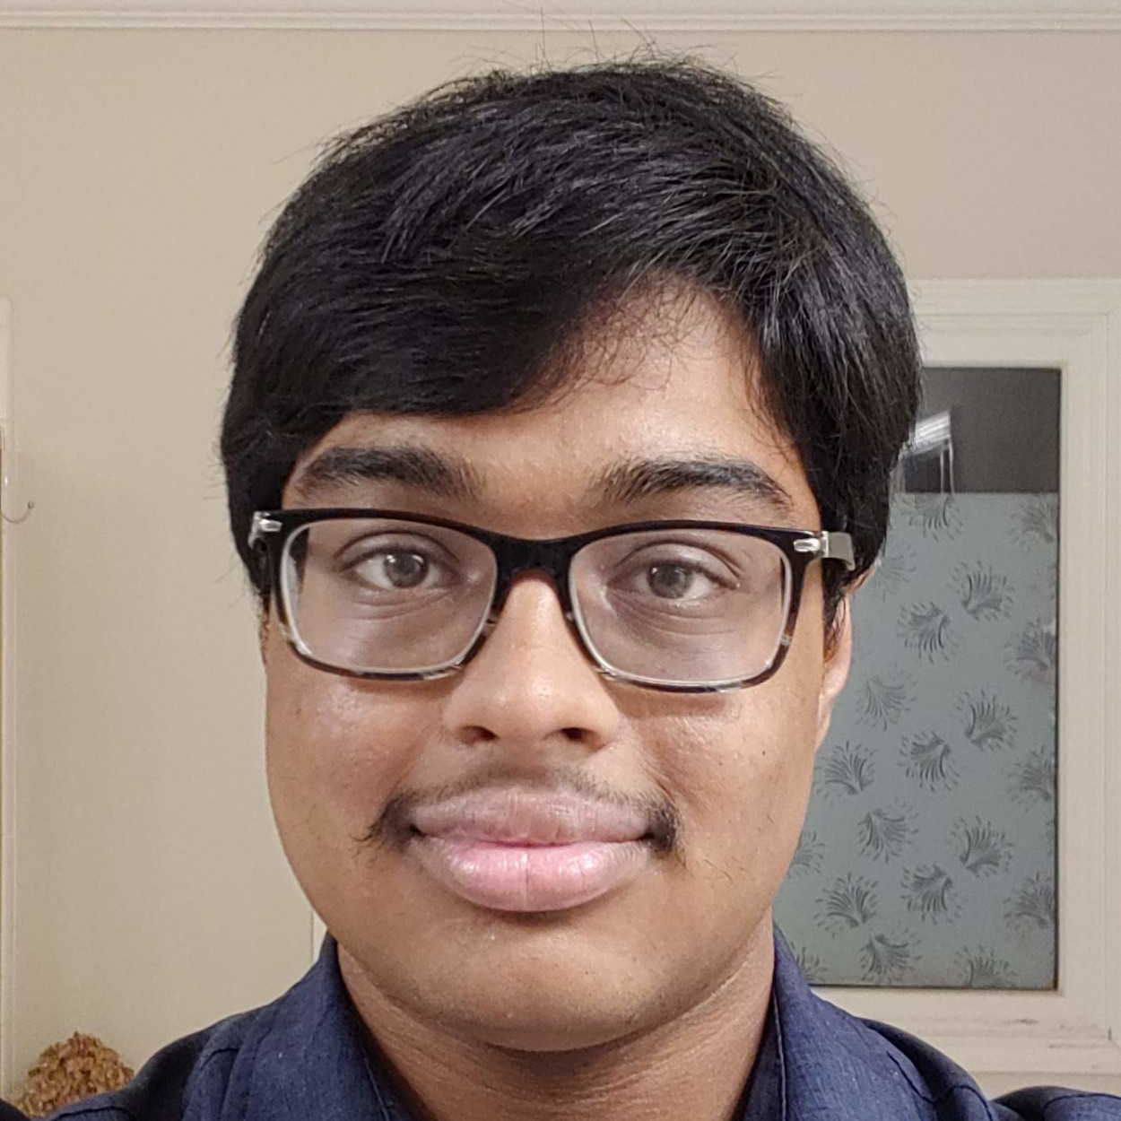
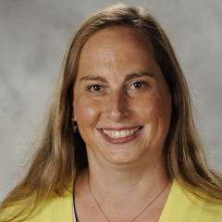
Team Members
Max Rudolph
Eddie Stevens
Dave Patel
Rishov Sarkar
Michael Bermudez
Nyaire Najieb
Suhani Jain
AutoQuads Team 33
Advisor: Dr. Jennifer Hasler
Notes:
Suhani

