Slide 1
AutoQuads Overview

Slide 2
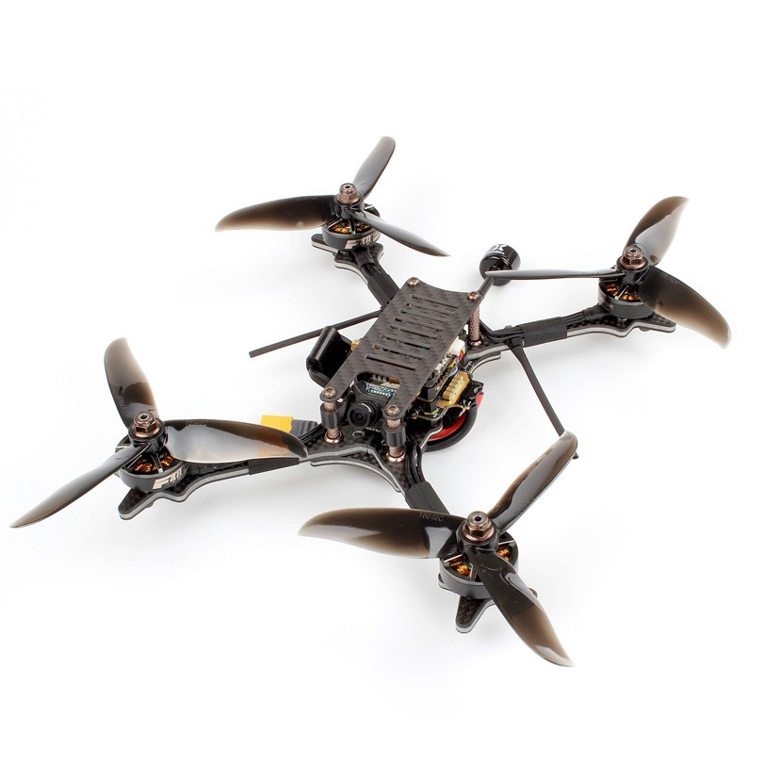
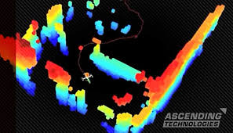
Our Goal
Build a drone that can autonomously fly through a racing course (with course knowledge apriori)

Slide 3
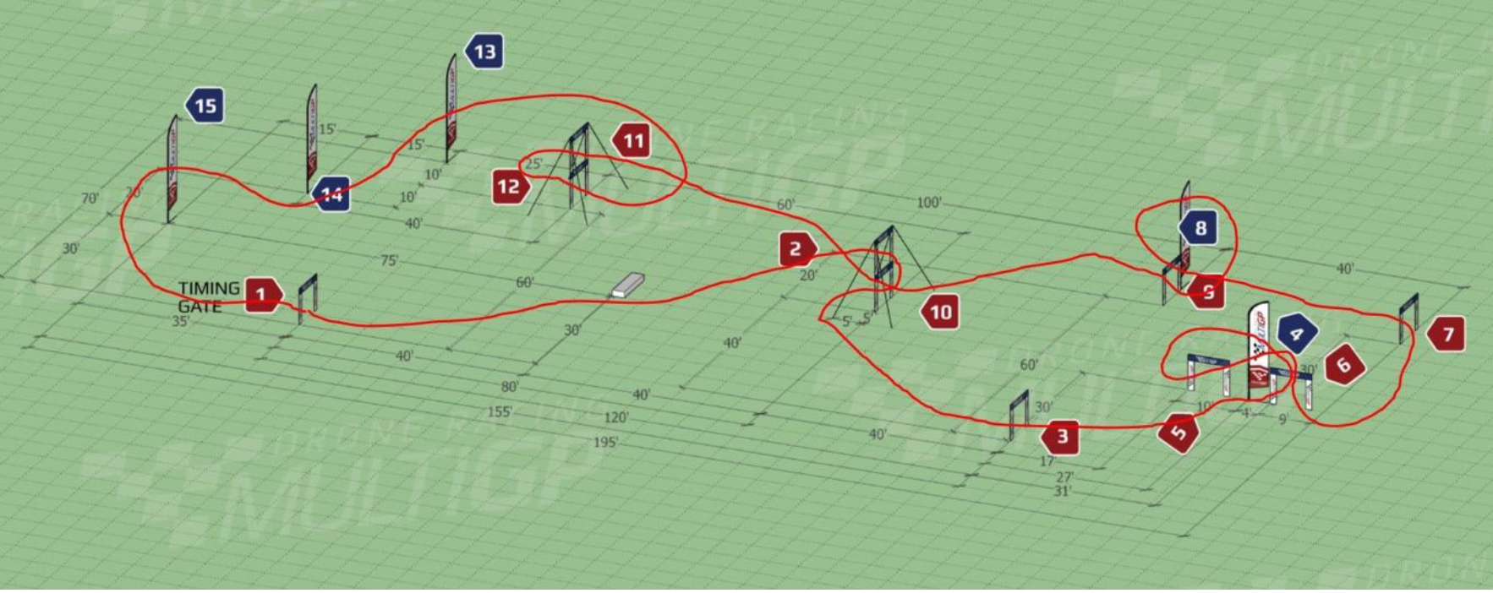
Possible Race Track

Slide 4
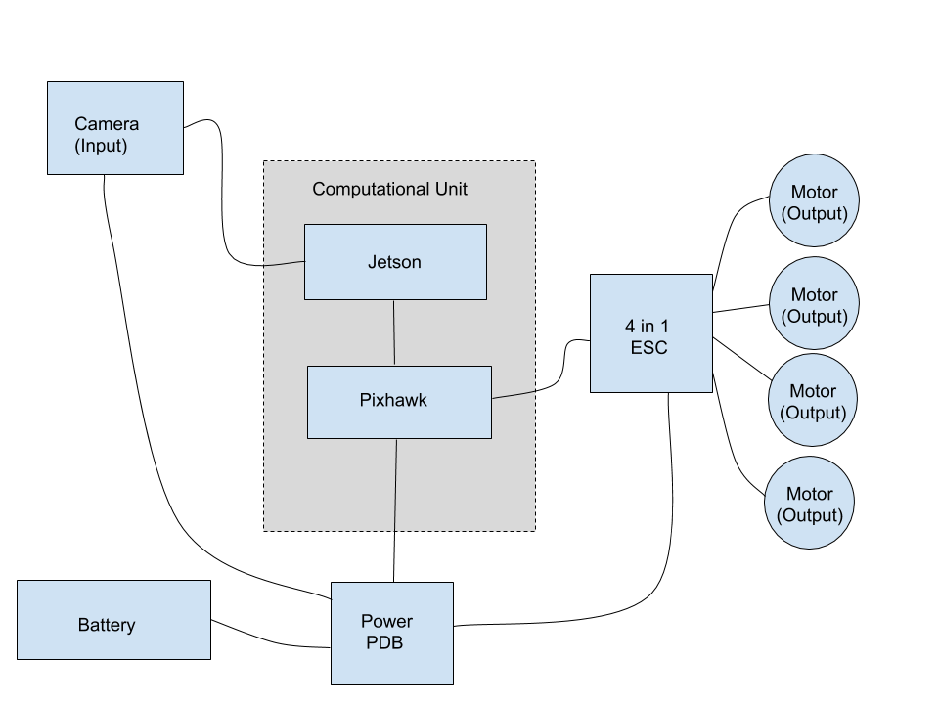
Proposed Flight System
Nvidia Jetson Nano: computer used to perform computer vision and path planning.
Pixhawk: flight controller to keep drone in air.
ESC: Electronic Speed Controller used to send signals directly to motor.

Slide 5
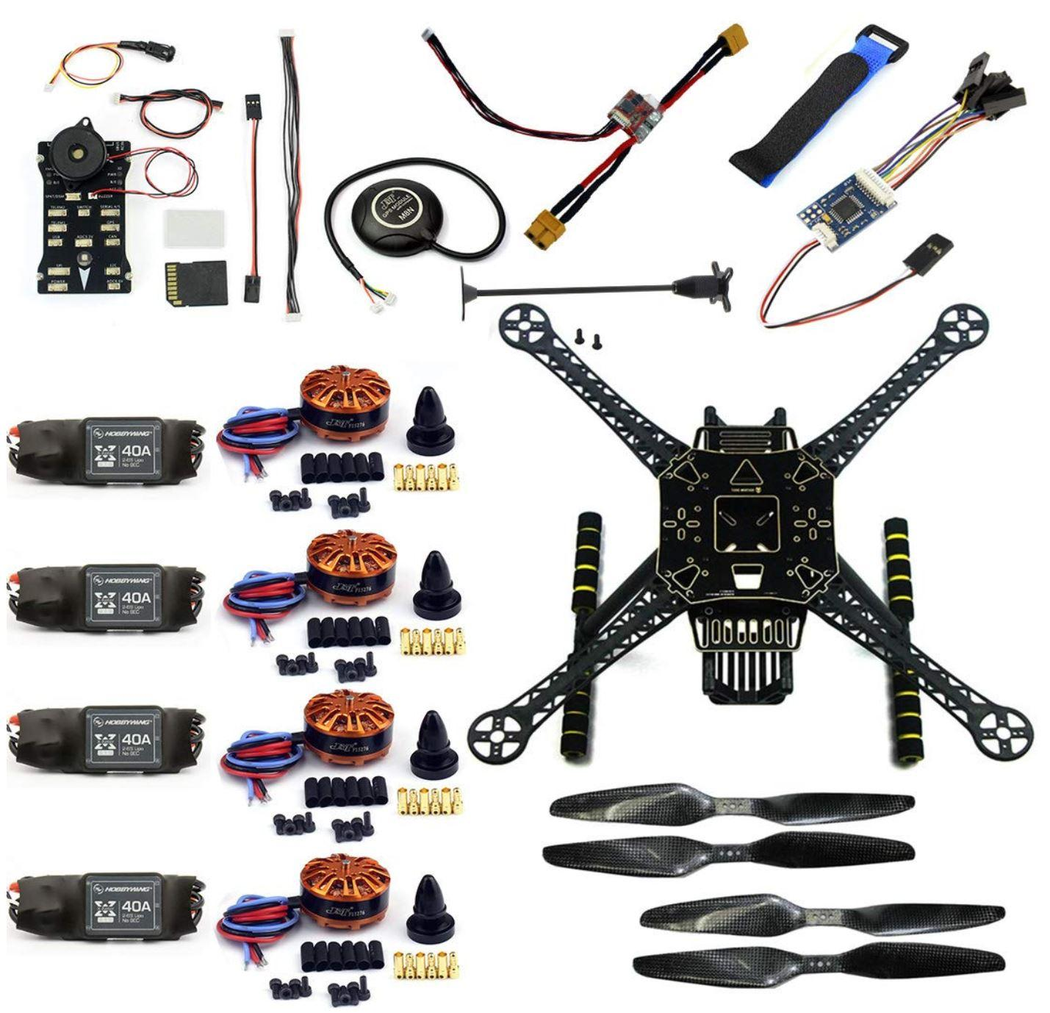
Hardware: Drone Kit
Most work on drone system will be in software, not hardware; perception, control, data networking, path planning
Drone kits are cheap, readily available, and reliable.

Slide 6
Computing Unit

Slide 7
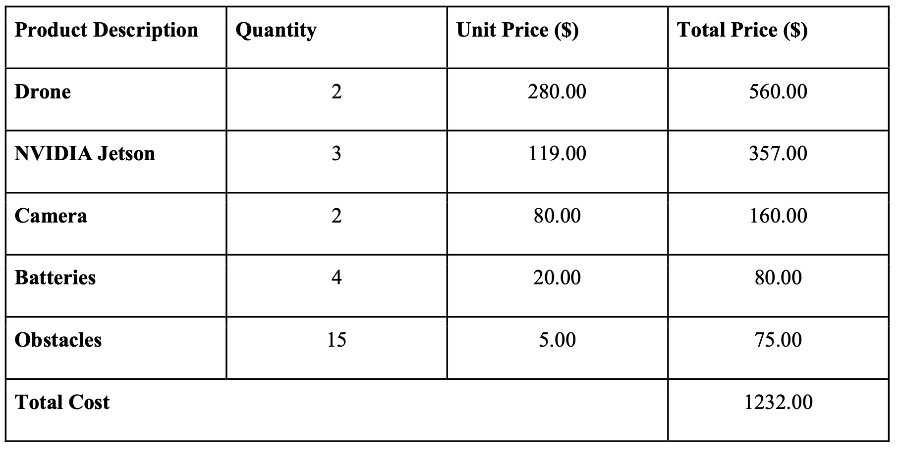
Estimated Cost

Slide 8
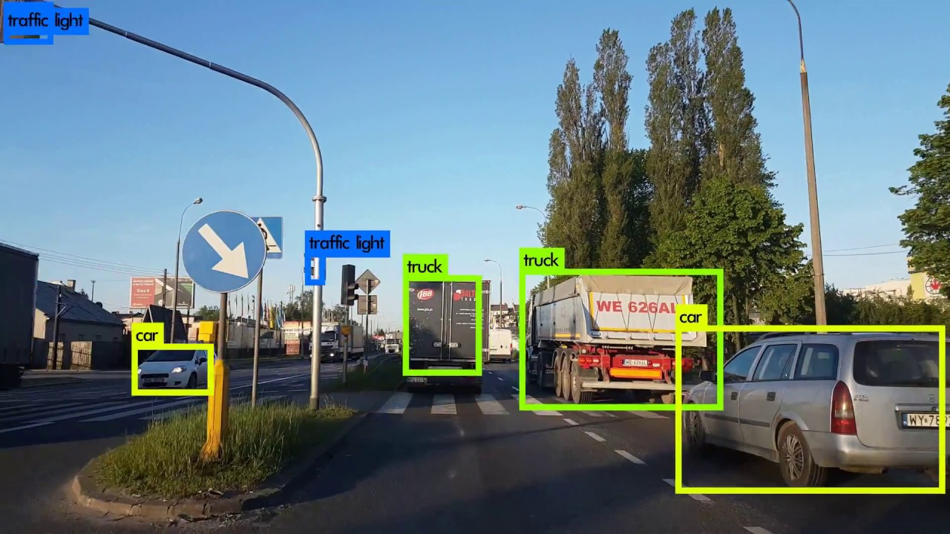
Machine Vision
OpenCV algorithms used on the Jetson will detect and locate objects in the drone’s reference frame.

Slide 9
Path Planning
Using a Model Predictive Controller, like AutoRally’s MPPI, and the obstacle locations, the Jetson will compute possible trajectories and choose the best one

Slide 10
Team Members
Max Rudolph
Eddie Stevens
Dave Patel
Rishov Sarkar
Michael Bermudez
Nyair Najieb
Suhani Jain
AutoQuads Team 33
Advisor: Dr. Jennifer Hasler

