Slide 1
Music Synthesizer
With FPAAs
Members:
Chris Walds, EE, cwalds3@gatech.edu Kristyn DiGiovanni, CmpE, kdigiovanni3@gatech.edu
Harrison Zhang, EE, hzhang462@gatech.edu Sriram Pulavarty, EE, spulavarty3@gatech.edu
Jongheon Park, CmpE, jpark802@gatech.edu Yewon Kim, EE, ykim728@gatech.edu
Justin Kelley, CmpE, jkelley1@gatech.edu

Slide 2
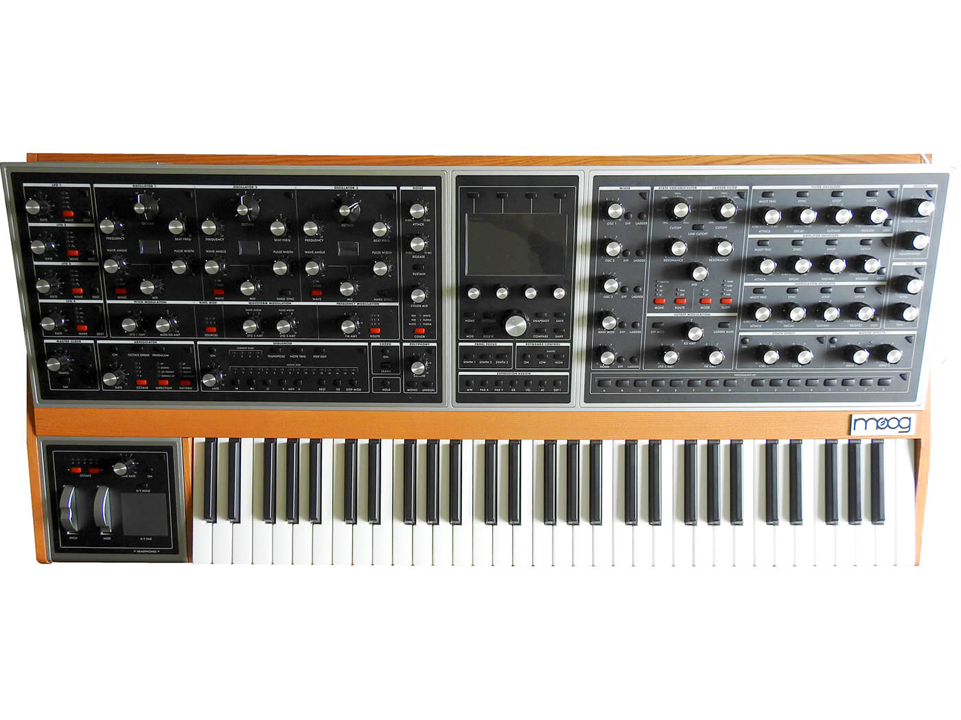
GOAL: To develop a low-power music synthesizer that leverages FPAA technology.
Notes:
Why are we creating this? Low Power, High-Level Programmability

Slide 3
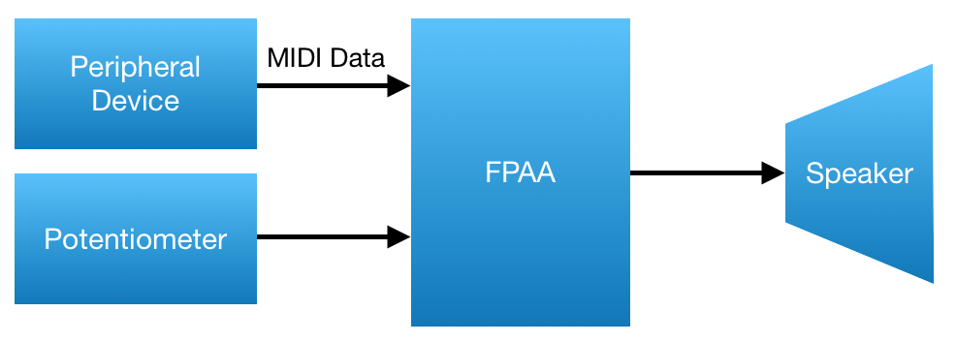
Potential High-Level Approach

Slide 4
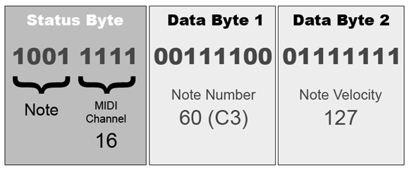
MIDI Conversion Using Assembly
MIDI Data Format
Notes:
MIDI in Byte Form, Using this Format to Code the FPAA in assembly

Slide 5
Alternative to using Assembly for MIDI Conversion
MBED Converts MIDI Signal
Notes:
Alternative for MIDI conversion is using the MBED to do so instead of using Assembly in the FPAA

Slide 6
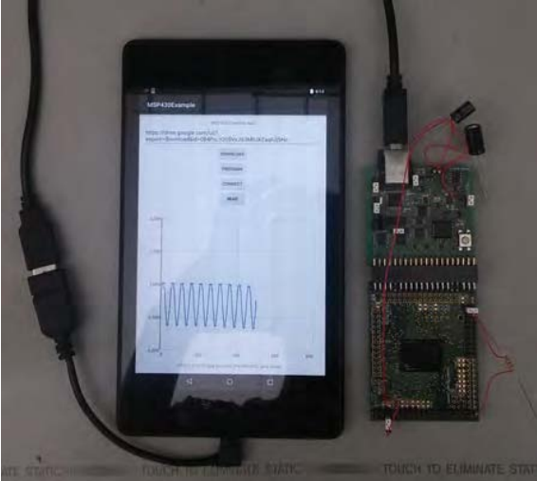
Sources of MIDI Generation
MIDI Keyboard
Android Application

Slide 7
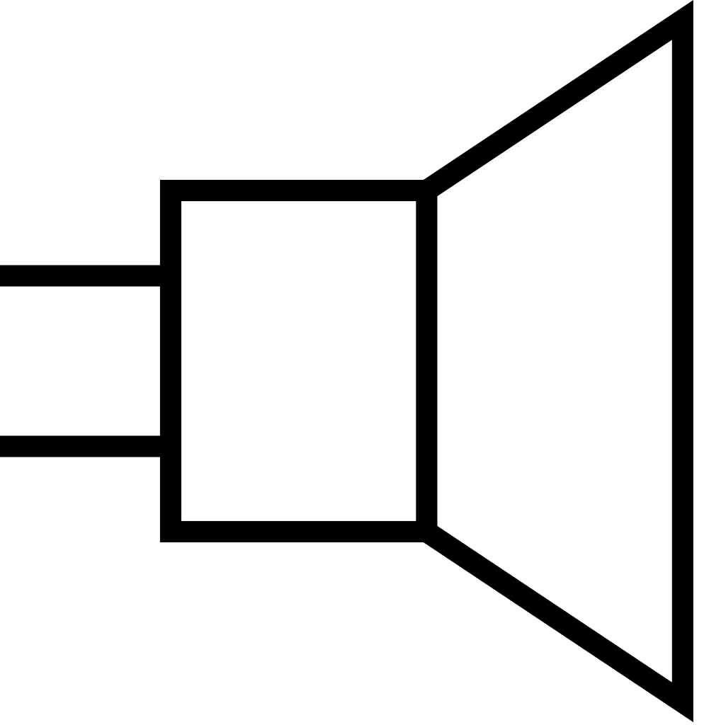
Project Demo Idea
MIDI Keyboard
FPAA
Speaker
Notes:
Project DEMO Idea given MIDI conversion information.

Slide 8
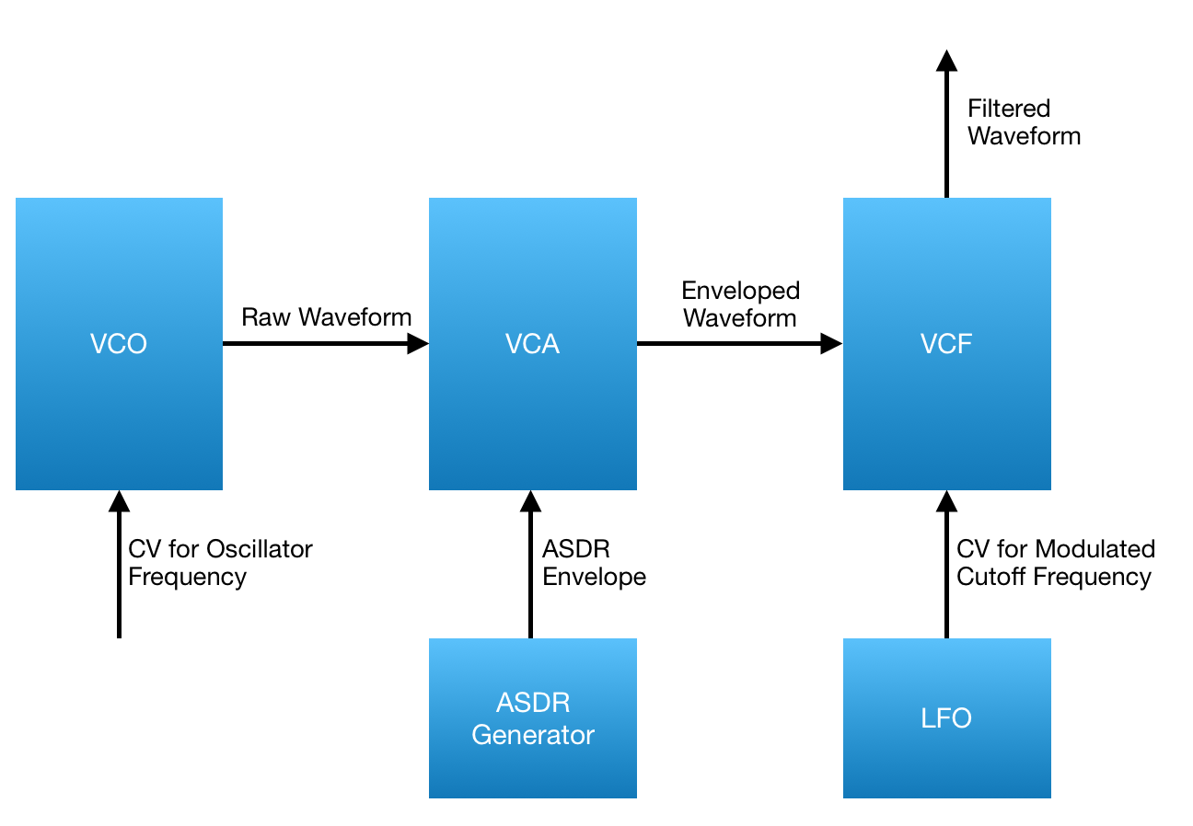
Music Synthesizer (Subtractive)
Vref, Vcsi, Vtri
V1p, v1n, v2p, v2n
Output Sound
MIDI Conversion to Square Wave
Square Wave
Tri Wave
Square Wave, Vrt, Vft, Vctrl

Slide 9
Transistor Level Diagrams
Voltage-Controlled Oscillator
ADSR Generator
Voltage-Controlled Filter
Voltage-Controlled Amplifier

Slide 10
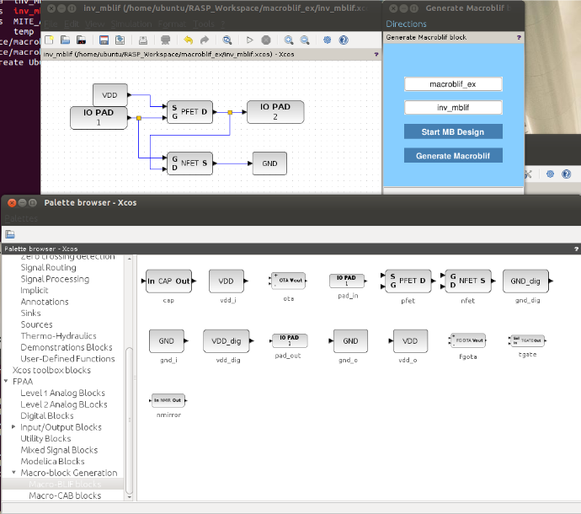
FPAA Programming Interface
Macro-Block Generation
Notes:
How we are programming the FPAA

Slide 11
Current Progress
Started Marco-Block Generation for VCO, VCA, and VCF.
Having compilation issues with XCOS / RASP Tools
Finished ASDR Marco-Block Generation and have begun testing voltage input values.

Slide 12
Proposed Timeline
Manually test individual blocks via debug hard/software
Use the on-chip
MSP430 to
process MIDI data
Verify system functionality and develop a working demo (possibly with smartphone app)
Verify Block
Functionality
2/4/20
Program MIDI
Decoding
3/3/20
Finalize tests
and demo
4/2/20
1/23/20
Finish Macroblocks
2/11/20
Assemble Macroblocks
3/19/20
Integrate Hardware
(CSI, VCO, VCA, VCF, ADSR)
Finalize the high-level design
Assemble individual components and debug

