Slide 1
Monocular Visual Odometry on Blimp Platform
with Noisy Image Stream
Senior Design Team XXLs

Slide 2
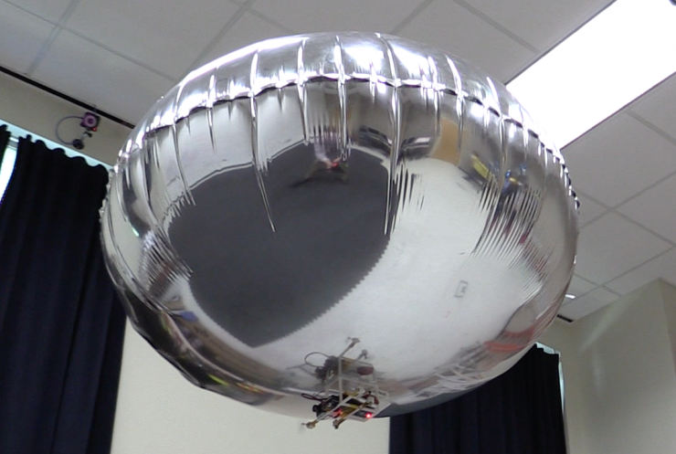
Real-life Problems and Motivations
The current blimp platform does not have a localization capability without opti-track system
The dynamics of the blimp platform is unique and ruled out easy vo implementation
Carrying capability of the blimp limits the camera that provides high quality images
Where am I?
We would like to extend the blimp localization capability outside the lab given the blimp dynamics and hardware limitations
Notes:
Note: Elaboration on what is “Unique”?
The team starts from considering the advantages and shortcomings of the blimp in the lab. Compared with other indoor aircrafts like drones, the blimp has several advantages including long operation hours and friendly human interaction. While Currently, the blimp platform lacks the capability of localization without the opti-track system in the lab. The dynamics of the blimp platform is unique which makes the visual odometry implementation not easy. Moreover, the carrying capability of the blimp is limited, like 70 grams in total, and it prevents to team to choose a camera that provides high quality images.
Given the blimp dynamics and hardware limitations discussed before, we consider that equipping the blimp with a visual odometry system will extend its localization capability.

Slide 3
Real-life Problems and Motivations Cont’d
Possible Applications with a VO pipeline:
Automatic Navigations
Blimp Tour Guide
Warehouse Surveillance
Human/Robot-Robot Interaction
Swarm Blimps
Tool Delivering
With the current situation, we could let blimp guide people at COVID-19 testing locations.
Notes:
Note: Elaboration on what is “Unique”?
When the blimp is equipped with a VO pipeline, it can be applied to some real-world scenarios.. Automatic navigations become possible since the blimp has a long operation hours and now it can localize itself. A blimp can serve as a tour guide and offers routing to visitors. Or it can be utilized in warehouse surveillance by reaching out to every possible space in large indoor warehouse area. The blimps also has more potentials in human-robot or robot-robot interaction, researches in swarm blimps is one of them. If the carrying capability can be improved, we can make the blimp do tool delivery, too.
With the current situation, we could let blimp guide people at COVID-19 testing locations.

Slide 4
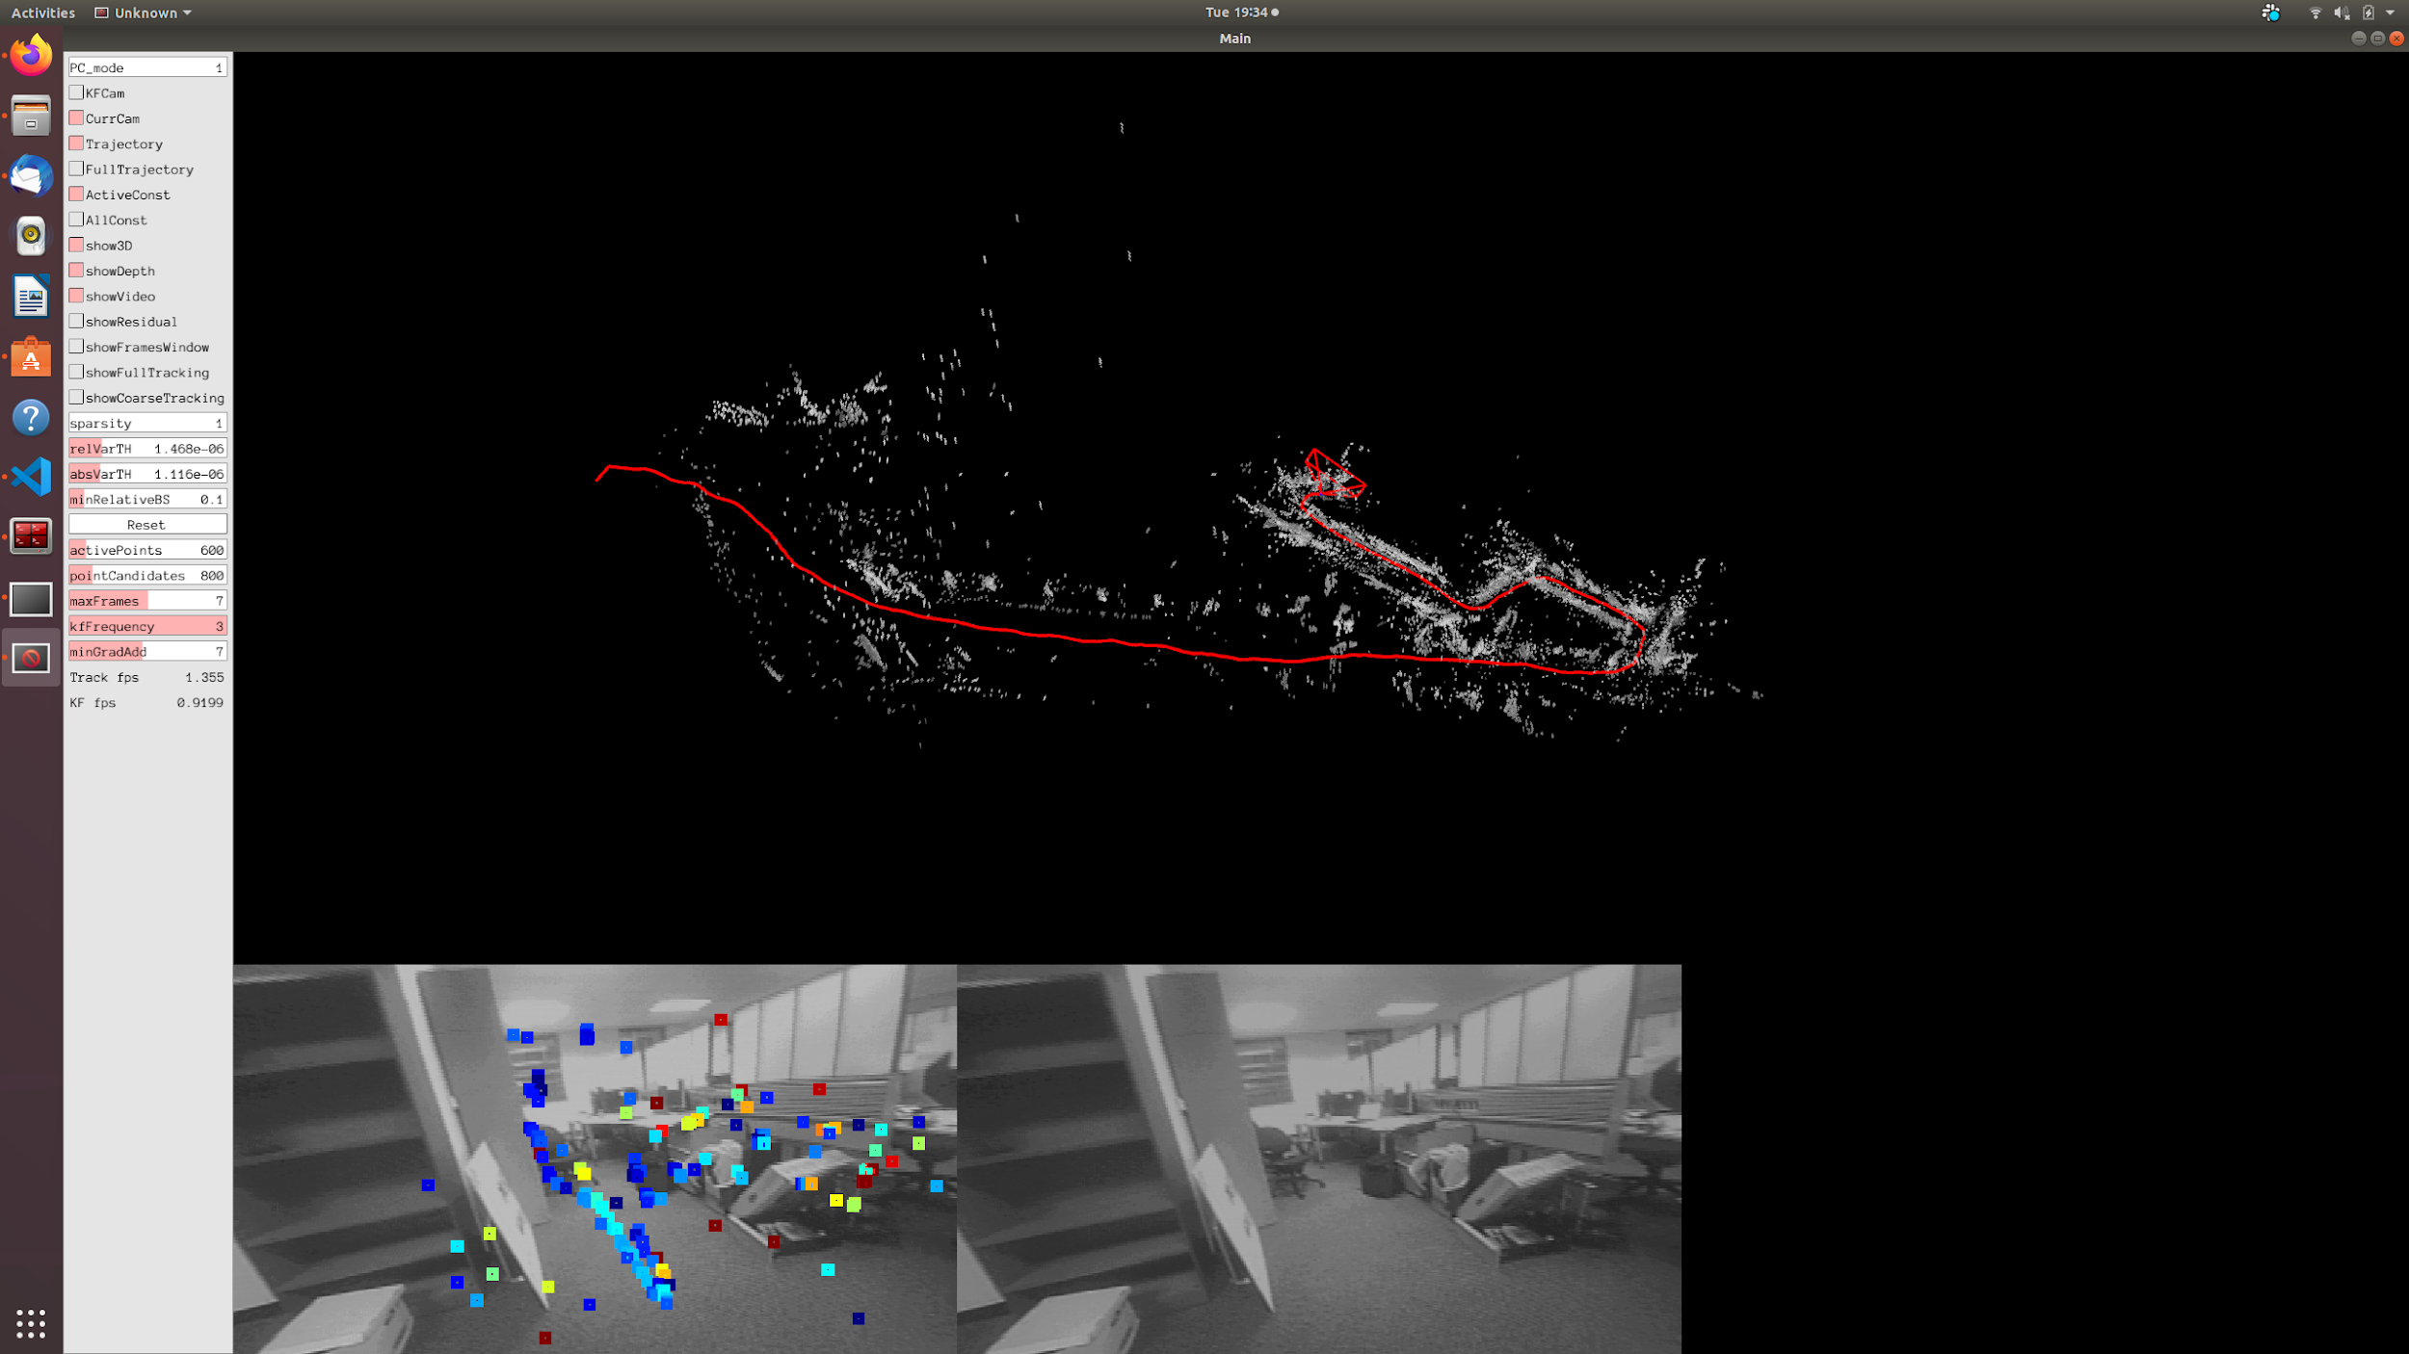
Goal
Deploy and achieve accurate (robust) visual odometry on Blimp, given the constraints of camera image quality and the platform dynamics characteristics.

Slide 5
Project Deliverables
A ROS pipeline for blimp to perform visual odometry on the blimp, including:
Noise reduction of camera stream and rejection of unrepairable image frames
Calibration of Fisheye Camera
Visual Odometry and Studies on Different Methods
Visualization of trajectory
Benchmarking
Also, we would like to share lessons learned from the project
Notes:
I suggest we should use figures like next slide instead of this one.

Slide 6
System Structure and Project Deliverables
Deliverable
Realtime
Noise Reduction and Rejection
Fisheye Camera Calibration
Visual Odometry
Visualization in ROS
Offline
Benchmarking
Notes:
This diagrams shows the structure of our VO system on the blimp. The VO ROS pipeline consists of five nodes as project deliverables. It starts with the Noise reduction of camera stream and rejection of unrepairable image frames, then correcting image distortion with the calibration of fisheye camera. After that, we perform VO on processed image stream and evaluating system performance through offline benchmarking. The last node is to visualized the blimp trajectory on ROS, providing a straightforward demonstration of its localization capability.

Slide 7
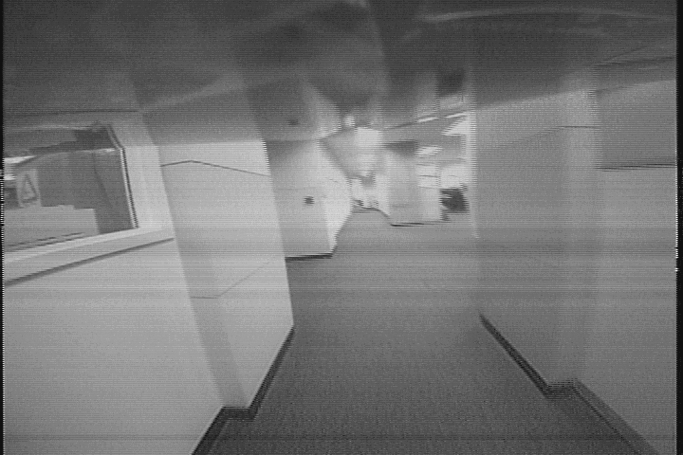
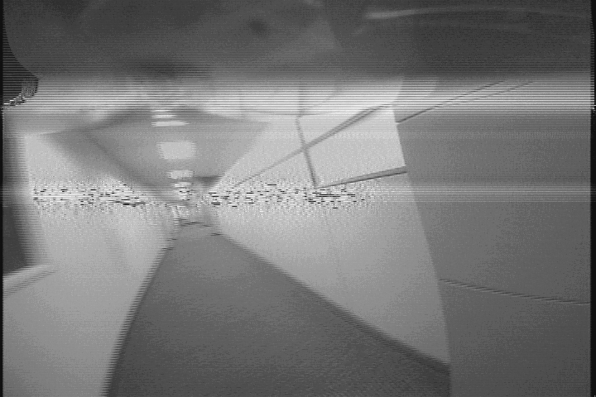
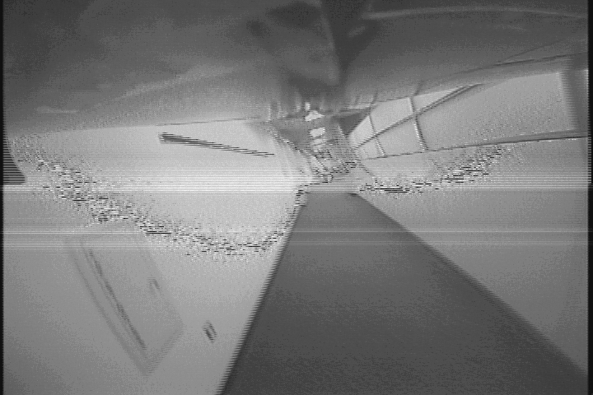
Noisy Images
~25% of the image from Analog camera is noisy (on a 4000 images dataset)
Will break feature tracking
Need rejection on highly noisy image and filtering on all other images
Notes:
why:
1.noises are not features → break feature tracking
2. 25% of the collected image are noisy ~ 1000

Slide 8
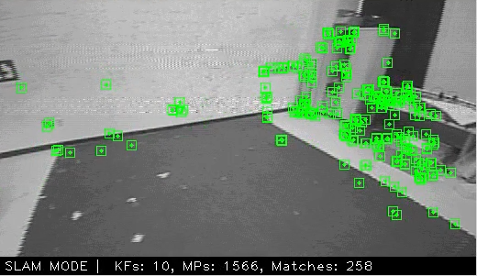
Typical Bad Features on Noisy Images
Noise Induced
Exposure / Lights Induced
Aliasing Induced
3
1
2
Notes:
image pixels that contains noise
the exposure of the image is not uniform on the surface with same color
zig-zag shape around the edges of the object

Slide 9
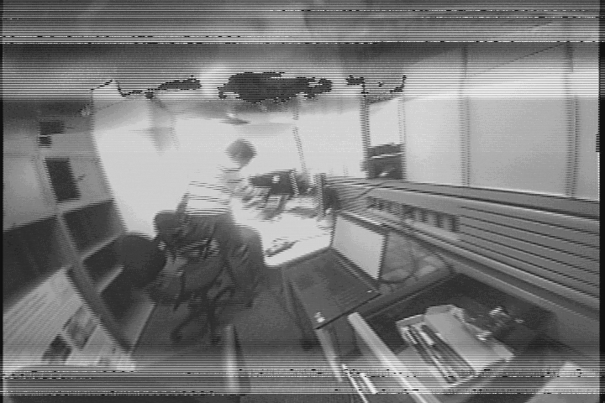
Dealing with Noisy Images
Image Reconstruction
Apply Fourier Transform
Noise Detection and Rejection
Segment image horizontally
Variance Estimation with vertical Gaussian kernel ([[2], [-4], [2]])
Methods tried but poor performed
Erosion
SVM with different kernels (MSE, Entropy)
Deep Learning Image classifier
Noise is appearing with little pattern!
Notes:
solution:
noise detection and reject highly noised images
noisy image reconstruction for less noisy images

Slide 10
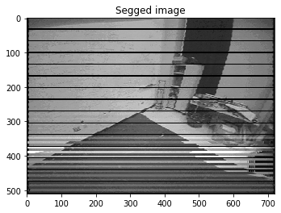
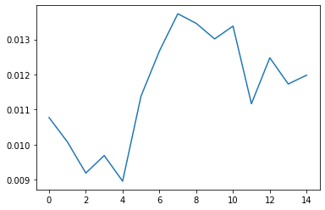
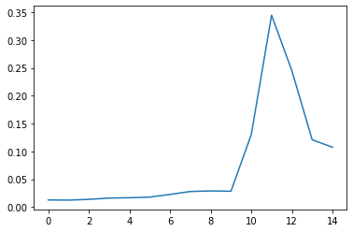
Noisy Images - Image Rejection
Vertical Gaussian kernel outperforms 2D Gaussian kernel in detecting horizontal noises
{
Last 5 “rows”
2D Gaussian
1D Gaussian (in the vertical direction)

Slide 11
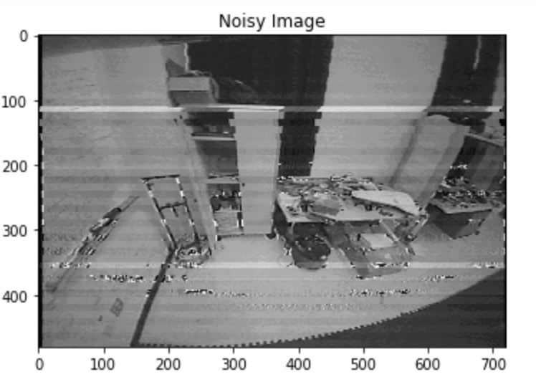
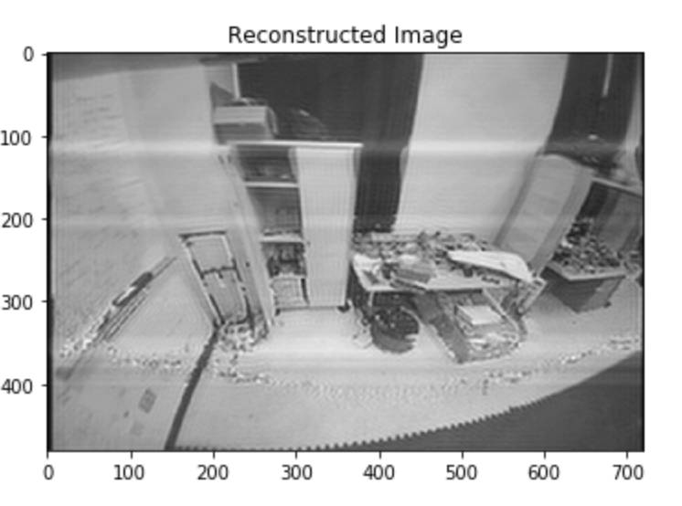
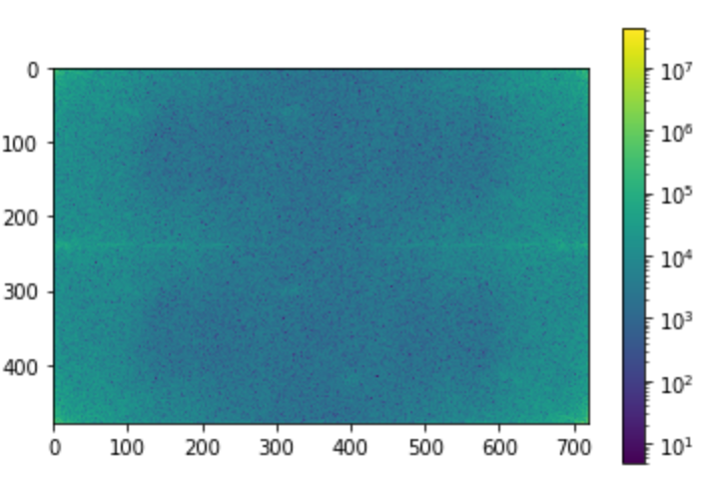
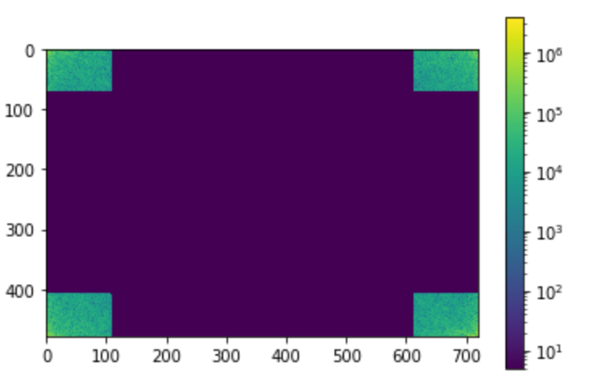
Noisy Images - Image Reconstruction
Fourier Transform
Reflect Intensity change
Reconstruct noisy image

Slide 12
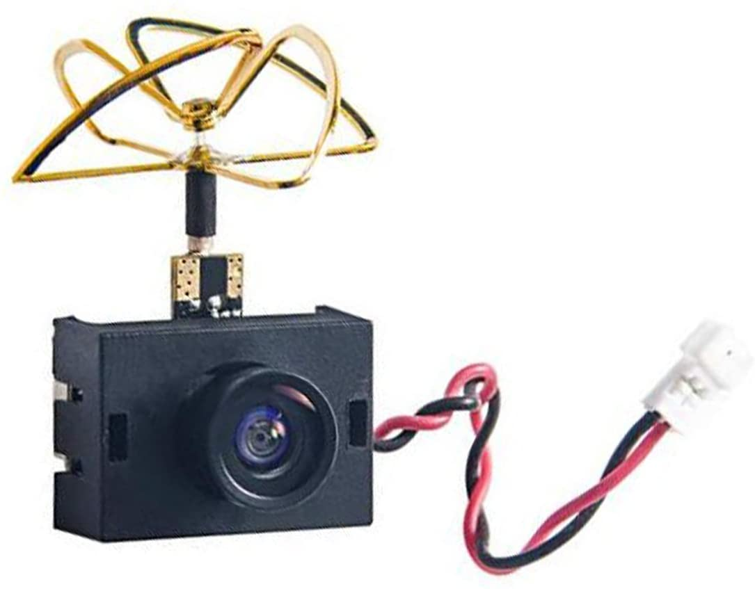
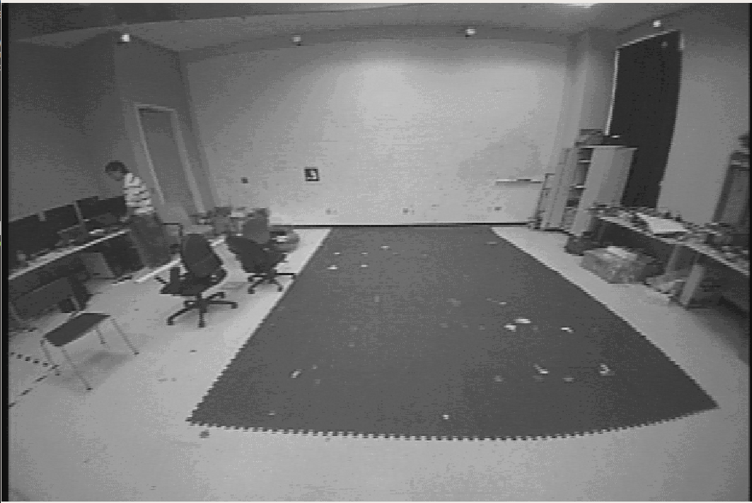
Fisheye Camera Calibration - Why
Why we need camera calibration
Fisheye Camera imposes huge lens distortion on the image stream
To restore the original features, we need to perform camera calibration
Camera calibration is after dealing noisy images
Noise usually appear within large horizontal blocks
Camera rectification may warped the horizontal lines in to “parabola”
120° FOV
Notes:
We perform calibration on the blimp camera because a fisheye camera will imposes hugh lens distortion on the image stream and we want to restore original features. From the image data we collected, we find noises usually appear within large horizontal blocks, brighter or dimmer horizontal lines, so we first denoising the image to prevent camera rectification from warping these noise lines into parabola.

Slide 13
Fisheye Camera Calibration
OpenCV / ROS cannot perform Fisheye Calibration Well
We use OcamCalib, but need to manually select calibration points
720
720
580
480
480
280
rectify
crop
Notes:
We look for some existing packages to perform the calibration. OpenCV/ROS cannot…. We use Ocam, a matlab toolbox

Slide 14
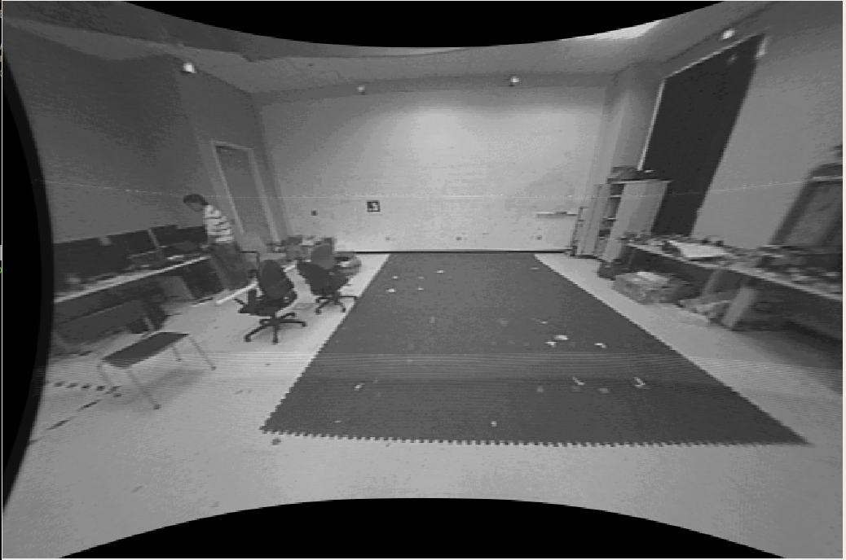
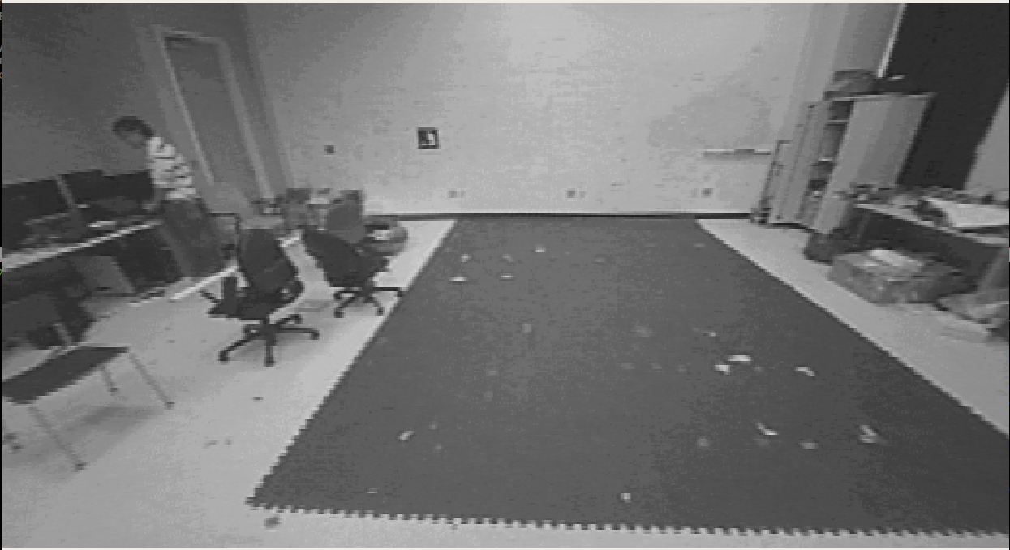
Fisheye Camera Calibration
Original
After Rectification
After Cropping
720 x 480
720 x 480
580 x 280

Slide 15
Visual Odometries
To get the localize the blimp, we use the preprocessed data to perform visual odometry
Where am I?
Notes:
Design choices

Slide 16
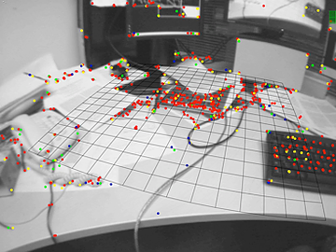
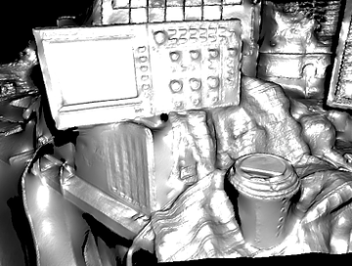
Sparse vs Dense
Sparse: Using only small selected pixels^{[1]}
Dense: Using all pixels^{[2]}
Fast
Slow
[1]G. Klein and D. Murray, "Parallel Tracking and Mapping for Small AR Workspaces," 2007 6th IEEE and ACM International Symposium on Mixed and Augmented Reality, Nara, 2007, pp. 225-234.
[2] R. A. Newcombe, S. J. Lovegrove and A. J. Davison, "DTAM: Dense tracking and mapping in real-time," 2011 International Conference on Computer Vision, Barcelona, 2011, pp. 2320-2327.

Slide 17
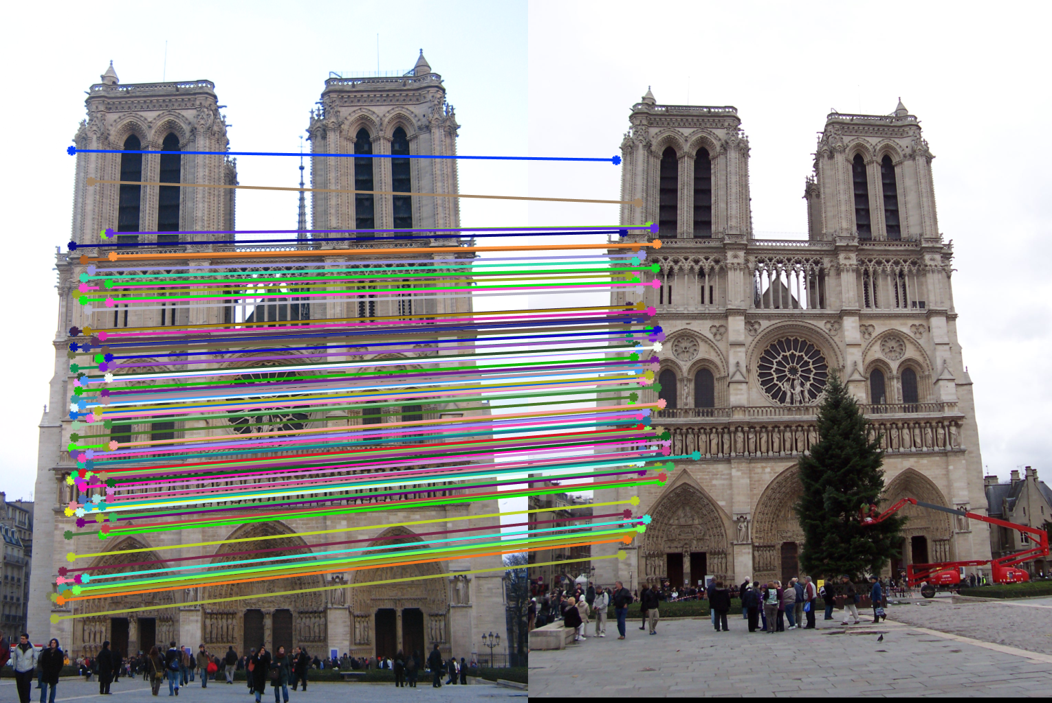
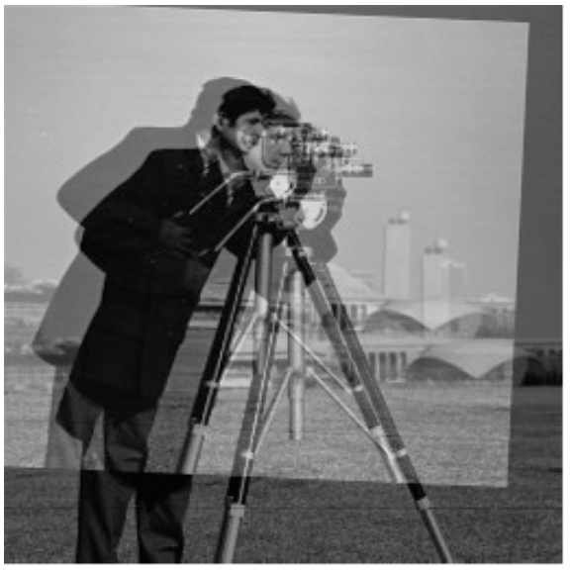
Indirect vs Direct
Indirect (Feature-Based): Extract features first, then solve epipolar geometry
Direct: Using photometric reprojection error to deduct epipolar geometry
Notes:
No matching required -

Slide 18
Recap: Typical Bad Features on Noisy Images
Noise Induced
Exposure / Lights Induced
Aliasing Induced
3
1
2

Slide 19
Feature-Based VO’s Challenges
Failure Stories of Indirect Methods
Vanilla KL-VO (SIFT)
SVO (FAST)
Orb-slam (ORB)
S.Lucey, “Direct Visual SLAM”, url:http://16623.courses.cs.cmu.edu/slides/Lecture_19.pdf

Slide 20
DSO - Direct Sparse Odometry^{[1]}
Direct: Minimizing photometric reprojection error
Sparse: Evenly sampling, selecting and using points with high image gradients
[1] J. Engel, V. Koltun and D. Cremers, "Direct Sparse Odometry," in IEEE Transactions on Pattern Analysis and Machine Intelligence, vol. 40, no. 3, pp. 611-625, 1 March 2018.

Slide 21
DSO - Direct Sparse Odometry
Image
Frame Hessian
Initiated
No
Initialization
Yes
Track
KeyFrame
No
Trace Points
Yes
Trace Points
Photometric Error
BA
Points for Traces
Notes:
Hessian = \nabla ^2 f
J = \partial \mathbf{f} / \partial x

Slide 22
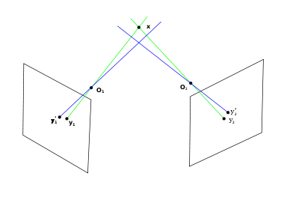
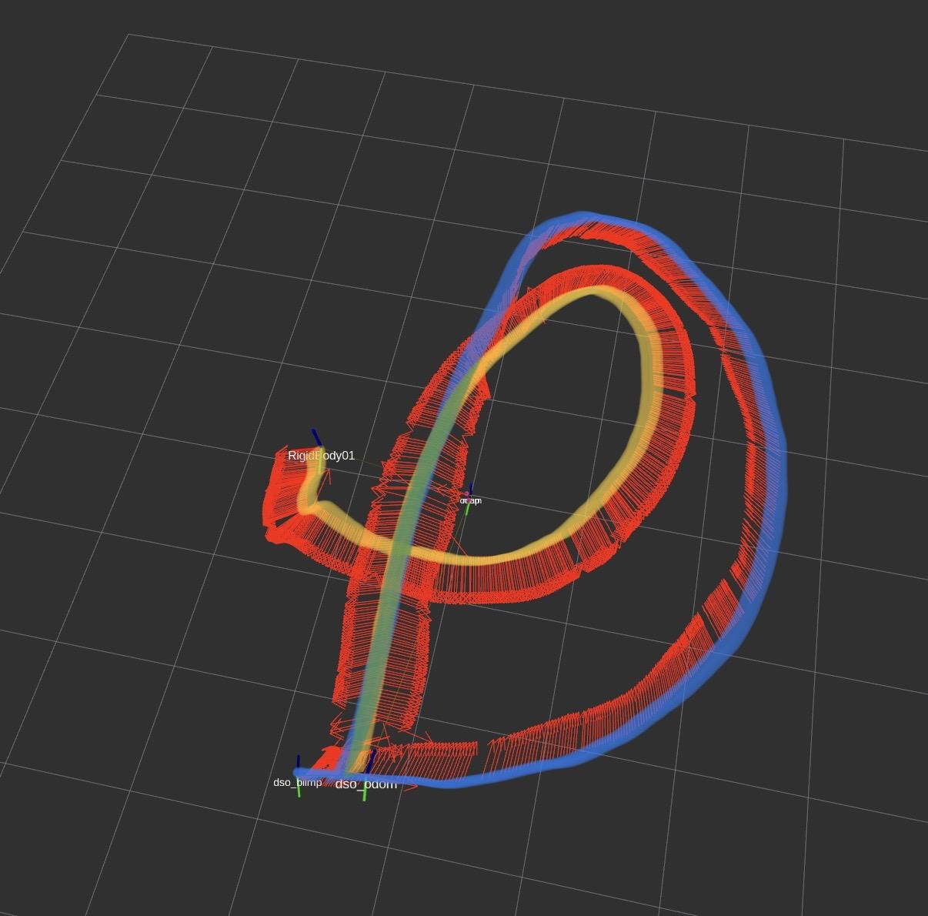
Huge Rotation - Huge Problem
Triangulation Fails Tracking

Slide 23
Original Method
Sample angular displacement according to previous transformation
Problems:
Low efficiency
Non-Linearity comes from rotations, failing tracking
Bad Tracking -> Bad Triangulations -> Failing Pipeline
Cluttered feature points with similar colors might yield small photometric error in the first place.

Slide 24
Solution
Image
Frame Hessian
Initiated
No
Initialization
Yes
Gyro /
Ground Truth Rotation
Inform
Track
KeyFrame
No
Trace Points
Yes
Trace Points
Photometric Error
BA
Points for Traces
Notes:
Be ready to explain every part of this pipeline

Slide 25
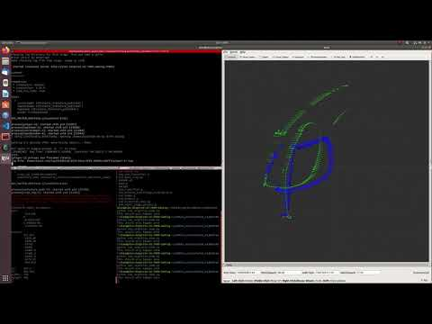
Rotation Informed Tracking
Idea:
Use onboard gyroscope as a source of accurate rotation.
Use this value as the initialization point for the optimization problem in VO.
Video Notation
Green as Optitrack Groundtruth
Blue as VO estimated odometry.

Slide 26
Visualization
To record, and compare the trajectory we estimated against the ground truth provided by the optitrack

Slide 27
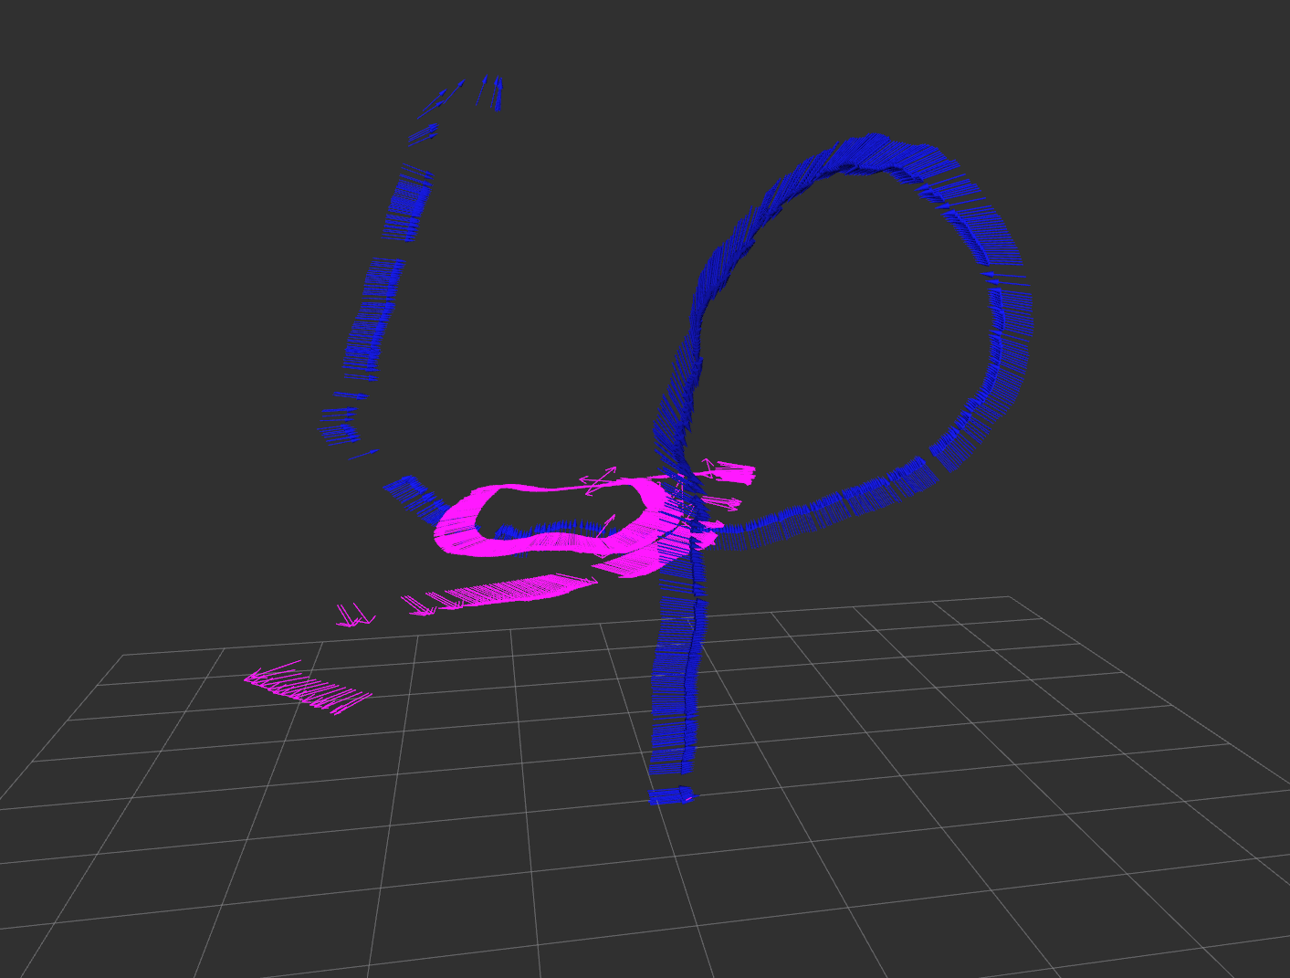
Trajectory Alignment
Why:
Absolute Ground Truth vs Relative VO
Optitrack orientation dependent on the pose of the reflective ball (may not be the direction that the blimp is facing)
VO initial direction might be arbitrary
Monocular VO run with an arbitrary scale
Therefore we need to:
To align VO estimation with Ground truth Optitrack
In real time operation
Use IMU to compensate for this difference
Purple: Optitrack Raw Pose; Blue: DSO Estimated

Slide 28
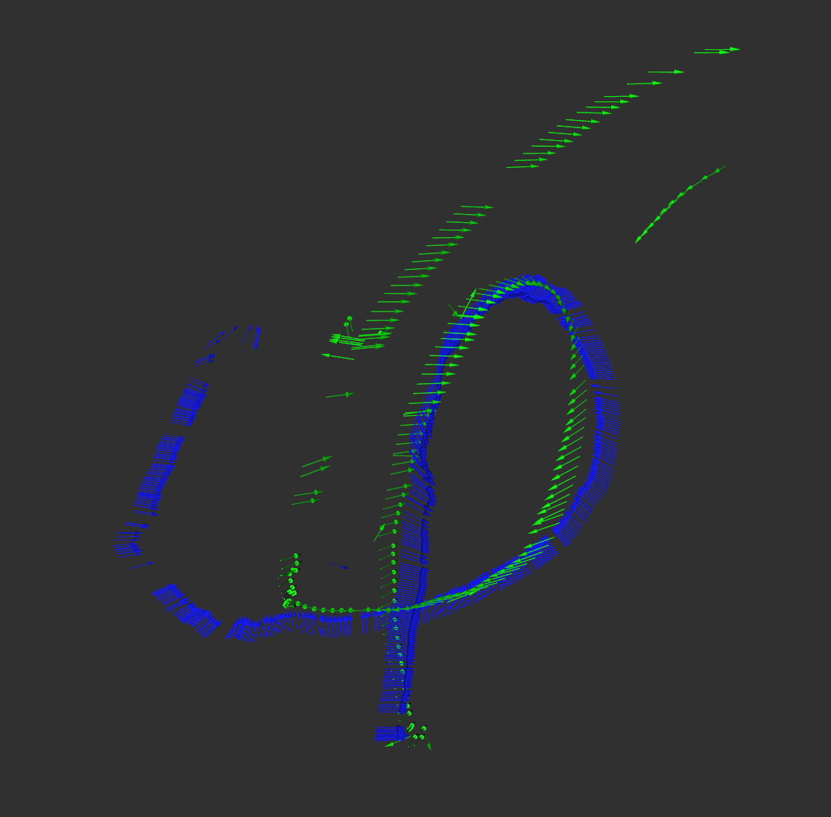
Trajectory Alignment
estimation
optitrack
We know:
It is a SIM(3) transformation
It is doing great on straight lines (approximately first 100-200 points)
An optimization problem- Fit first 200 points using transformation with least MSE (Euclidean Distance)

Slide 29
Visualization
ROS
Trajectory
Rviz Visualization
Trajectory
TF
TF
DSO
Trajectory Generator
Ground Truth Alignment
Trajectory Compensator

Slide 30
Benchmarking
To evaluate the performance of the system, and to find out which improvement could be more efficient
We are evaluating:
Drifts
Scale errors
Notes:
"Since we are trying to find a 3D similarity transformation between the two trajectories, within the scope of this transformation, scale is the word to use, although to put into the large context that this is a trajectory, speed is the real-world application term."

Slide 31
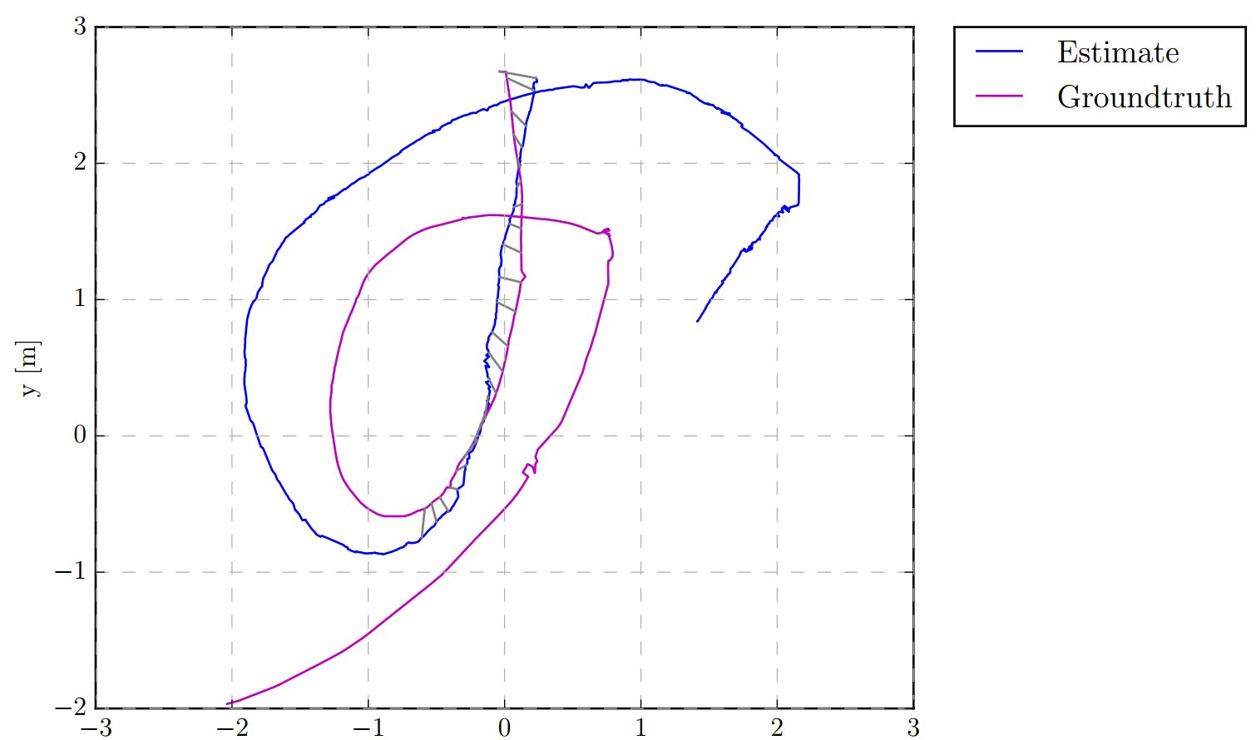
Benchmarking

Slide 32
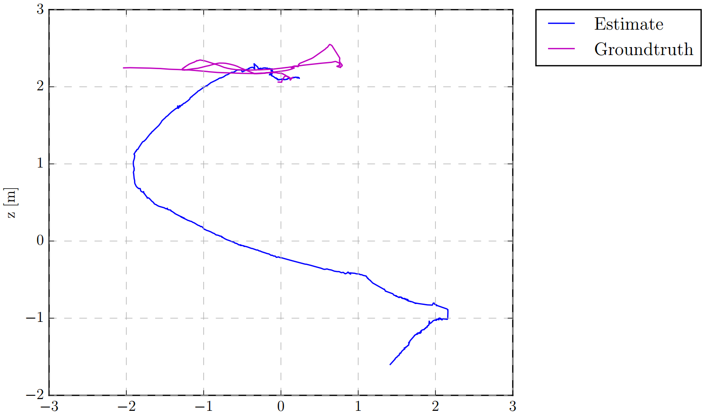
Benchmarking
Notes:
Additional sensors to adjustment altitude

Slide 33
Benchmarking

Slide 34
Lesson Learned
Images
When dealing with random noises, assume gaussian is always a good place to start.
Machine learning algorithms would require a good conversion of data for it to learn a result.
Random noise
VO
Indirect methods work relatively worse in noisy and low resolution image streams.
In situations where the global minimum of the optimization is hard to reach
Either by the limited number of features
Or by the hard triangulation problem given by large rotation + small translation
Introducing a ground truth rotation helps solve the problem.

Slide 35
Possible Future Work
VI-DSO: include IMU in the BA of DSO
To help adjust scale problem
And the spiral downwards
Loop-Closure: building a Map
Utilize labels such as AprilTag to help compensate for DSO drift.
Applications:
Navigations
Swarms

Slide 36
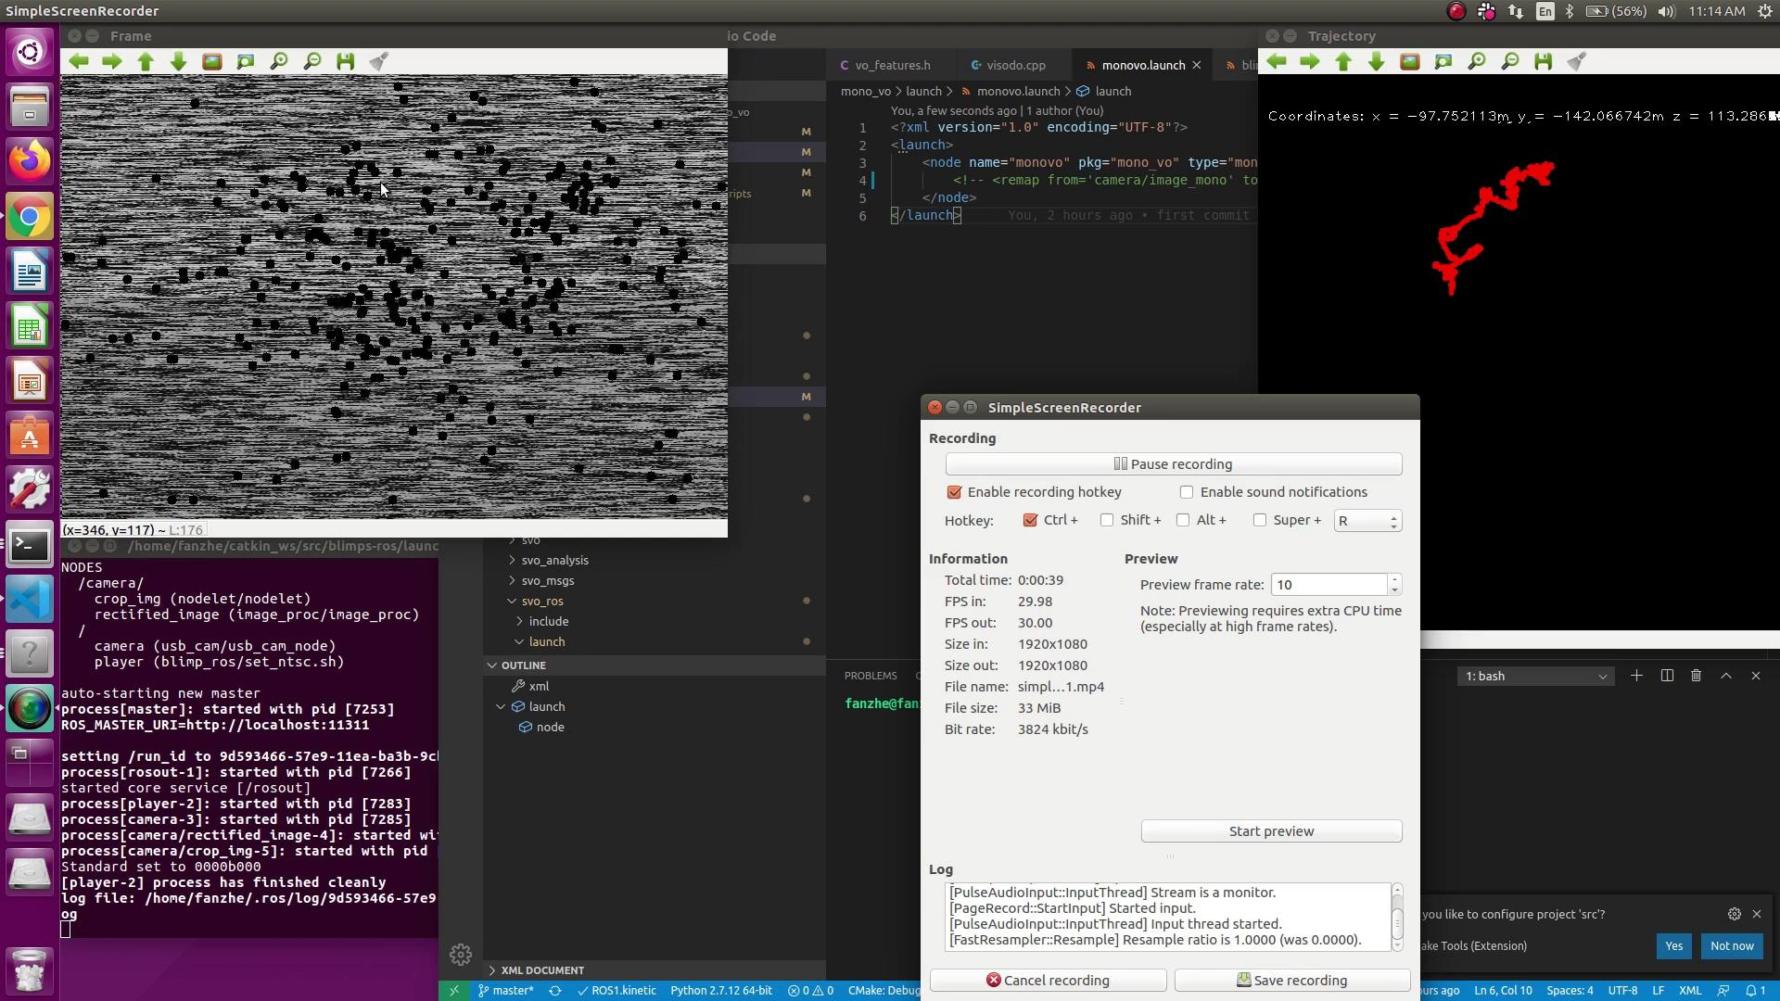
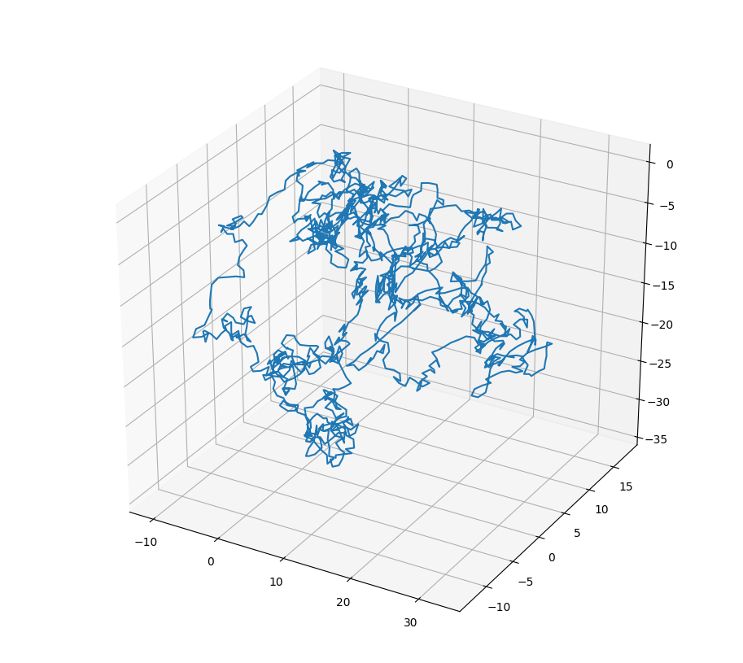
Appendix: Failures of ORB, SVO, Vanilla VO
Notes:
1. Presentation Too long
A. Remove some unnecessary technical details for the online version
B.
2. Due by Tuesday Morning
3. Comment on
A. Surprising things from Teammates
B. Impressed things from Tony and Dr. Zhang

Slide 37
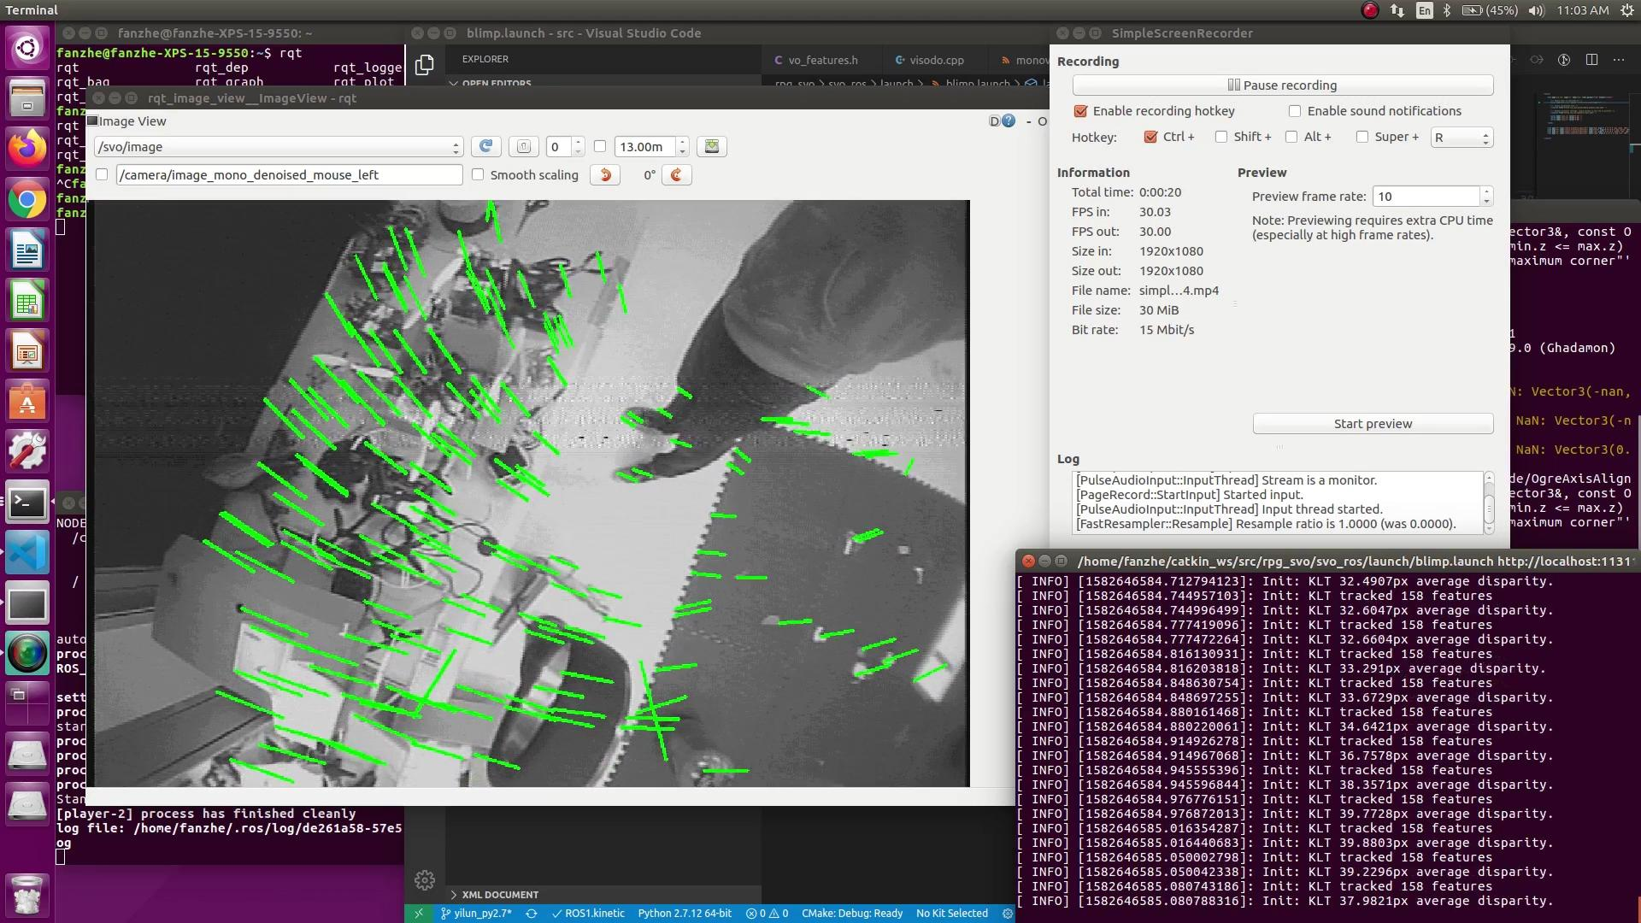
Appendix: Failures of ORB, SVO, Vanilla VO

Slide 38
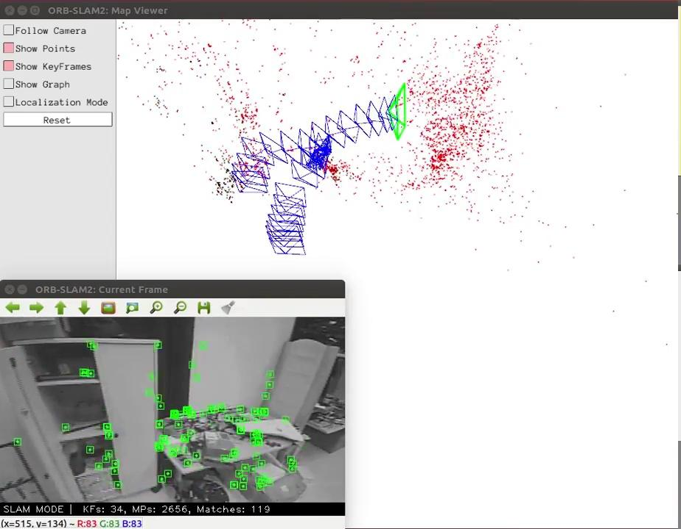
Appendix: Failures of ORB, SVO, Vanilla VO

