Slide 1
Audio Digitizer

Slide 2
Project Overview
Introduction
Multi-channel audio synthesizer
Simultaneously sample multiple channels of audio data
Convert audio data into a playable format

Slide 3
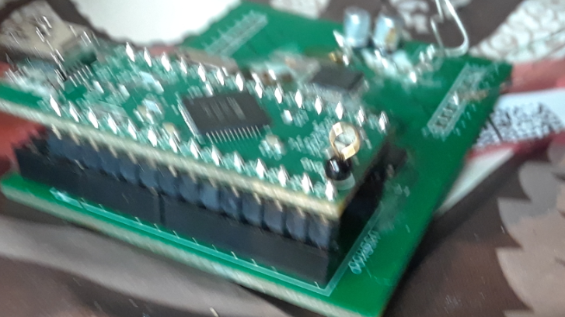
Project Overview
Why this project?
Interest
Practical experience in PCB layout and production
Exposure to I2S and SPI communication
Provide a cost-effective solution

Slide 4
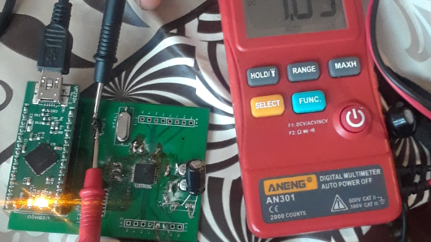
Project Overview
What is the desired result?
Sample multiple channels of audio data
Control sampling rate through software
Convert raw audio data into a wav file

Slide 5
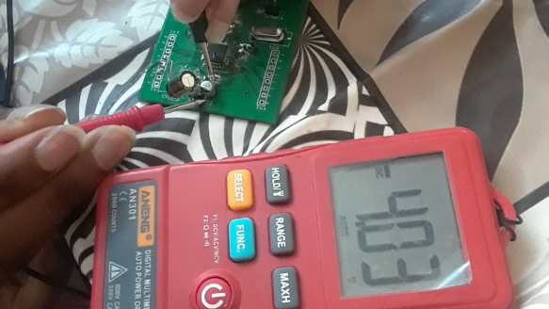
Project Overview
What were we able to accomplish?
We can affect the sampling rate through software
Codec can sample and transmit audio data
We can properly initialize all components

Slide 6
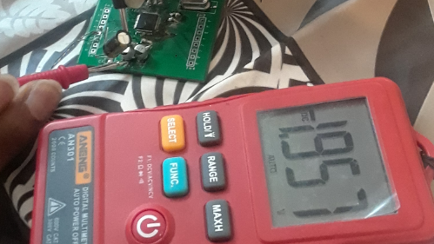
Project Overview
Unable to accomplish …
Reading audio data with the FTDI chip
Schematic error

Slide 7
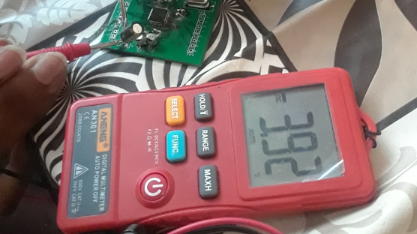
Project Overview
List of what we’ll be showcasing in our demonstration
SPI communication from FTDI
Show we can sample and transmit audio data
Show changing the sampling rate in software is reflected in hardware

Slide 8
Demonstration
SPI communication from FTDI - PulseView
Show we can sample and transmit audio data - PulseView
Show changing the sampling rate in software is reflected in hardware

Slide 9
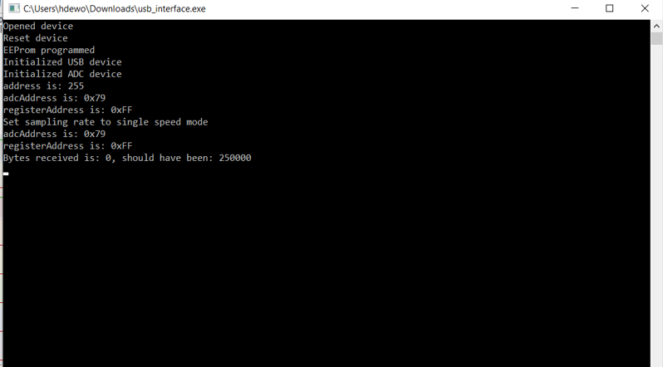
Conclusion
Any Questions?

